Slide 1

Getting Started with the DESSA System
Educator and Student-Completed Assessments
Notes:
Facilitator Reminders:
Project the PPT in Presenter Mode
Open any other apps or documents that you will need for the session, such as the DEMO
Shut down all other applications and browser windows
Put Slack and phone/other devices on do not disturb to avoid interruptions
RECORD SESSION TO THE CLOUD
Talking Points:
Hello and welcome to Getting Started with the DESSA! This is the “PLUS” session, where we will cover both the educator completed assessments and the student completed version, the Student Self-Report (SSR).

Slide 2
Goals for Today’s Session
By the end of today’s session, you will be able to:
Identify key components of the DESSA assessments .
Demonstrate best practices for collecting ratings data and interpreting the results.
Explore key features of the Educator Portal and the Student Portal.
Notes:
Talking Points
In this session, we will provide a high-level overview of the teacher-completed DESSA assessments, as well as the student completed assessment for the middle and high school grades. The training itself will focus on the assessment tool and the online platform, which is the DESSA System Educator Portal. Any district or organization-specific details should be provided to you by your leadership team(s).
In our time together today, we will:
Identify key components of the DESSA assessments – both the educator and student completed versions.
Demonstrate best practices for collecting ratings data and interpreting the results.
Explore key features of the DESSA System online platforms– the Educator Portal and the Student Portal

Slide 3
Session Structure
Introductory overview of the DESSA System and assessments
Put any questions in the chat for your leaders to address
Logistics:
  Session Length: 90 Minutes
  Recording and presentation slides provided following the training
  Halfway through, we will take a break!
Notes:
Talking Points
In terms of the session structure today, this training is meant to be an introductory session. However, as questions arise, feel free to put those in the chat so that we can share them out to your leadership afterward and ensure that they are addressed. The training content will last about 90 minutes, and it’s being recorded so we can share that and the presentation slides after the training. About halfway through, we will take a break.

Slide 4
Today’s Agenda
Here’s how we’ll spend our time together today:
DESSA Overview
Educator-completed versions
Student Self-Report (SSR)
Educator Portal
Optimistic Closure
Notes:
Talking Points
Let’s talk through how we’ll spend the rest of our time together:
We’ll share an overview of the DESSA assessments
We’ll practice completing a rating for the educator completed assessment
And highlight the different features for student-driven learning within the Student Portal
We’ll walk through an overview of the Educator Portal, including the available data reports and instructional resources
And finally, we’ll close out with an optimistic closure and opportunity for feedback.

Slide 5
Opening Reflection
Strength-Based Mindset:
What has gone well so far since the start of the school year?
Notes:
Talking Points
Let’s start today by centering in a strength-based mindset.
We are still within the Back to School part of the year and a million things are going on at all times. I invite you pause and think about the successes so far – no matter how big or small. What has gone well so far since the start of the school year?
Please take a moment to add something in the chat, and we would love to hear from a couple folks by coming off mute to celebrate some successful call outs!
(offering think/participation time)
As we discuss the DESSA today, it will help to keep this strength-based approach front of mind, as the DESSA is rooted in this same approach. Whether this training is a refresher for you or it’s an introduction to the DESSA, approaching implementation with a solutions-based lens is key!

Slide 6
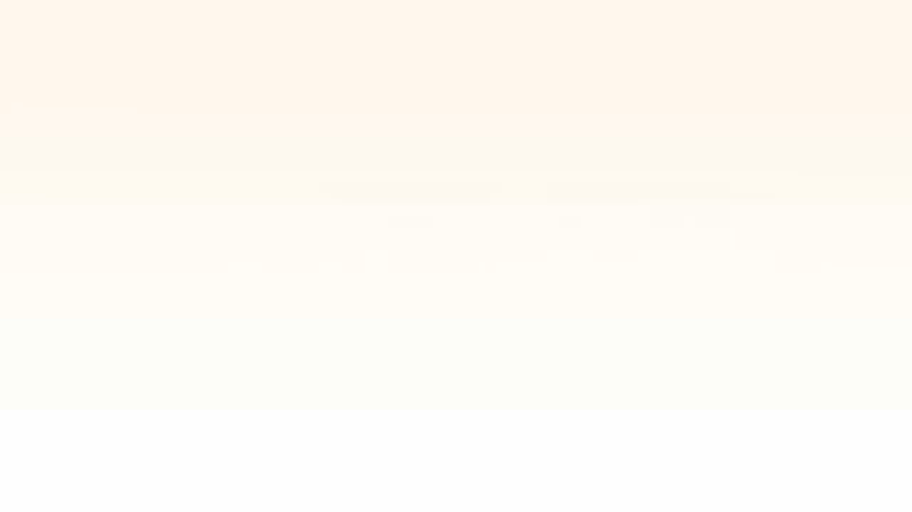
Video: DESSA System Overview
Notes:
Talking Points
We are going to start with a short video about the DESSA and the online platform where it is located, called the DESSA System. After the video, we will break down the key details about the assessment and its scores, so for now just sit back and watch this high-level overview.
(Press play- video embedded)
If needed: Online Video Link: https://go.screenpal.com/watch/c0e0F5V4PMQ?redirect=true
Video Run time: 3:08

Slide 7
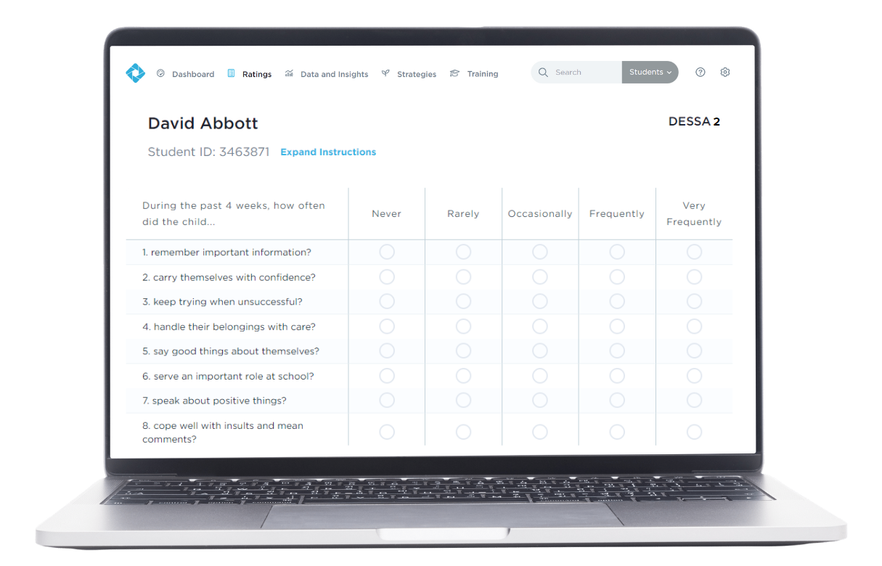
What is the DESSA?
An evidence-based social and emotional competency assessment to support student growth.
Notes:
Talking Points
That video gave us a great overview of the different components of the DESSA System. In these next few slides, we will expand on those areas, starting with: What is the DESSA?
In short, the DESSA is an evidence-based social and emotional competency assessment to support student growth, including a screening tool and a full diagnostic assessment that educators complete for their assigned students.
The DESSA is a behavior rating scale completed by educators and assesses social and emotional competencies in students grades K–12th. It is accompanied by the DESSA mini, a screener and progress monitoring tool of overall social and emotional competence. DESSA ratings, data reports, and intervention resources are located within the online Educator Portal.

Slide 8
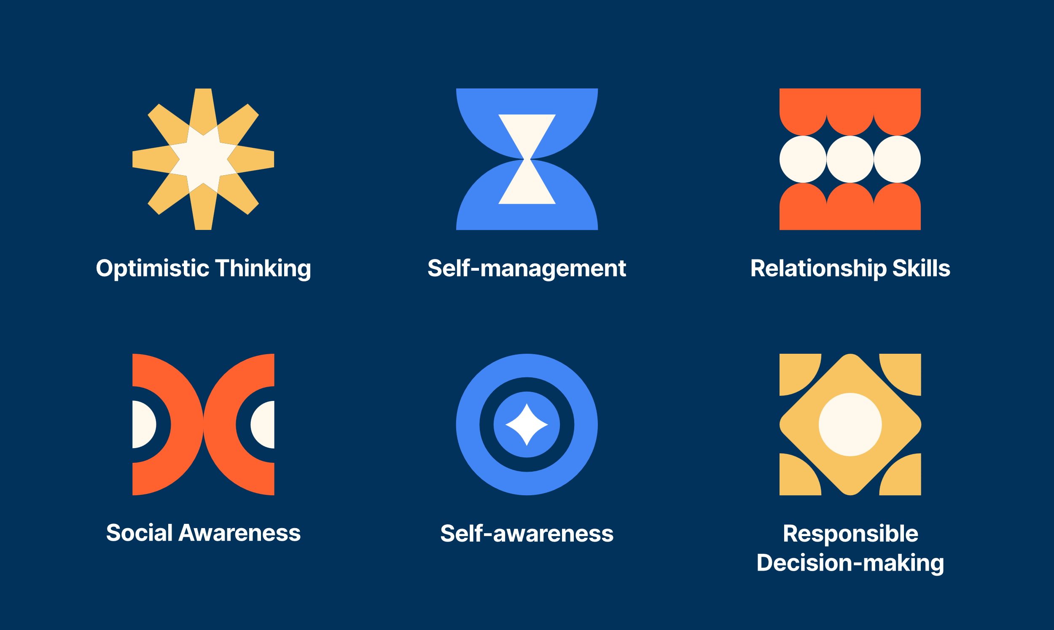
What does the DESSA measure?
Notes:
Talking Points
Let’s now go one level deeper. The DESSA measures 6 overall competencies: Optimisitic Thinking, Self-Management, Relationship Skills, Social Awareness, Self-Awareness, and Responsible decision making. The DESSA was developed based on resilience theory, which is why the Optimistic Thinking competency is included in this assessment. The goal is to foster protective factors and resilience in students through skill strengths. Let's explore these competencies a little more.
Optimistic Thinking: the belief and demonstration of confidence, hopefulness, and positive thinking regarding oneself, others, and one’s life situations in the past, present, and future.
Self-management: the ability to manage emotions and behaviors across different situations and environments and to demonstrate agency as one works to set and achieve personal and collective goals.
Relationship Skills: the abilities to establish and maintain healthy and positive relationships including effective communication, collaborative problem-solving, negotiating conflict, and demonstrating helpful and supportive behaviors.
Social Awareness: the understanding of social norms for behavior; the ability to empathize with, respect, and take the perspectives of others; and the feeling of connection and belonging with family, peers, schools, and community groups.
Self-awareness: the ability to understand emotions, thoughts, and values and how they influence one’s behavior; recognize strengths and limitations; and develop healthy identities and a sense of purpose.
Responsible Decision-making: the ability to make careful, reliable, and constructive choices about personal and social behavior that are appropriate across diverse situations; to consider the personal, social, and collective impact of one’s actions; and to demonstrate curiosity and an open-mindedness to learning.
Article with definition of competencies https://selcompass.zendesk.com/hc/en-us/articles/29465433977357-DESSA-2-Competencies

Slide 9
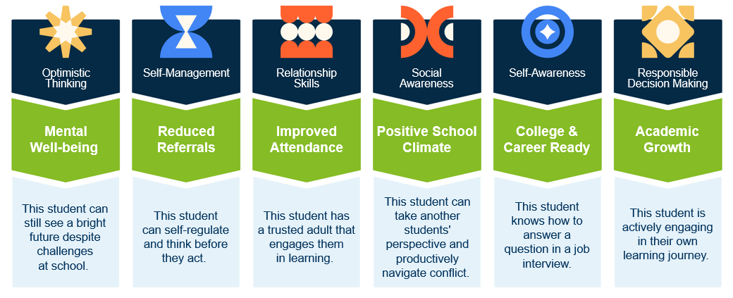
These skills are critical for students to be successful inside and outside the classroom
Reflect: Which of the competencies is resonating with you most right now
given your work with students and families?
Notes:
Talking Points
These skills – Optimistic Thinking, Self-Management, Relationship skills, etc - are critical for students to be successful inside and outside the classroom.
They are everyday observable behaviors that when demonstrated consistently and well, contribute to being a successful student, a successful classmate, a successful employee, volunteer, neighbor, human being.
When students have these skills, when they are able to demonstrate them consistently and independently, we see positive results. Examples for each competency are listed in the green section of this image, and the blue text box below.
For example, Optimistic Thinking supports mental well-being. A student can still see a bright future despite challenges at school. Self-Management skills support a reduced amount of referrals because students can self-regulate and think before they act. Relationship skills contribute to improved attendance. Take a minute or so here to review the competencies and impacted areas on listed on this slide.
(Click) Reflect: As you review this slide, I encourage to reflect on which of the competencies is resonating with you most right now given your work with students and families?

Slide 10
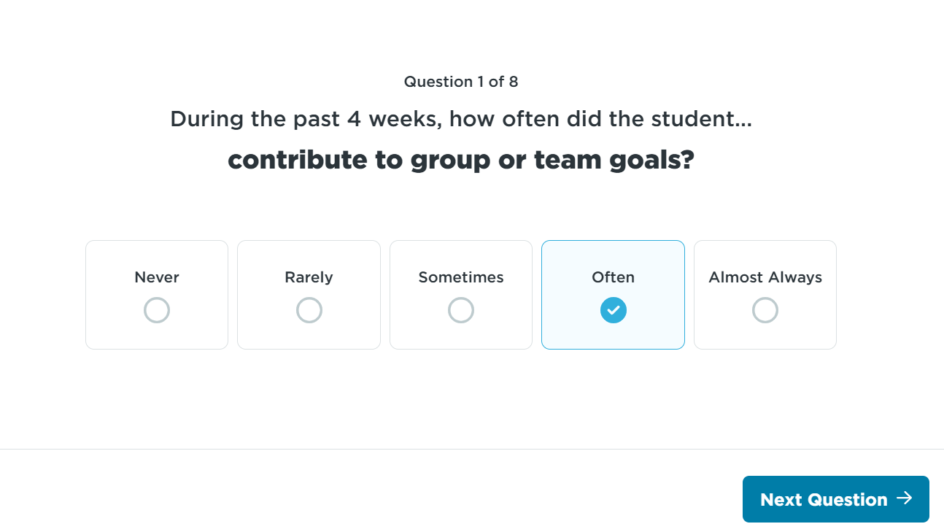
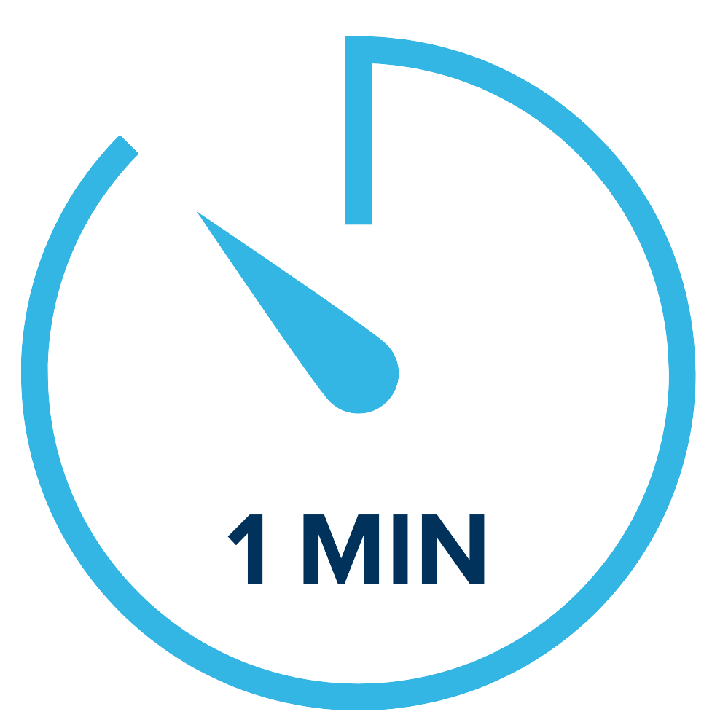
DESSA mini - Screener
(Educator-completed)
Universal Screener
Educators Complete
4 Forms
Score:
Social-Emotional Total (SET)
Notes:
The DESSA includes different versions of the educator and student completed assessments. For this session, we will focus on the DESSA 2 mini (screener) and DESSA 2 (full assessment).
The DESSA 2-mini is a universal screener of social and emotional competence designed for all students. It has 8 questions and takes about 1 minute per student for an educator (or rater) to complete.
The primary purpose of the “mini” screener is to quickly and accurately identify which students may be at risk of academic and behavioral difficulties based on their social and emotional development.
The screener is completed online after at least 4 weeks, or a cumulative of 24 hours over a 4-week period of interaction and observation of the student. There are 4 different forms that can be utilized for progress monitoring throughout the school year.
The results from the DESSA-mini produce a Social-Emotional Total (SET) score that provides an indication of a student’s overall social and emotional competence at the time of assessment.
This data can help educators plan how best to strengthen, readjust, or add universal supports. This screener can also help to identify students that may benefit from additional assessment.
A few examples of questions that are on the DESSA-mini are listed here, with the answer options that can be selected based on the frequency in which the educator has observed the student to utilize a specific skill.

Slide 11
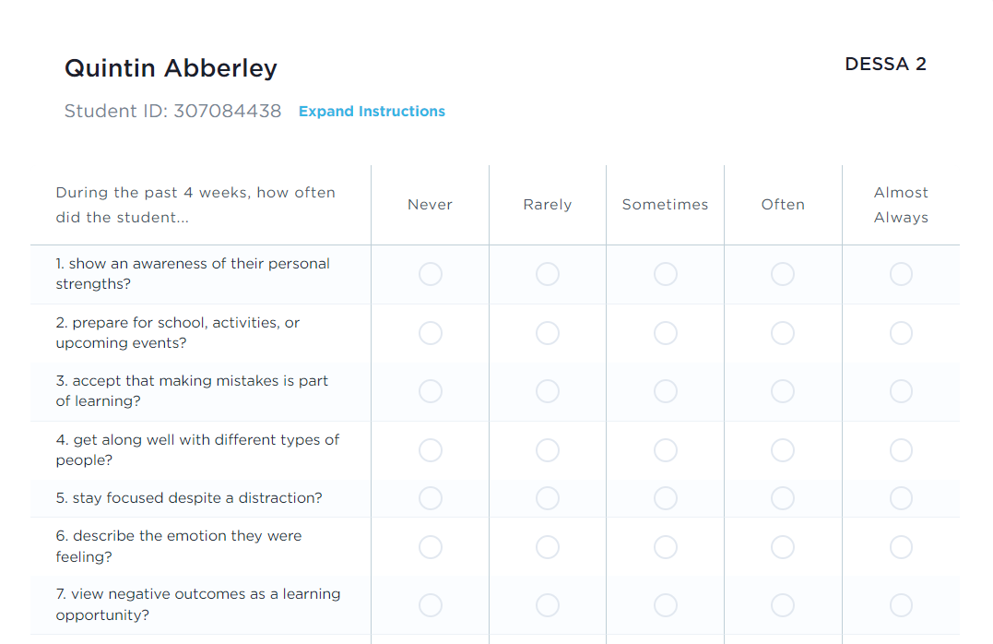
DESSA – Full assessment
(Educator-completed)
Completed as a follow-up to the screener
Assessment of 6 competency areas
Educators Complete
Scores:
Social and Emotional Composite (SEC)
6 competency areas
Notes:
The DESSA 2 is a full assessment of students' social and emotional competencies. It takes about 5 minutes for an educator to complete, and it is typically completed as a follow-up assessment after the DESSA-mini for certain students, if needed. We will look at that conditional process in just a moment.
The results of the DESSA produce one total score, the Social and Emotional Composite (“SEC”) score, and a score for each of eight social and emotional competencies per student.
Similar to the DESSA-mini, each question on the DESSA is a positively worded, desirable behavior and offers the educator (or rater) the same Likert frequency scale to select their answer.
The DESSA data provides an indication of student strengths and needs across multiple competencies, it can help educators plan how best to strengthen, readjust, or add universal and tiered supports in specific areas.

Slide 12
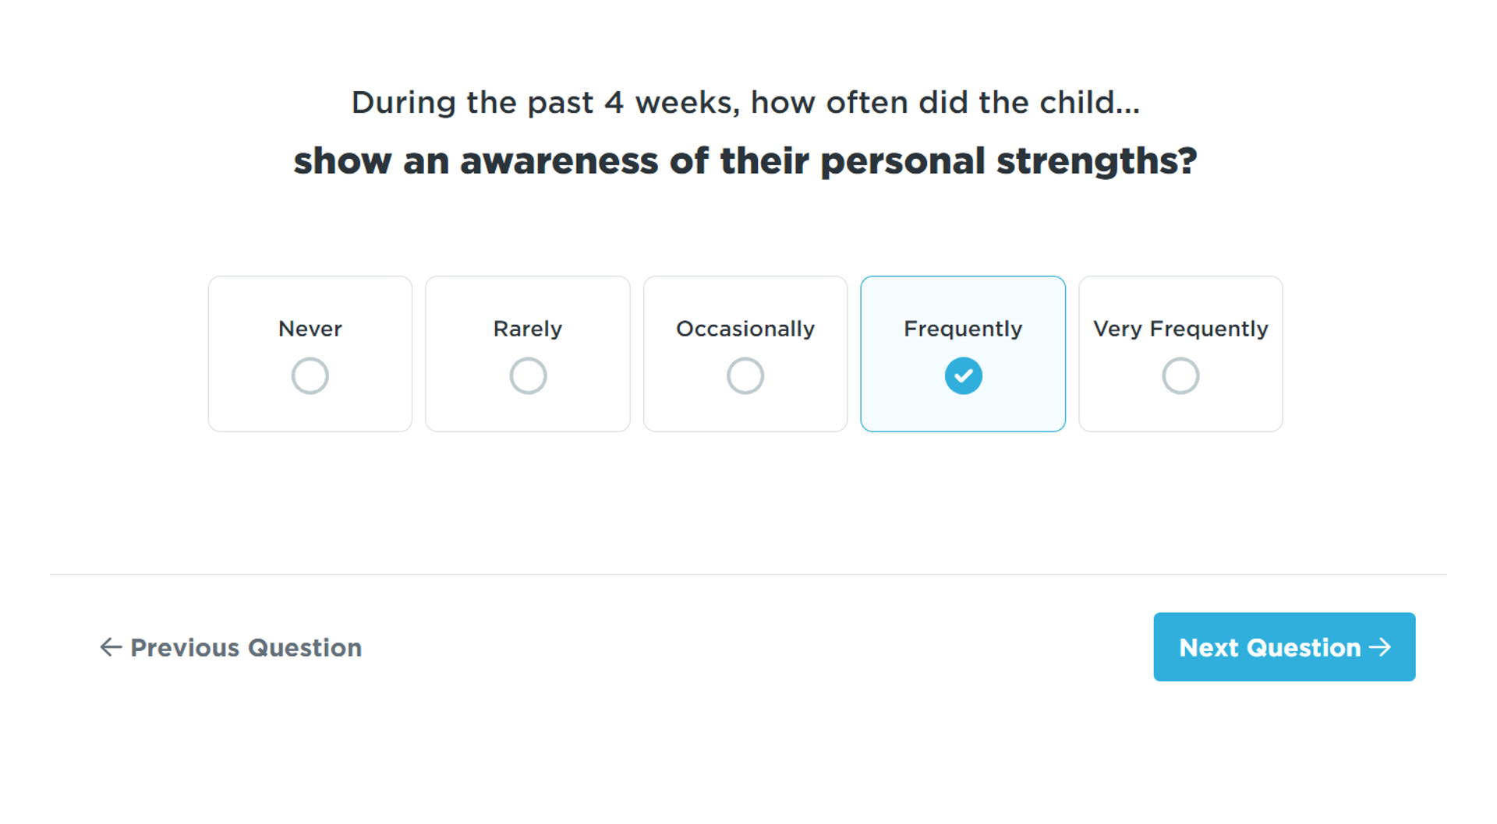
DESSA Items
(Educator-Completed)
Notes:
As a strength-based assessment, the DESSA includes items (questions) that are positively phrased, desirable behaviors. Ratings are completed using a Likert scale based on the frequency in which the behaviors listed are observed by the rater within the past four weeks. Some examples include:
(read screenshots)

Slide 13
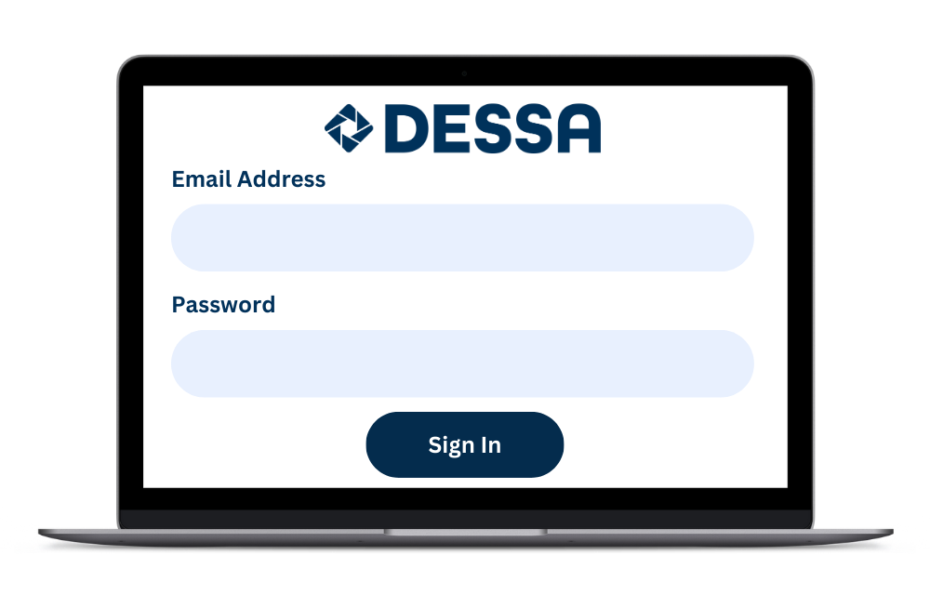
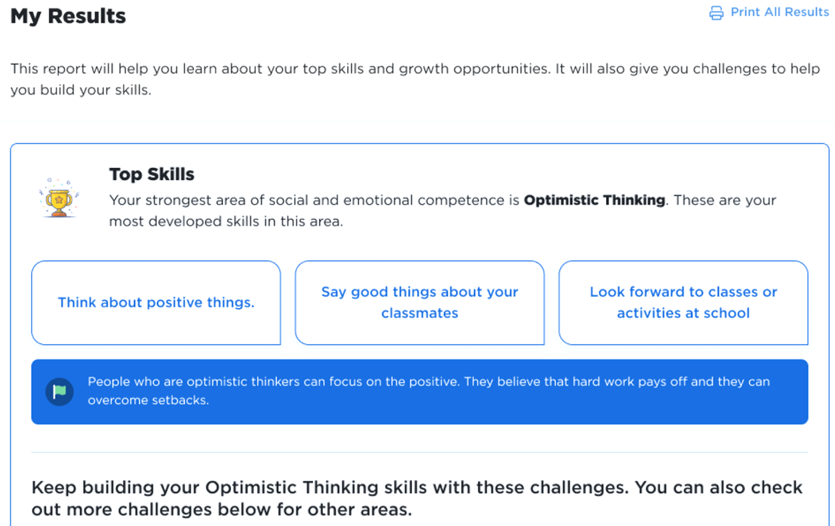
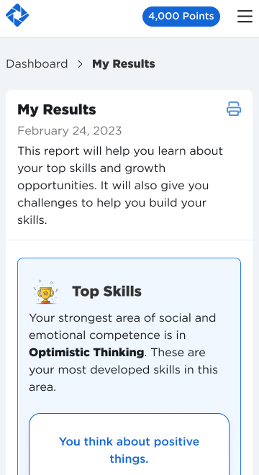
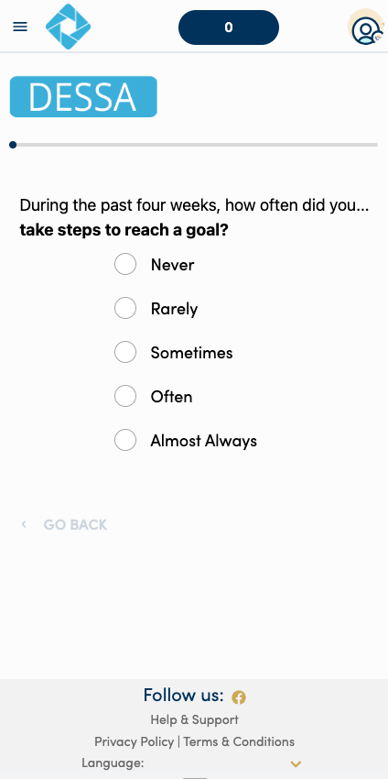
DESSA Student Self-Report (SSR)
(Student- Completed)
Data & Insights:
Educators access
SSR data and view students’ progress
Assessments are completed by students in the Student Portal, and there are opportunities for challenges and goal setting.
Notes:
The DESSA Student Self-Report (SSR) is completed by students in grades 6-12. It is a self-assessment geared for middle and high school students to rate themselves on social emotional competencies and takes most students less than 7 minutes to complete.
Students complete assessments in the student portal and they’re able to use that data to set goals or select challenges (activities) where they can harness and grow their social and emotional skills.
Lastly, educators can view the data or any progress that students are making in their Educator Portal.

Slide 14
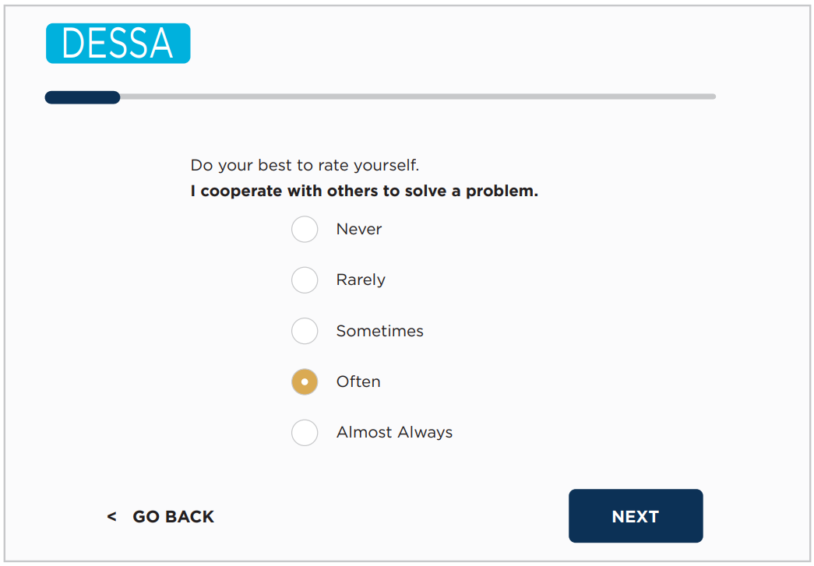
Sample Student Self-Report Questions
Notes:
Here is an example Student Self-Report question (read slide)

Slide 15
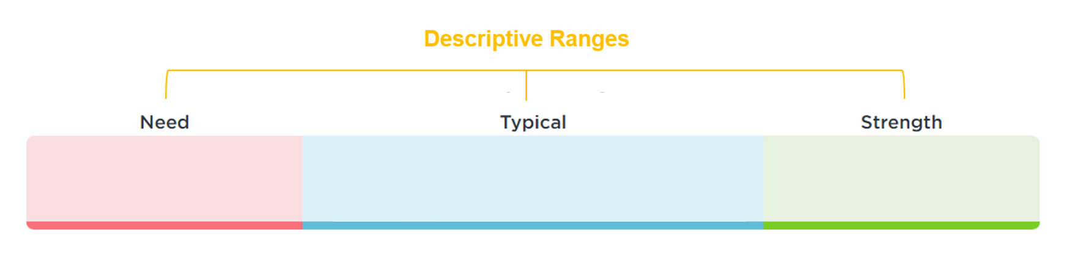
DESSA Results
T-scores are categorized into 3 descriptive ranges
T-scores:
28-40
T-scores:
41-59
T-scores:
60-72
Notes:
Next, we’ll move into the results for the DESSA. The DESSA assessments report results using T-scores:
T-scores are categorized into three descriptive ranges, and as strength-based measures, higher T-scores mean a higher level of social and emotional competence.
Scores of 60 and above are considered a strength; scores between 41-59 inclusive are considered typical (demonstrating typical patterns of development); and scores of 40 and below indicate a need for instruction.
A common implementation practice includes completing a DESSA-mini screener for all students. For the students who demonstrate a need for instruction on the DESSA-mini, a full DESSA assessment is then completed.
The term need for instruction was thoughtfully chosen to convey that the student needs support and instruction in this area. That is, it reflects that the student has not YET acquired these skills.
It is NOT a personality trait or deficit. Rather, it is simply a lack of skill acquisition.
So, the goal is not to label or stigmatize students within the “Need” range, but instead, it’s used to increase our awareness as educators that a student needs our instruction, assistance, and support in acquiring and practicing these important skills.
Once we’ve identified a need for instruction, it’s OUR responsibility to have a system or plan in place to support skill development and provide that instruction.
We use the information from the follow-up DESSA assessment to gather really specific information on a student so that we can support them moving forward.

Slide 16
DESSA Norms
All DESSA assessments are norm-referenced and standardized
All DESSA assessments have a psychometrically sound foundation
All DESSA assessment meet standards for reliability and validity
Norms
16%
68%
16%
Notes:
In terms of the assessment development, it’s important to note that:
All DESSA assessments are norm-referenced and standardized.
All DESSA assessments have a psychometically sound foundation, meaning →
All DESSA assessment meet standards for reliability and validity .
From the standardization sample, we can anticipated that the majority of students will score within the Typical range (68%) and that there will be about equal amounts of students in both the Strength and Need for Instruction ranges (16% each). We can use this information to compare the results collected to the expected norms, and to guide our data-driven making decisions about how to support students in developing these important skills.
If you are interested in these details, the technical manual for each version of the DESSA is available in our online Support Portal. Chapters 2 and 3 provided the information regarding assessment development, standardization, psychometric properties, reliability, and validity of the DESSA.

Slide 17
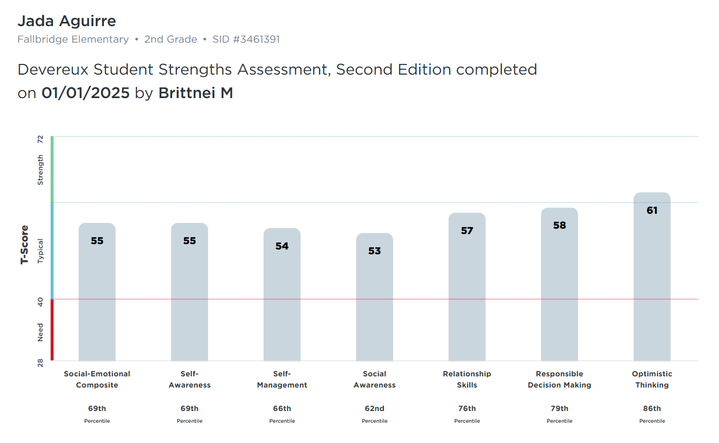
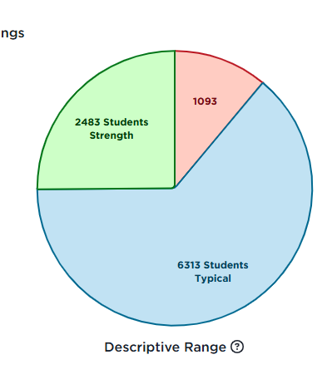
DESSA Results in the Educator Portal
Notes:
Talking Points
we’ll take a look at more report options later in this session, but at a high-level, the results are available in real time within the DESSA System educator Portal. There are many interactive reports that can be used to generate reports for whole group (either school wide or classroom wide), small group (such as an intervention group), and for individual students.

Slide 18
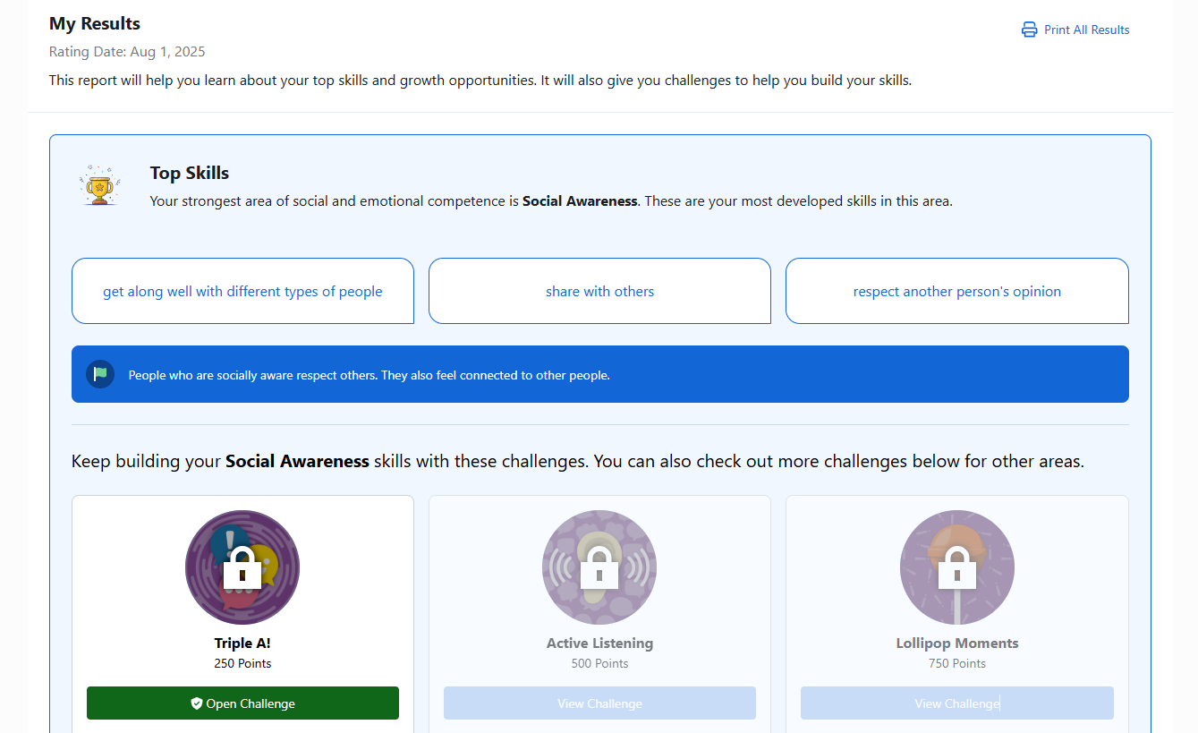
DESSA SSR: Student-Completed Results
Student
View
Notes:
Here is what you’ll see after the full teacher Second Step DESSA or student-completed assessment is complete.
You will see a social-emotional composite score and a score for each individual competency.

Slide 19
General Implementation Overview
Pre-Assessment
Post-Assessment
End of School Year
Start of
School Year
Ongoing, universal, and data-driven SEL Instruction
Targeted intervention and individualized instruction, as needed
Notes:
As I mentioned at the start of the session, your district has implemented a pilot of the DESSA last year and is now expanding district wide. Your leadership team is very detailed oriented with all of the pieces needed for a successful implementation and will provide some internal FAQ and implementation resources for your group specifically. Generally speaking, here’s what a yearlong DESSA implementation typically looks like
A pre-assessment is completed towards the start of the school year. All students are screened using the DESSA-mini. A follow-up DESSA assessment is typically completed if a student demonstrates a need for instruction based on the DESSA-mini results.
A post-assessment following this same process is completed prior to the end of the school year. There is the option for a mid-assessment, as well.
Throughout the school year, ongoing, universal, and data-driven instruction of social and emotional skills is provided to all students, and targeted intervention and/or individualized instruction is provided to students who demonstrate a need for further support in specific skills areas, typically in the small group or individual setting.
Additionally, throughout the school year, staff are having discussions about the data they collect or best practices for supporting students.
Educators are constantly teaching these skills, whether it’s through explicit instruction, modeling, or relationship building with students. Students are constantly learning from each other, about themselves, and by interacting with adults within their school environment.
A key point to keep in mind is that the teaching and learning of social and emotional competencies are continuous. It’s not just during the rating windows of collecting data that we are actively involved in this process; it’s all year round.

Slide 20

Q & A
What questions, curiosities, or big ideas would you like to share regarding any of the DESSA assessments?
Notes:
What questions, curiosities, or big ideas would you like to share regarding any of the DESSA assessments?

Slide 21

In the chat:
How might a strength-based approach improve:
-Conversations about students?
-Culture and climate?
-Engagement with families?
Notes:
Talking Points
We’ve talked a lot about a strength-based approach and how DESSA can support that mindset.
In the chat, I will invite you to consider this prompt: how might a strength-based approach improve conversations about students? How might it impact culture and climate? And how can it influence conversations with families?
Take a moment to consider one of these questions and add your response to the chat.

Slide 22

Take a break!​
Let’s meet back in 3 minutes

Slide 23

DESSA mini
DESSA (full assessment)
Educator-Completed Assessments
Notes:
Our first section focused on an introduction of the DESSA overall. What we will do now if separate the two versions – the educator completed version and then the student version. Our final section will look at the online platform.

Slide 24
Educator-Completed Assessments
DESSA mini
DESSA (Full)
Universal Screener
Completed as a follow-up to the screener
5 minutes to complete per student
8 items
1 minute per student
Scores:
Social and Emotional Composite (SEC)
6 competency areas
Score:
Social-Emotional Total (SET)
Notes:
As a reminder, the educator completed versions of the DESSA include: the DESSA mini and the full DESSA assessment.
The main difference between the two are that the screener’s main purpose is to quickly and accurately identify students overall skill level, where as the full assessment provides a deeper dive into all of the competency areas.

Slide 25
How to Complete a Rating
Notes:
Talking Points
We are going to focus on HOW to complete a rating as an educator. This is especially important part of the process to ensure that we collect the most reliable data possible.

Slide 26
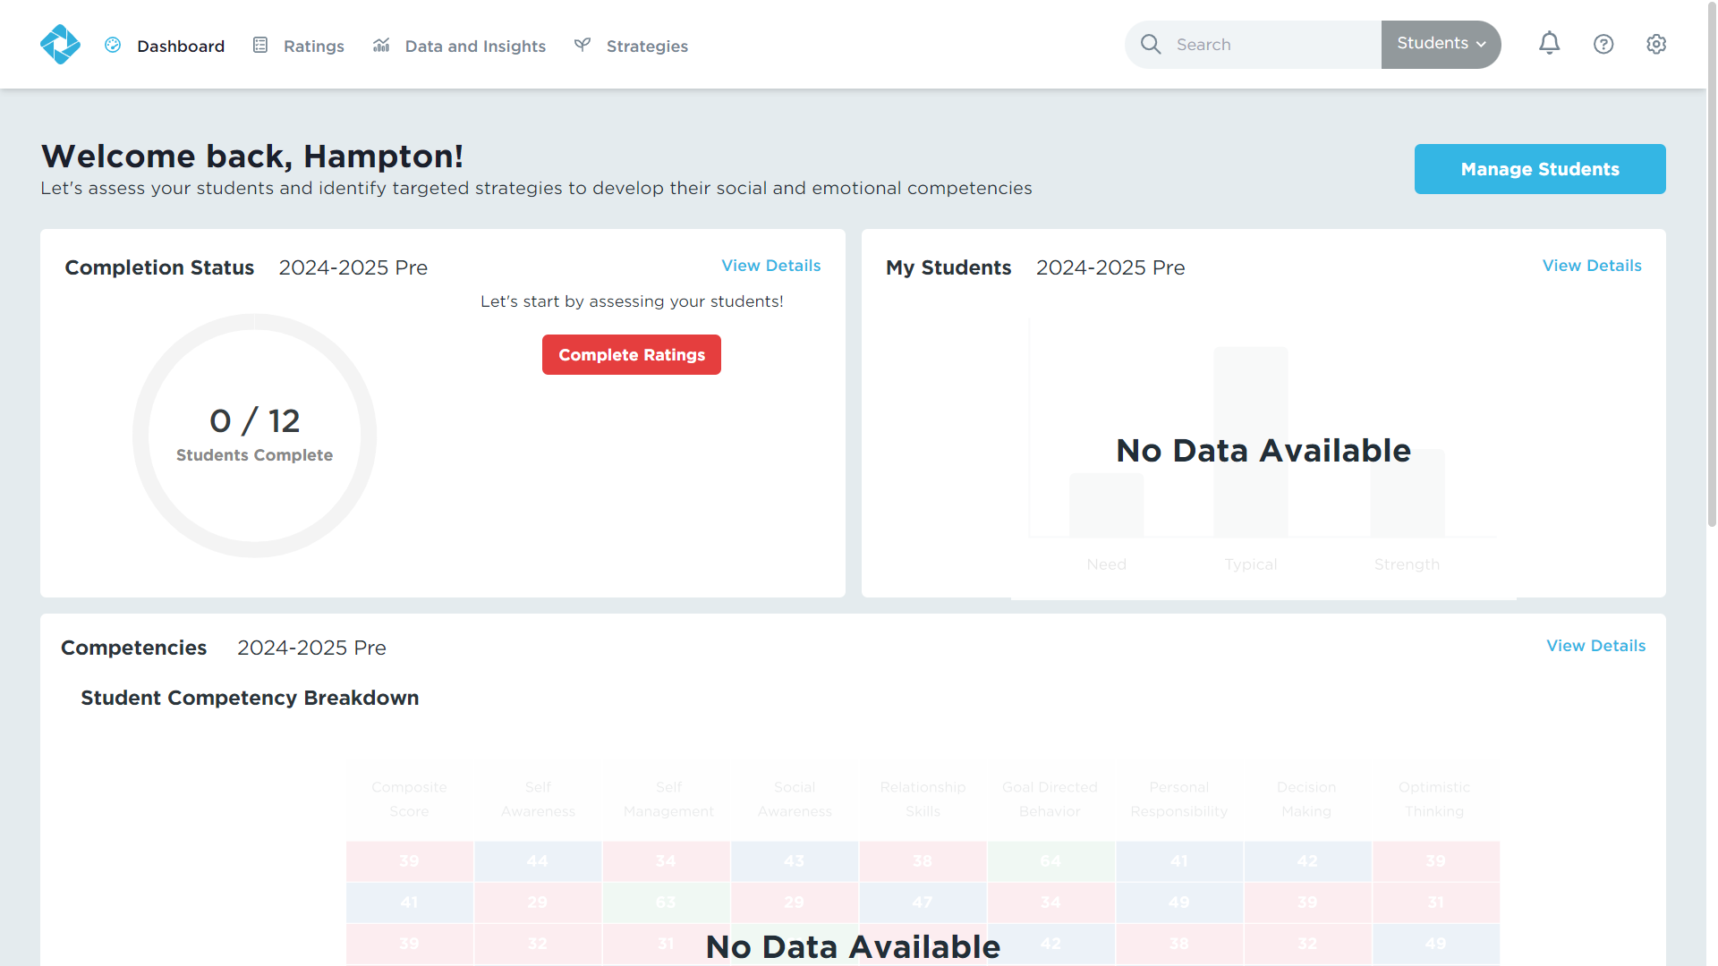
Ratings in the DESSA System
Notes:
Educators complete DESSA ratings within the DESSA System for their assigned roster of students. Your district will have your individual rosters integrated into this platform, so that when a rating window is open, you will have access to the list of students you need to complete ratings for. Let’s consider some best practices for completing these ratings.

Slide 27

Tips for Educators Preparing to Rate
Be intentional in observation.
Get familiar with the DESSA items.
Don’t overthink it.
Stick to your facts.
Plan your rating time
Notes:
Talking Points
First, it’s important to be intentional with observations. Doing this helps you to get to know your students better, puts on a positive lens to look for strength-based behaviors, and also helps you to understand more about social and emotional competence. It also allows for you to be less biased when observing your students.
Next, familiarize yourself with the DESSA assessment questions. The more you know about the assessment, the easier your intentional observation will be and the more accurately you will be able to complete your rating. You can download the DESSA-mini/DESSA you will use from the support portal. I will show you where to find it later when we look at the online system. Read it over, think about the behaviors it asks about, and when and how you might observe them.
Try not to overthink or overanalyze, especially when completing the rating for the DESSA-mini. Ask yourselves simple questions like this: What can students do on their own? How often do they do it? Your first response is often the most reliable response.
Stick to your facts. Raters will base their rating on the last 4 weeks with the student, not an interpretation or what they have “heard” about the student. Remember an intentional observation and accurate rating will be unbiased and based only on what the rater views during the observation period.
Finally, it’s important to plan your rating time. For your specific district, there has been time alotted today at the end of this training to complete your assigned ratings.

Slide 28
Let’s Practice a Rating
Imagine your school-aged self or someone you know. You can even imagine your favorite book character.
Answer each question according to that person’s behavior.
Notes:
Talking Points
Now it’s time to practice a rating! In just a moment, we will have an example of the DESSA on the screen.
You will imagine your school-aged self or someone you know. You can even imagine your favorite book character.
Answer each question according to that person’s behavior.

Slide 29
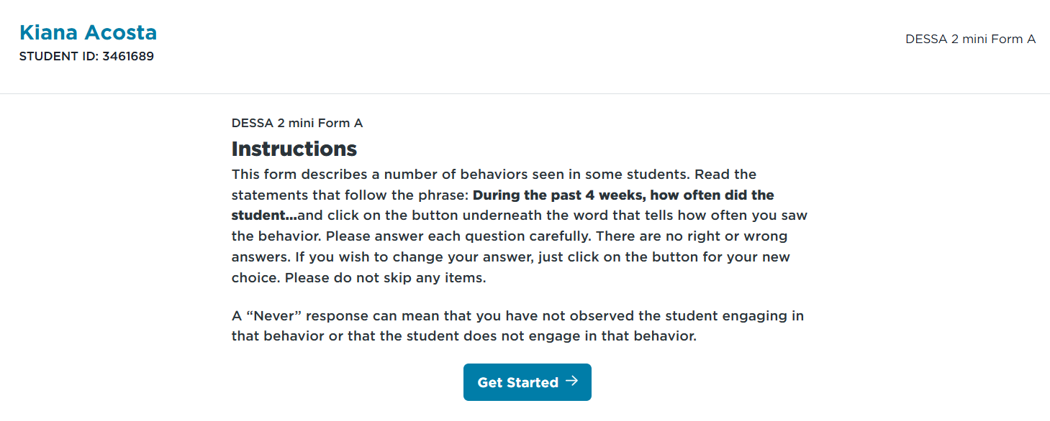
Let’s Practice a Rating
Notes:
First, the directions for each student will read:
(read directions on the screen)

Slide 30
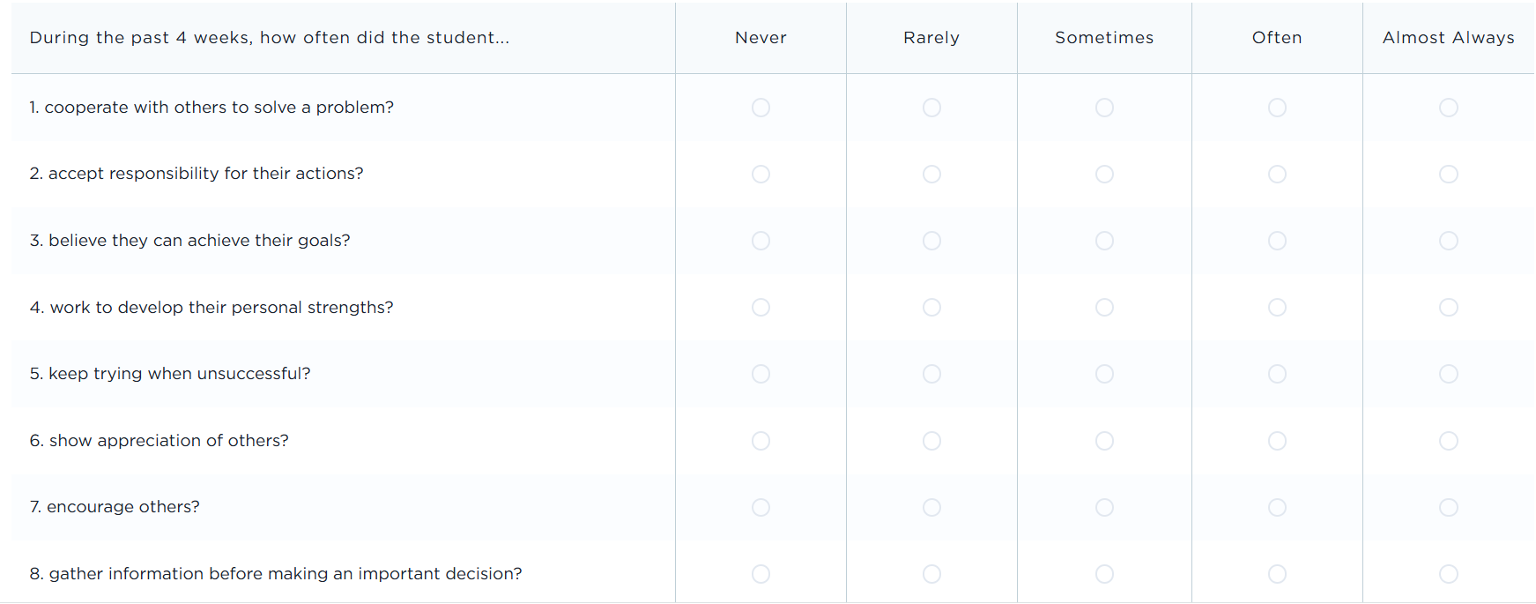
Let’s Practice a Rating
Notes:
Here’s the DESSA mini screener for our practice rating. The answer options are: Never, Rarely, Sometimes, Often, and Almost Always.
(Facilitation – read the items and allow time for attendees to “complete” their rating based on the person they have in mind.”

Slide 31
Pause:
Any “ah ha!” or additional questions after completing a practice rating?
Notes:
Before we switch gears and look at the online platform, let’s pause: are there any “ah ha!” moments or other questions that came up for you while completing this practice rating?

Slide 32

DESSA Student Self-Report (SSR)
Grades 6th-12th
Notes:
Next, we will focus in on the Student Self-Report (SSR) and the Student Portal. We will end our session with looking at the Educator Portal, which houses everything you need as the educator.

Slide 33
DESSA Student Self-Report (SSR)
(Student- Completed)
Assessments are completed by students in the Student Portal, and there are opportunities for challenges and goal setting.
Notes:
As a reminder, the SSR is completed by students in grades 6th-12th. Students can change the assessment language and use screen reader accommodations to complete the assessment.
The SSR has versions for both middle school and high school, with post-pandemic norms.

Slide 34
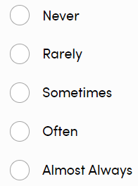
Sample Student Self-Report Questions
Do your best to rate yourself.
I can recognize my own strengths. (Self-Awareness)
I stay focused despite a distraction. (Self-Management)
I make others feel welcome or included. (Social Awareness)
I am able to resolve conflicts positively. (Relationship Skills)
I gather information before making an important decision. (Responsible Decision Making)
I believe I can overcome setbacks. (Optimistic Thinking)
Answer Selection Options
Notes:
Talking Points
Here are some examples of the items (questions) on the SSR. As you can see, all of them are formed into “I” statements because this helps students evaluate themselves. You’ll also notice that all of the items are asking students how often they are engaging in positive prosocial skills. It’s important that students and staff understand what the DESSA student self-report is (a standardized, strength-based measure of student social emotional competencies) and what it is not. It is NOT a measure of mental health or general well-being. It does NOT measure risk or deficits. It is a self-assessed observational rating of students’ every day social and emotional skills.​

Slide 35
Sample Student Self-Report Questions
Notes:
Here is an example Student Self-Report questions.

Slide 36
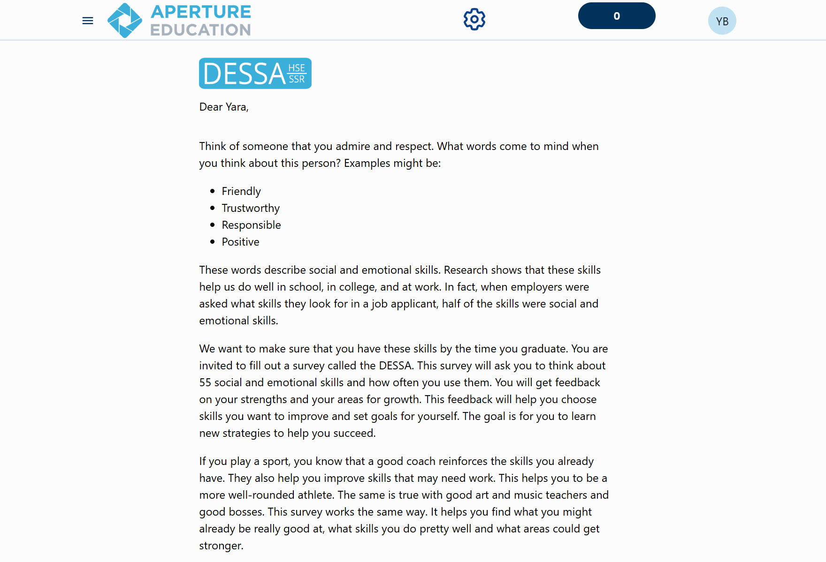
After students register and log in, they will be met with a welcome letter and can follow the prompts to the assessment.
Notes:
After students register and log in, they will be met with a welcome letter and can follow the prompts to the assessment.

Slide 37

Notes:
Talking Points
Before we continue, let’s watch this brief video that will share an overview of the SSR. This video is shared with students when they log into their Student Portal and it’s a help introduction to both the assessment and platform.
https://www.youtube.com/watch?v=EWt1YMYDLLs

Slide 38
How Students Access the Student Portal
Website login with username and password
SSO (such as Clever or Classlink)
Details for your specific program should be provided by your district/organization leadership
Resource: Accessing the Student Portal with or without SSO (Support Portal Article)
Notes:
How student will access their Student Portal accounts depends on the implementation and integration details set up by your district or program leadership. There are a few different ways student can access the platform (in general): through a website link with their own username and password or through an SSO avenue such as Clever or Classlink.
In the chat and the follow up resources, we will put a link to a support portal article that covers the details for how to log in using each of the options – for your future reference.

Slide 39
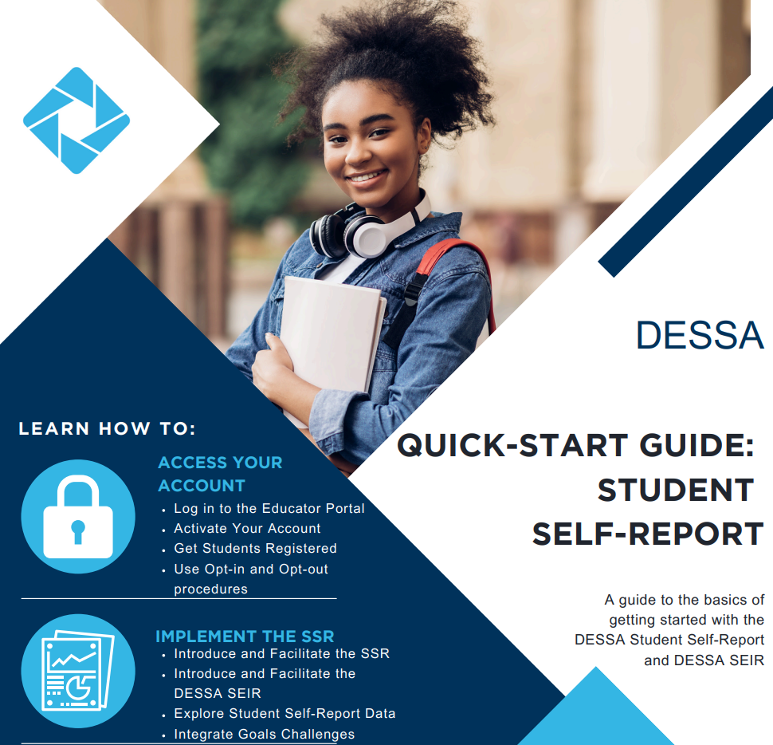
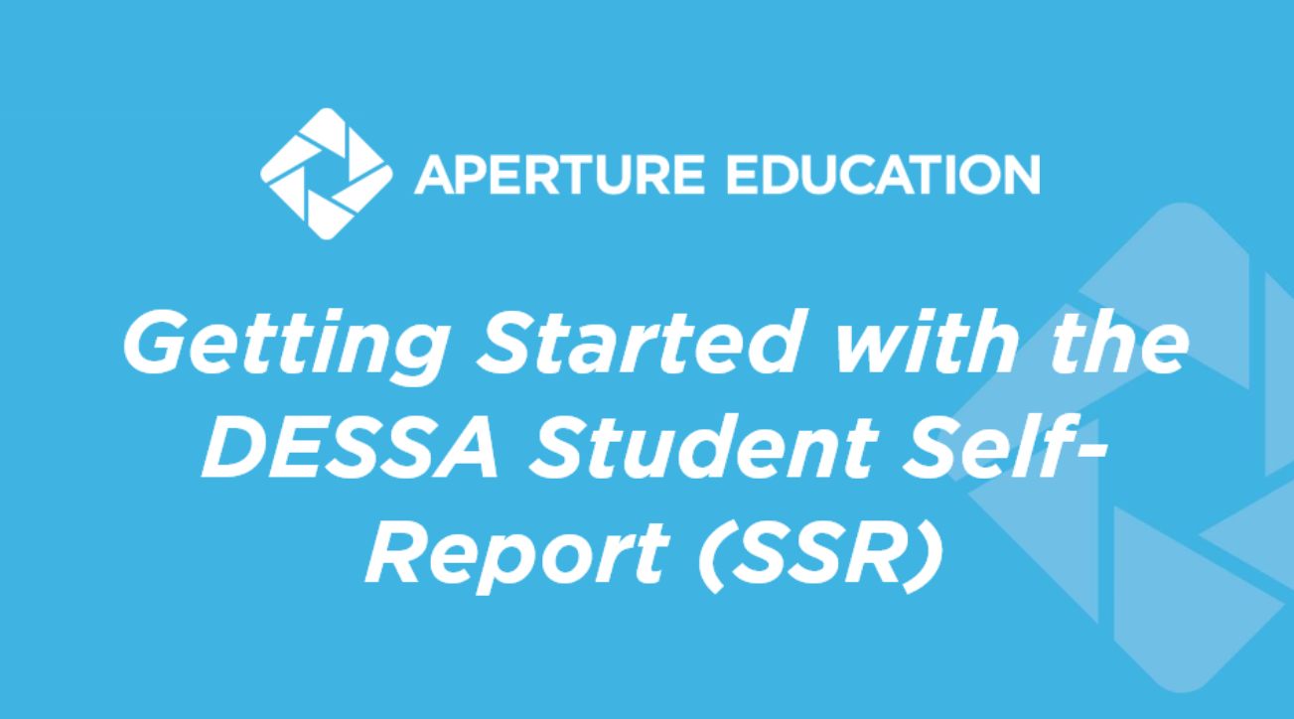
Implementation Resources
Notes:
Talking Points
To support the implementation in the classroom, we recommend using the ready-to-use materials available within the Support Portal.
The PowerPoint slide deck is an in-classroom resource can be used by teachers to introduce the SSR to students and guide them in the process of Registering and Accessing the Student Portal.
The quick start guide provides an overview of the main components needed to successfully collect SSR data.
There is also a one-page resource that is student-facing that connects the skills measured by the DESSA to their overall development and growth.
https://info.apertureed.com/en/hc/getting-started-with-the-dessa-student-self-report-ssr-educator-and-student-facing-resources

Slide 40
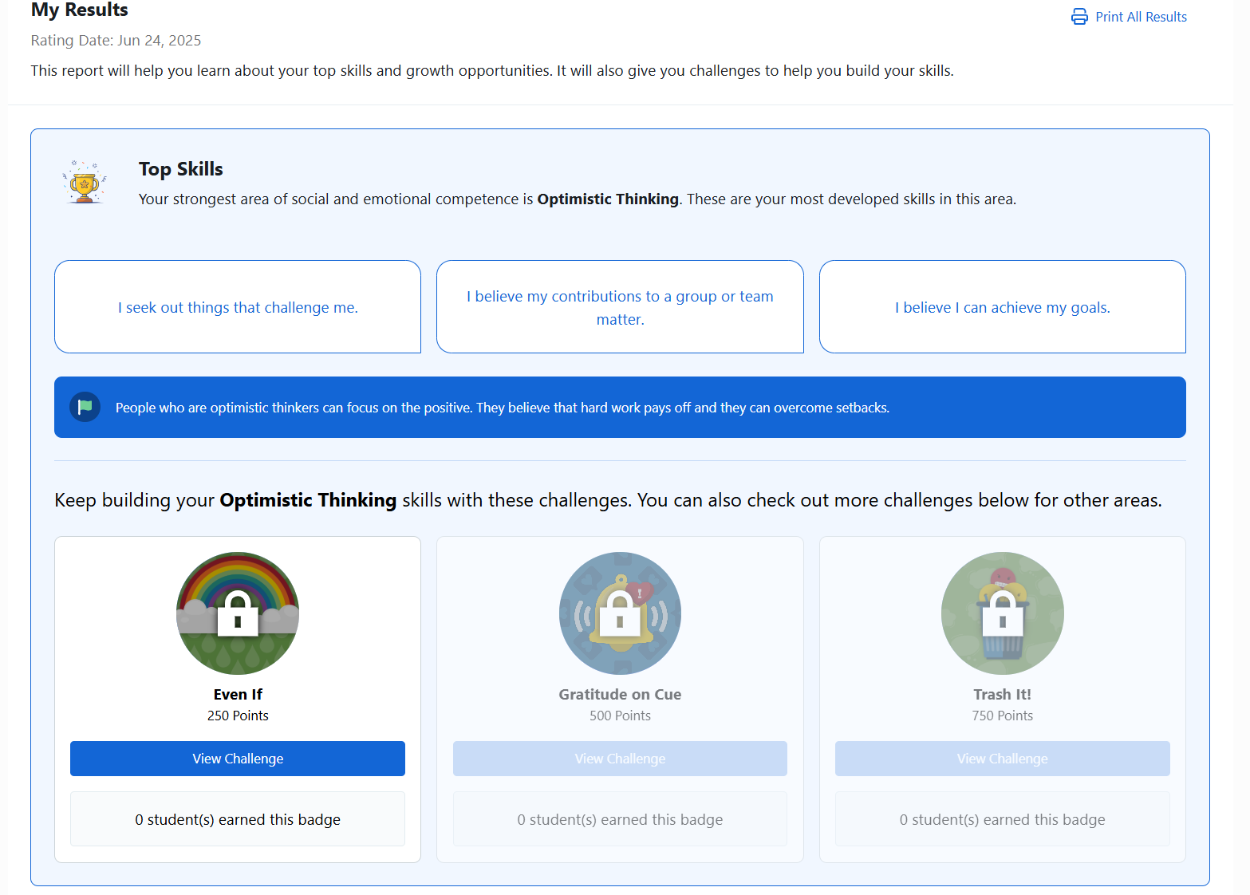
Results, Top Skills, and Challenges
Tier 3
Tier 2
Notes:
Let’s look at the Student Portal platform in some more detail. After students complete their Student Self-Report, they will have immediate access to their results and be given an opportunity to accept challenges and set goals.
CLICK: Let’s take Lilya for example. She’s just completed her Self-Report and now she has her results. Top skills will always tell students their most developed skill. According to how she rated herself, Optimistic Thinking was her most developed skill.
CLICK: As a result, Lilya is given opportunities to build her top skill through challenges. You can see that if she completes the challenge, she’ll earn 250 points. As school leaders, you can choose how to incentivize these points.
Let’s walk through this challenge together.

Slide 41
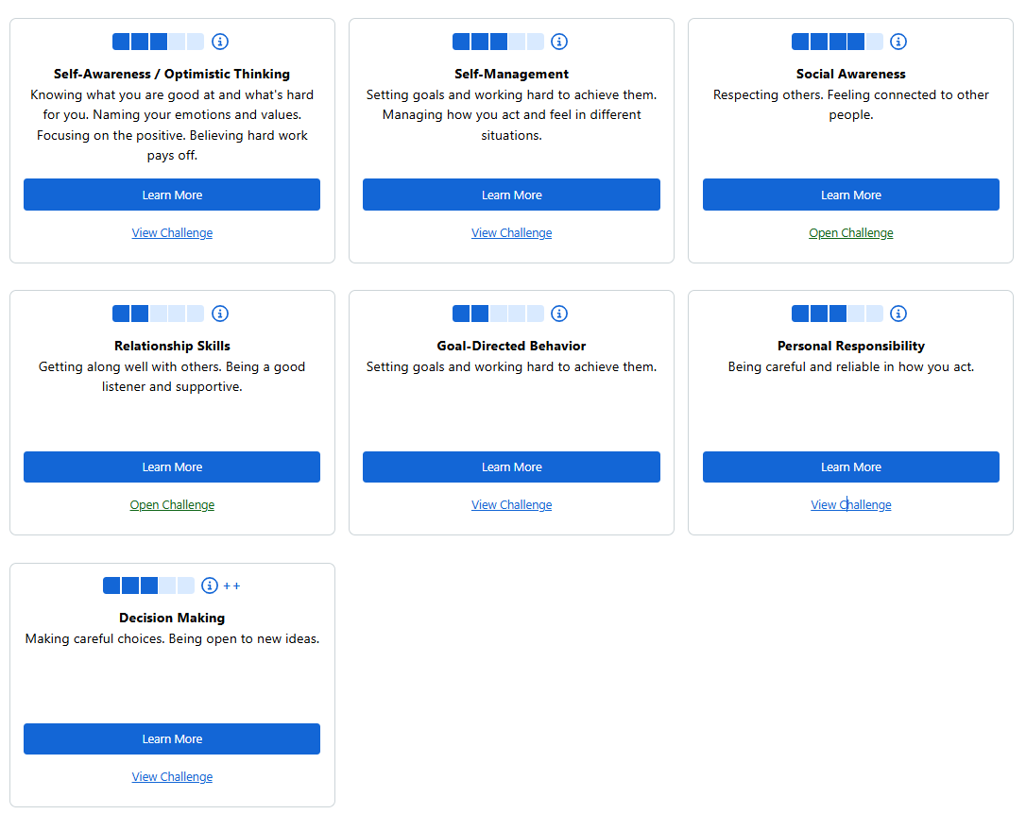
Results, Top Skills, and Challenges
Notes:
If you’re implementing the DESSA Student Self-Report, after students complete their Student Self-Report, they will have immediate access to their results and be given an opportunity to accept challenges and set goals.
CLICK: Let’s take Lilya for example. She’s just completed her Self-Report and now she has her results. Top skills will always tell students their most developed skill. According to how she rated herself, Optimistic Thinking was her most developed skill.
CLICK: As a result, Lilya is given opportunities to build her top skill through challenges. You can see that if she completes the challenge, she’ll earn 250 points. As school leaders, you can choose how to incentivize these points.
Let’s walk through this challenge together.

Slide 42
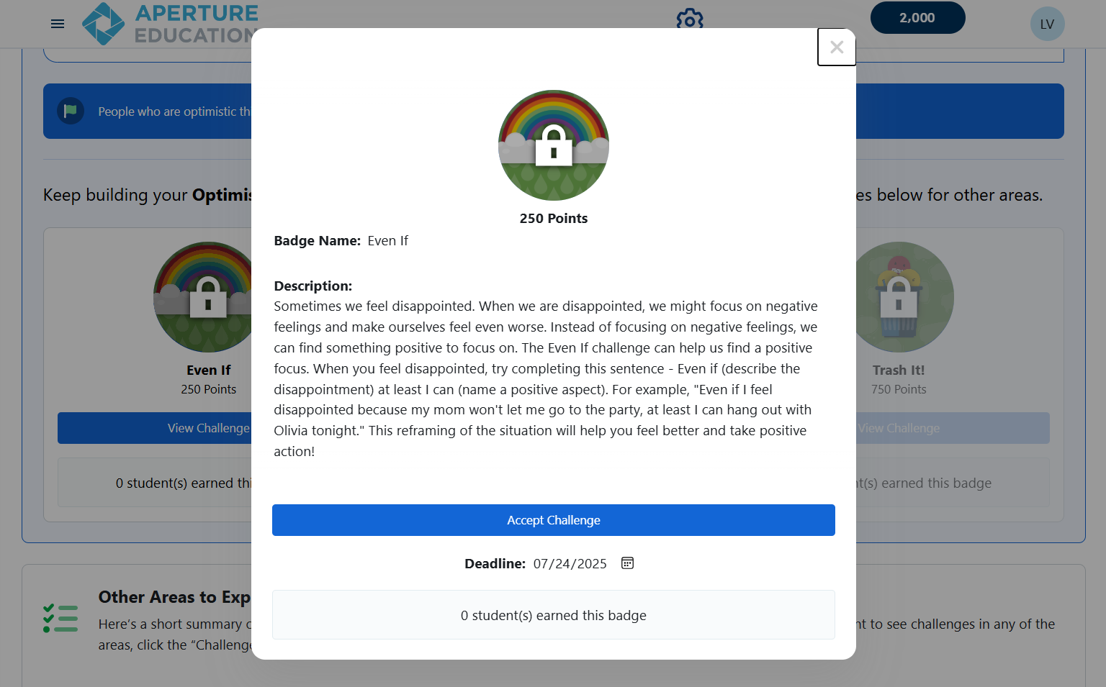
Student Challenges
Tier 3
Tier 2
Tier 2
Tier 1
Notes:
CLICK: As you can see, when I clicked on “View Challenge”, I was able to see a description of the challenge and the deadline.
CLICK: The deadline is adjustable, and this window will even show you how many students completed the badge. That’s meant to drive up the competition between classmates.

Slide 43
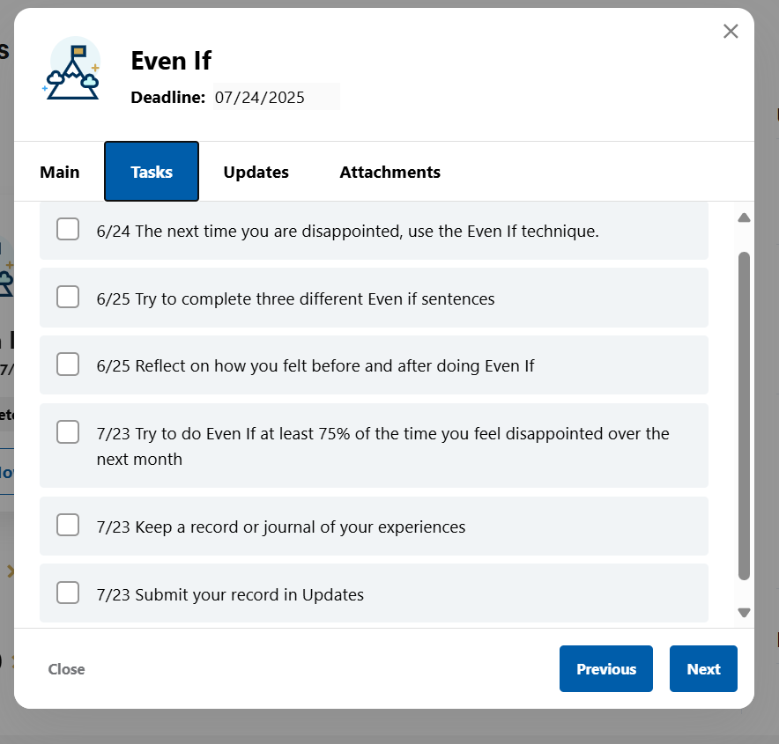
Student Challenges
Tier 2
Ter2
Notes:
Once I accept the challenge, I will have tasks. Each task will be based off the topic of the challenge shown in the description. Each time I complete a task, I will check a box. I also earn 5 points for each task I complete. I can record updates and even link attachments.
After I complete the challenge, I’ll earn the points and be able to move on to the next challenge that will help me further develop my top skill.

Slide 44
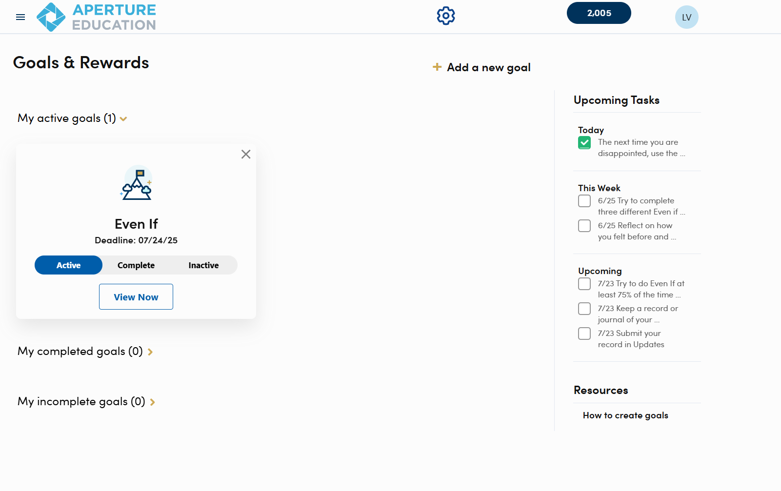
Setting Goals
Ter 3
Tier 2
Tier 1
Notes:
Now that we’ve covered viewing and accepting challenges, let’s move on to goal setting. We know that setting and achieving goals is critically important in middle and high school. So, let’s learn how we can empower our students to set goals.
This is something you can make a mandatory practice at the beginning of each week, month, quarter, or semester.
Under our Goals and Rewards section, we see that Lilya already has her Even If challenge, but she can create a goal too!
Students can click “Add a new goal” and follow the prompts.

Slide 45
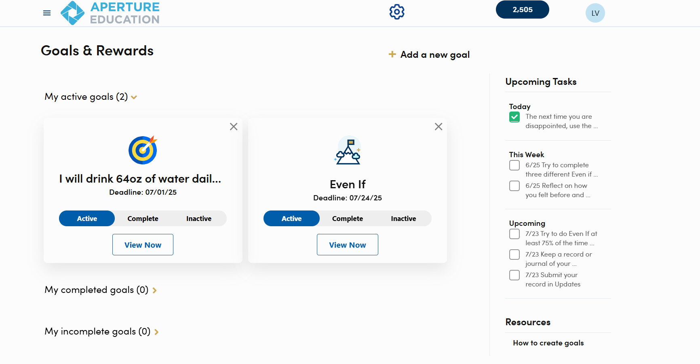
Setting Goal
Notes:
Voila! After they have followed all of the prompts, the goal will be added to my Goals and Rewards Dashboard.
As an Educator, I can have students engage in the Student Portal to work on these things as often as I’d like and incentivize with extra credit or however you see fit!

Slide 46
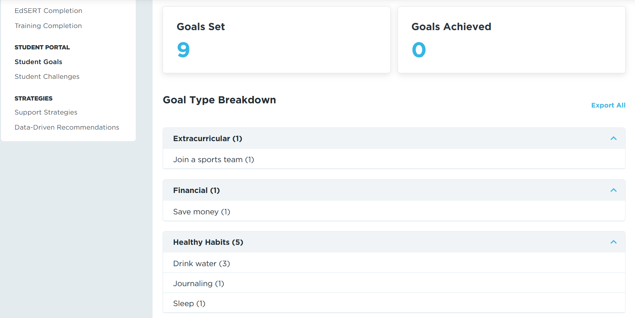
Student Goals & Challenges: Educator View
Notes:
You might wonder how you as an Educator can see Student Goals and Challenges. Great question. There are two ways you can review this information.
CLICK: One way is to visit Data and Insights, scroll down to the Student Portal section. Click Student Goals or Student Challenges and export the information into a spreadsheet.
CLICK: This will give you their name and the information they entered.

Slide 47
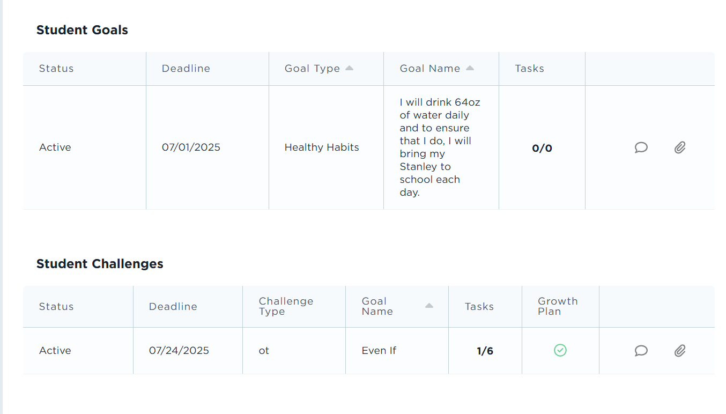
Student Goals & Challenges: Educator View
Notes:
Another way is to search a student’s name at the top of your dashboard and scroll down to their individual goals and challenges. As you can see here, I searched up Lilya and scrolled down to her goals and challenges that we just entered.

Slide 48
DEMO Access: Student Portal
Login Link: https://demo.student.apertureed.com/login
Username: DAbbo170
Password: Inverness2024!
Action: Review the SSR results, the Challenges, and Goal Setting features
Notes:
We are going to provide a Student Portal login for you to explore for a few minutes (5 minutes). For this activity, we will not be completing the SSR assessment in a demo environment. We will be giving you access to an account that has already completed a self-rating and you can view the assessment results, the challenges features, and the goal setting option. I will enter the log in link, username, and password in the chat and it is also on the screen now.
Login link: https://demo.student.apertureed.com/login
Username: DAbbo170
Password: Inverness2024!
As you review this platform, take a moment to connect to the competency areas that we are asking students to rate themselves on. Consider – how do these skills show up for you at work? At home?

Slide 49
DEMO Access: Student Portal
Login Link: https://demo.student.apertureed.com/login
Username: DAbbo170
Password: Inverness2024!
Action: Review the SSR results, the Challenges, and Goal Setting features
Notes:
We are going to provide a Student Portal login for you to explore for a few minutes (5 minutes). For this activity, we will not be completing the SSR assessment in a demo environment. We will be giving you access to an account that has already completed a self-rating and you can view the assessment results, the challenges features, and the goal setting option. I will enter the log in link, username, and password in the chat and it is also on the screen now.
Login link: https://demo.student.apertureed.com/login
Username: DAbbo170
Password: Inverness2024!
As you review this platform, take a moment to connect to the competency areas that we are asking students to rate themselves on. Consider – how do these skills show up for you at work? At home?
Your students will not log in like this. They will log in through SSO within _________

Slide 50

The Educator Portal
Notes:
From here, we are going to continue discussing the DESSA implementation through the online platform, the DESSA System Educator Portal. You may have already had time to explore this platform, but this is where everything lives for the DESSA – the ratings, the assessment results and data reports, instructional materials, and other resources.

Slide 51



User Roles in the DESSA System
Can generate and view all reports for the program, sites, and students.
Can generate and view reports from their site only.
Can generate and view reports for their assigned students.
Notes:
There are 3 different types of user access. The user access in the Educator Portal dictates what information is displayed on the dashboard and the types or amount of data viewable in your DESSA account.
First, the Program Administrator access is typically provided to district leaders or other staff responsible for setting up rostering, assessment windows, and rating assignments. Program administrator access will allow the user to view data for all sites within their district.
Next, the Site Leader access is generally provided to school or site-based leaders, including Principals and Assistant Principals, as well as other leaders that may need access to data across the campus, such as School Counselors, School Psychologists, Social Workers, etc. Site Leader access will allow the user to access to data for their specific site.
Finally, the Rater access is provided to educators that are assigned to complete ratings within the Educator Portal. The Rater access allows for educators to complete DESSA assessment for the students that they have been assigned to rate and view the data for their assigned students.

Slide 52
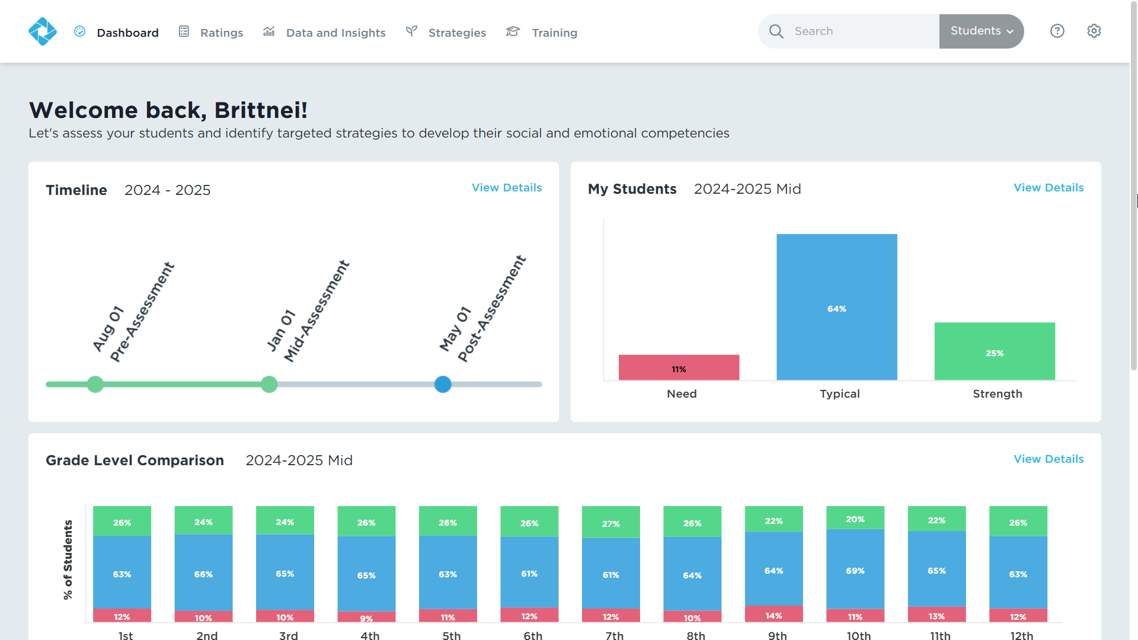
Site Leader Dashboard
Notes:
All users will land on their dashboard when they log into the Educator Portal. There 5 tabs across the top of the screen that we will navigate through.
When Site Leaders log in to their account, the dashboard will provide a quick snapshot of the rating window timeline, a preview of the My Students report, which displays an overview of student performance. On the bottom of the screen, they will see a grade-level comparison of all the grades in their building.

Slide 53
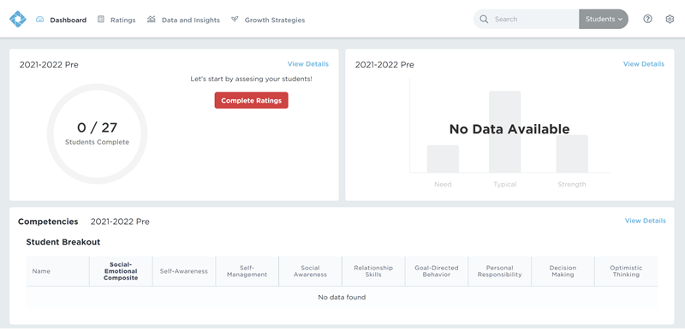
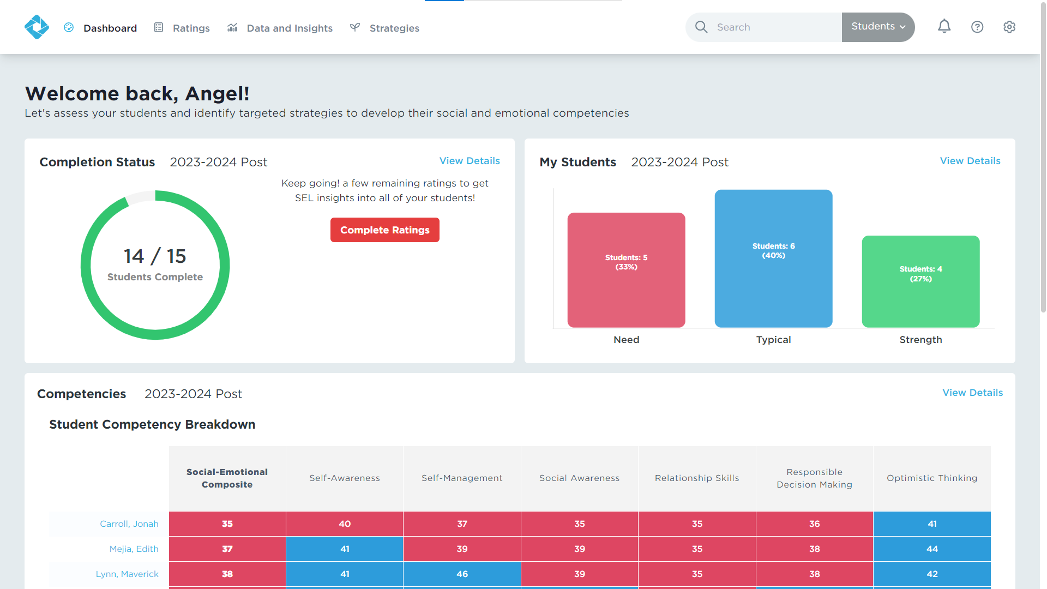
Educator Dashboard
Notes:
When a user first logs into the Educator Portal, the dashboard will likely appear blank since there won’t be any ratings completed yet and therefore, there won’t be any data in the system.
Once ratings begin to occur that data will populate in the system and be able to be viewed here as well in the data and insights tab, which we will go over in more detail in a few moments.
Educators will see a quick snapshot of the rating progress and data that has been collected based on the current or most recent rating window, an overview of the student performance on the right side, and a breakdown of student scores who received a DESSA 2 assessment at the bottom of the screen. Educators will only see data for the students in their classroom or on their roster.

Slide 54
Ratings Tab
Login to your Educator Portal.
Click the Ratings tab.
Notes:
Next, is the ratings tab. As an educator, this is where you will see the roster of students you have been assigned to rate. The system is very easy to use and should be relatively intuitive; just follow the prompts to complete the all the ratings for your students.

Slide 55
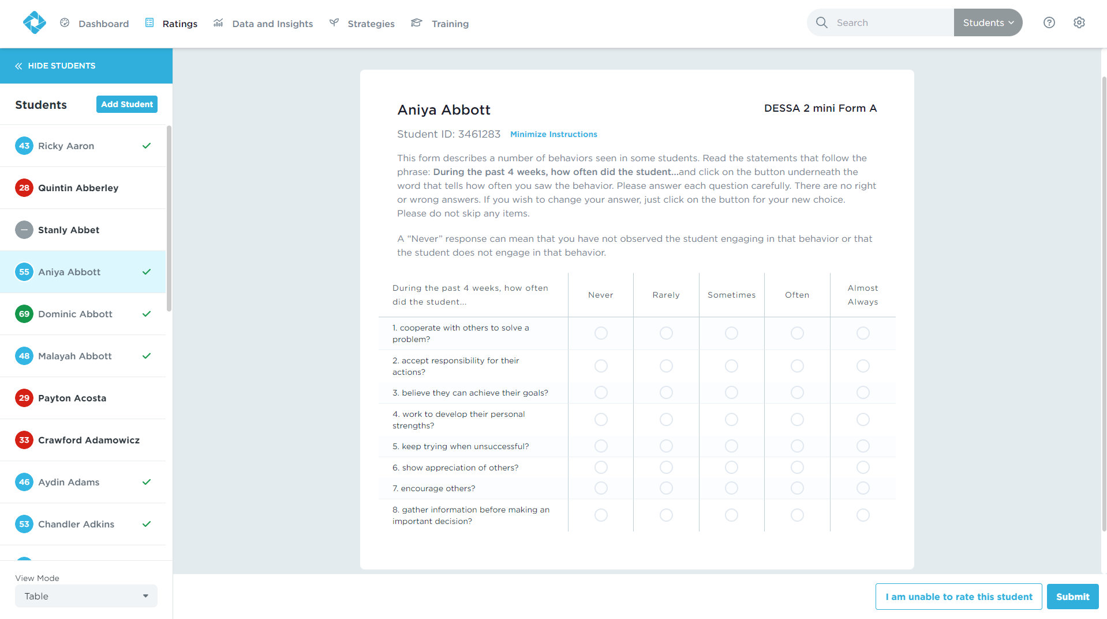
Ratings Tab
The Ratings tab shows the assigned roster of students.
Answer all DESSA 2 mini questions.
Educators can skip up to 2 questions on DESSA 2
Notes:
For the screener, you have to answer all 8 questions on a DESSA-mini. You can skip a question and come back to it; however, you cannot skip a question and complete the rating.
The circles on the left side of the student names indicate whether or not they’ve been rated, and the descriptive range in which they scored.
Gray signifies that they have not been rated, red means they have a need for instruction, blue means they scored in the typical range, and green means they scored in the strength range.
Students with a check mark do not need any further assessment.
Clicking on a student with a red circle and no check mark will automatically initiate a full assessment.
Clicking on a student with a blue or green circle and no check mark, will show you their T-Score and give you the option to progress monitor.

Slide 56
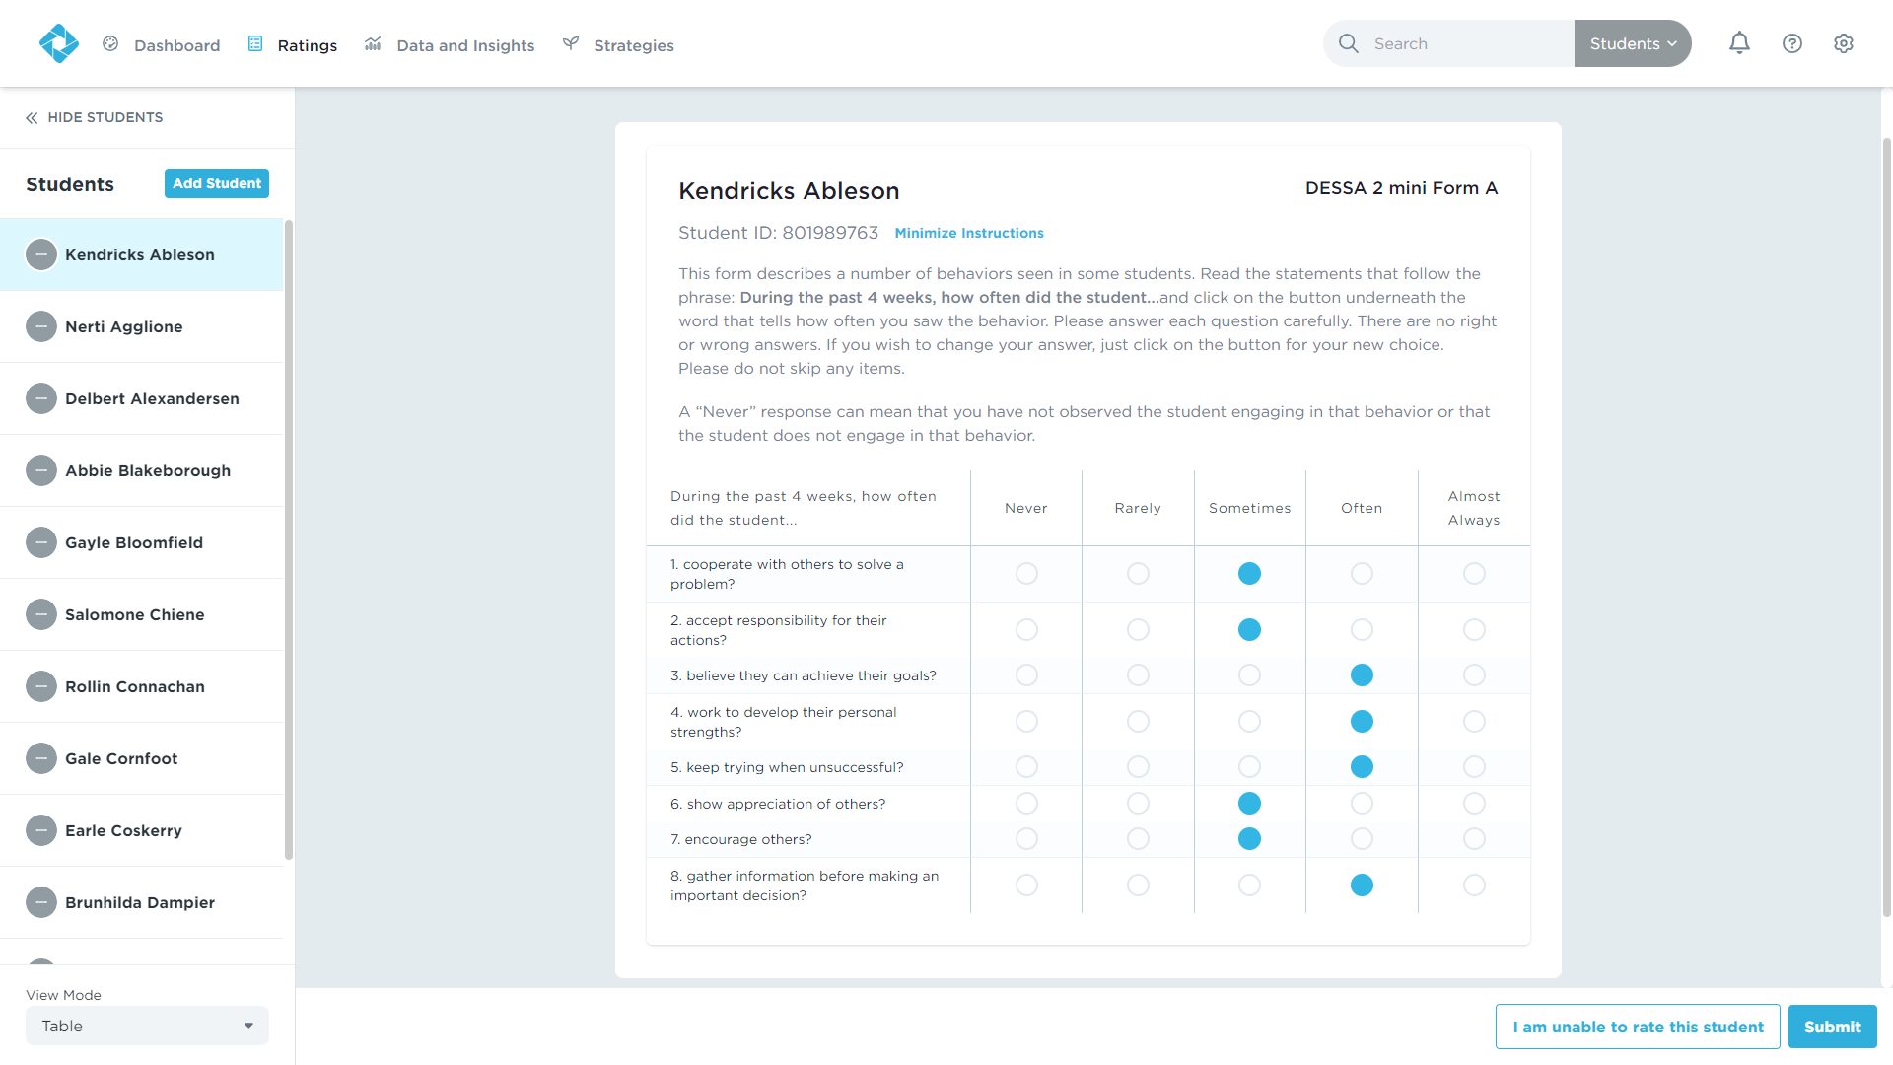
Ratings Tab
Select a student to rate.
Read the instructions.
Answer every question as honestly as possible.
Click “Submit”.
Notes:
As we’ve discussed already, you will complete the ratings to the best of your ability based on what you have observed for each student (not in comparison to other students). To complete a rating:
Select a student to rate.
Read the instructions.
Answer every question as honestly as possible.
Click “Submit”.

Slide 57
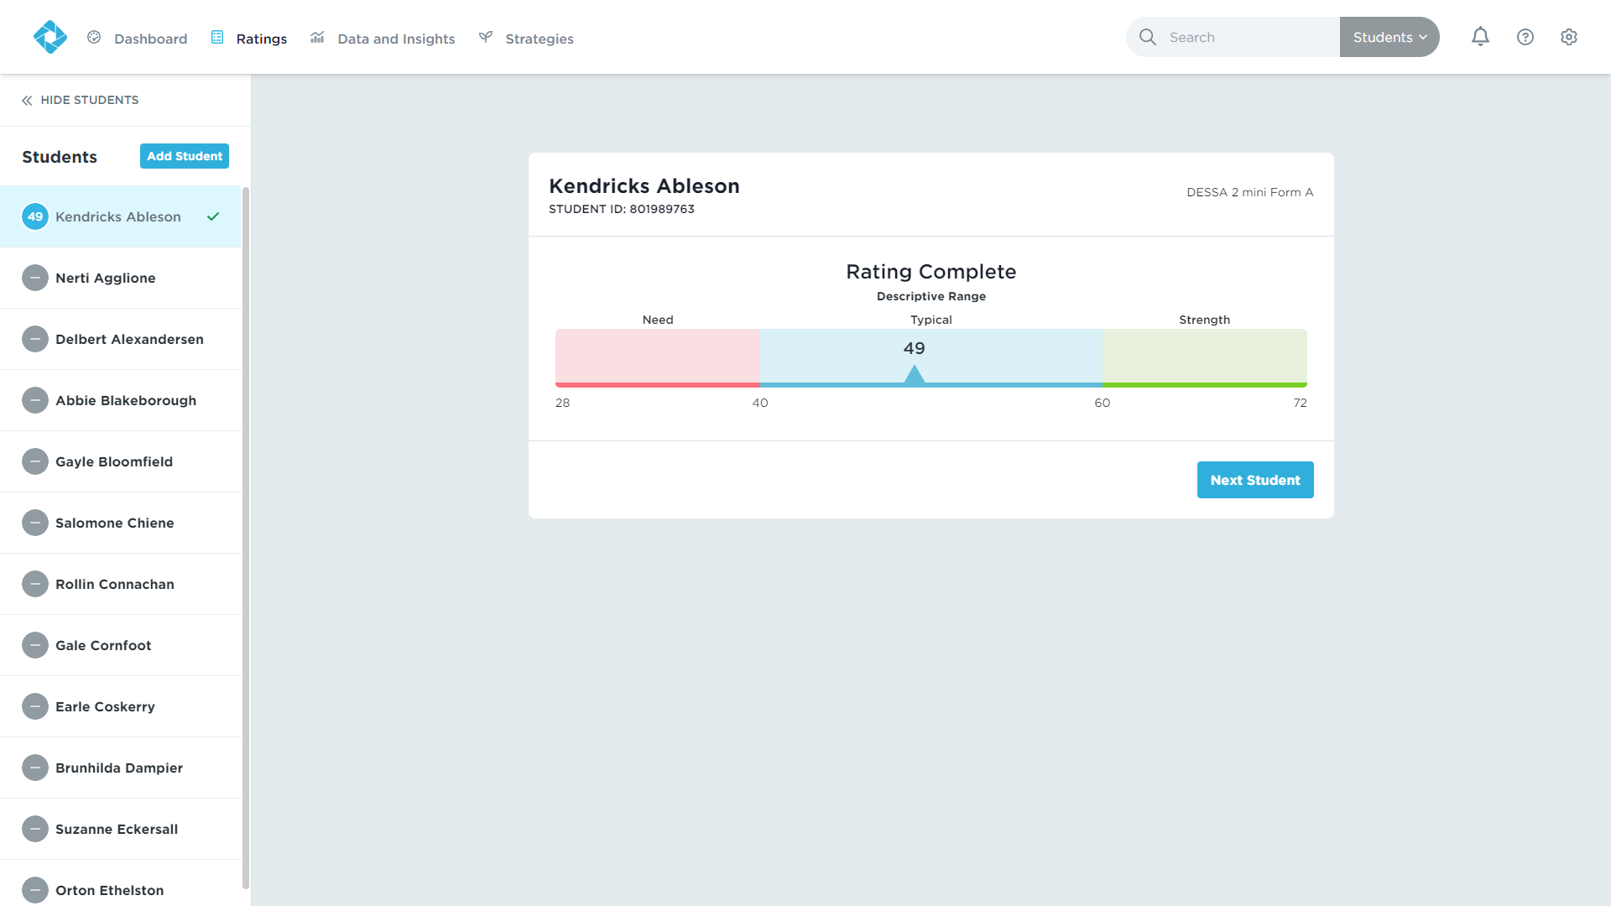
Ratings Tab
Results will be available immediately.
Continue rating the remainder of your student roster.
Notes:
Results for an individual student will be available immediately after submitting your rating.
Continue rating the remainder of your student roster.

Slide 58
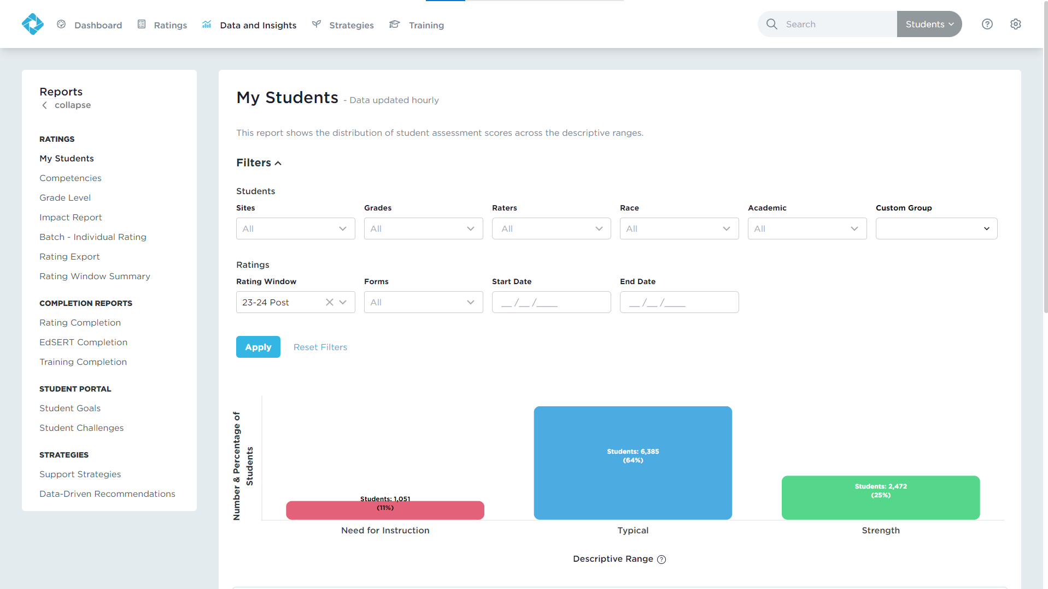
Data and Insights Tab
Real-time results
Interactive, filterable charts
Downloadable reports
Notes:
Data and Insights will give you just that: data from the DESSA assessments and insights into how you can support your students.
You’ll get Real-time results, Interactive, filterable charts, and Downloadable reports. You can use the filters to generate reports for subgroups of students or use the search bar to locate an individual student by typing in their name or student ID.
We wont be going into the details of all the Data and Insights reports during this session – that is for another training after you have collected your ratings data.

Slide 59
Student Goals & Challenges
Notes:
Talking Points
You might wonder how you as an Educator can see Student Goals and Challenges. There are two ways you can review this information.
[CLICK] One way is to visit Data and Insights, scroll down to the Student Portal section. Click Student Goals or Student Challenges and export the information into a spreadsheet.
[CLICK] This will give you their name and the information they entered.

Slide 60
Student Goals & Challenges
Notes:
Talking Points
Another way is to search a student’s name at the top of your dashboard and scroll down to their individual goals and challenges. As an example, I searched up Lilya and scrolled down to her goals and challenges.

Slide 61
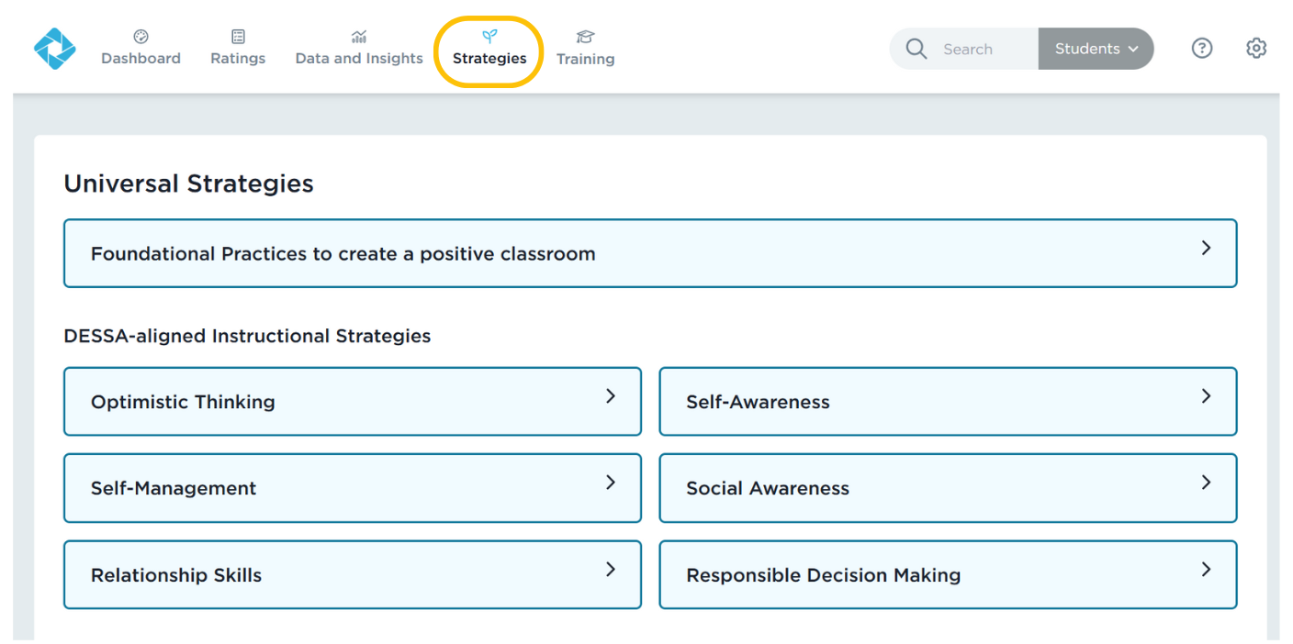
Strategies Tab
Notes:
Next over on the tabs list is the Strategies tab.
The DESSA System includes lessons, activities, and resources for data-driven instruction and intervention. Under the Strategies tab, there are a variety of materials available to all users:
Foundational Practices: The Foundational Practices are best practices that are easy to implement consistently at the universal level. These activities create a supportive and positive learning environment throughout a school and within a classroom.

Slide 62
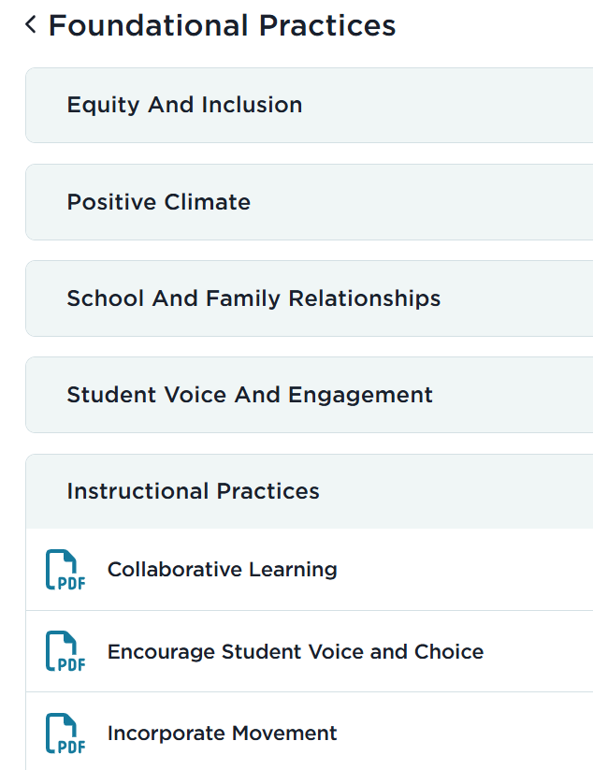
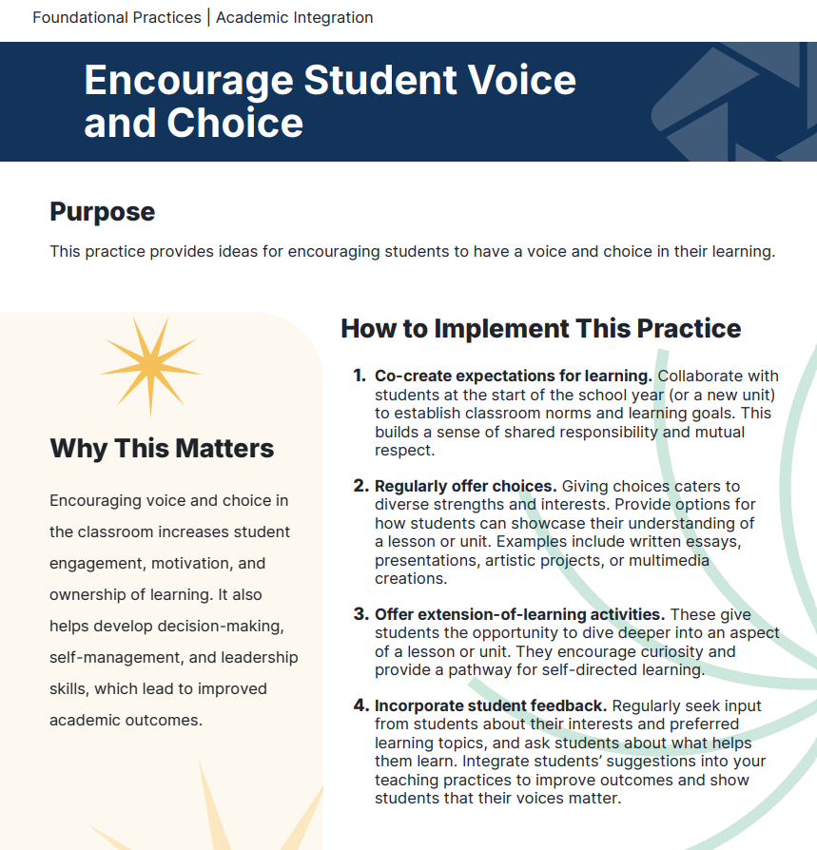
Foundational Practices
Notes:
Foundational Practices: The Foundational Practices are best practices that are easy to implement consistently at the universal level. These activities create a supportive and positive learning environment throughout a school and within a classroom.

Slide 63
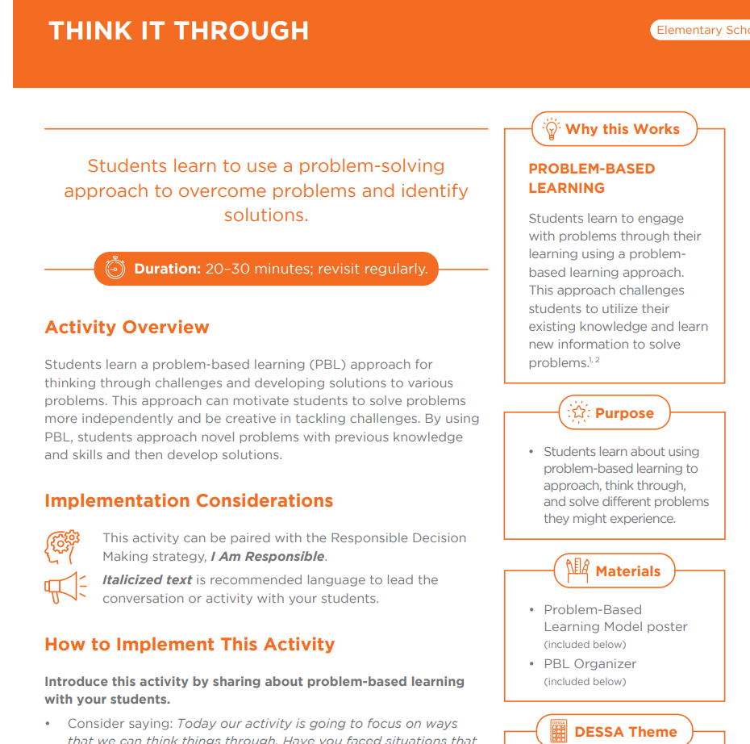
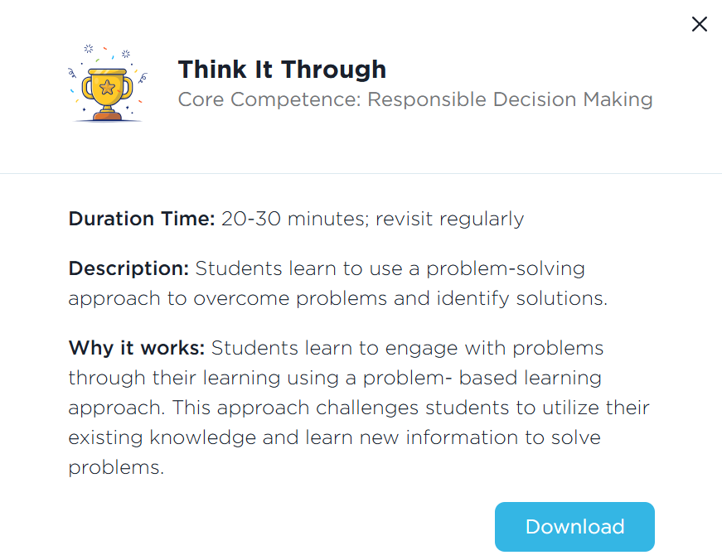
Strategies
Notes:
Strategies: These lessons are research-based, DESSA-aligned materials that provide direct instruction of social and emotional skills. The Strategies are designed for universal instruction and include step-by-step directions for facilitation, along with extension activities and modifications for differentiated instruction. Student and educator reflection prompts are included in each strategy.

Slide 64
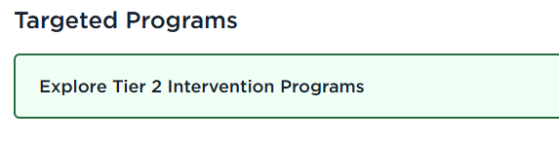
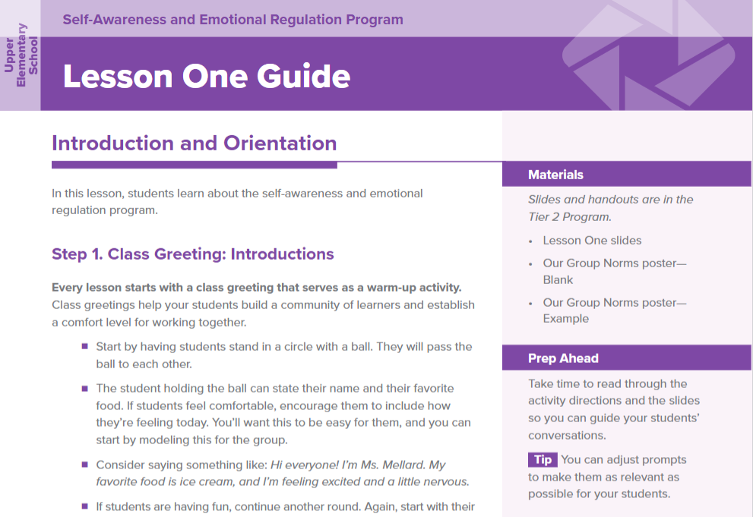
Tier 2 Intervention Programs
Sequenced, intensive lessons to develop student resilience skills with a focus on:​
Self-Awareness and Emotional Regulation
Social Awareness and Behavior Regulation
Social and Emotional Skill Development integrated with Academic Intervention
Responsible Decision Making
Relationship Skills
Notes:
Talking Points
The Tier 2 Intervention Programs consist of five multi-week programs designed for targeted, small group instruction for students who need intensive skill building.
Lessons within the Tier 2 Intervention Programs are designed to be delivered in a scope and sequence that builds skills through repeated practice and active engagement.
All of the intervention programs are available within the DESSA System, also under the Strategies tab.
The programs are grouped by grade bands: Early Elementary, Upper Elementary, Middle School, and High School.

Slide 65
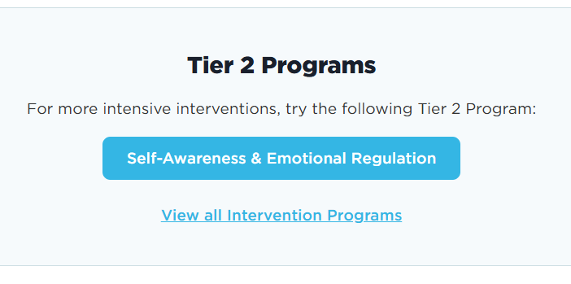
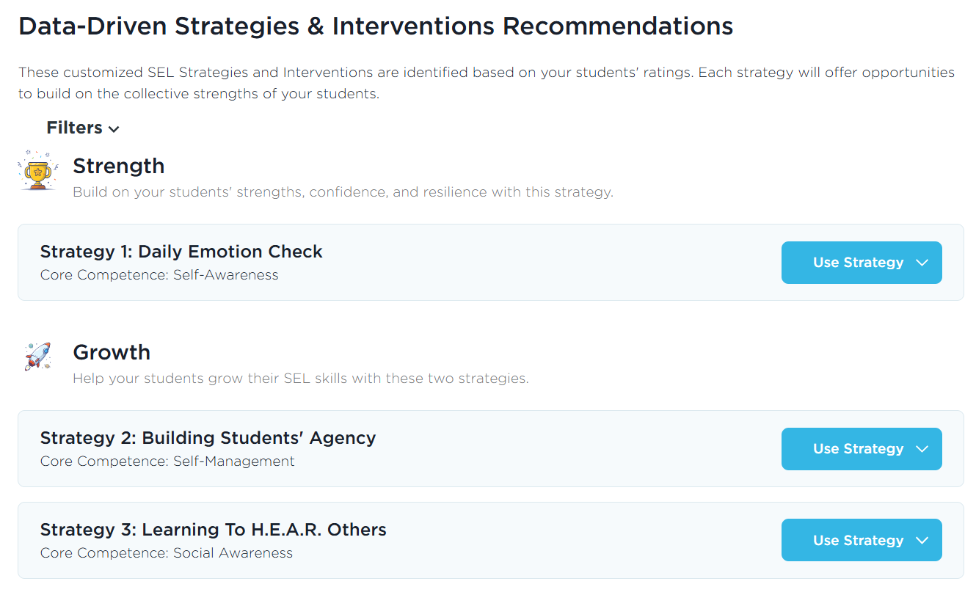
Data-Driven Recommendations
Notes:
The one report we do call out in this session is the Data-Driven Recommendations. This report is located under the Data and Insights tab and it connects your DESSA results to the strategies resources under the Strategies tab. It takes the “guess work” out of it for you – based on your data, it will recommend DESSA-aligned instructional materials to use with your students.
Once you generate this report for your stundets, three strategy recommendations will be presented: The first strategy is based on students' strengths, and the second and third strategies will help you build students' growth in lower-scoring competencies. You can view the overview of the strategy lesson and download a PDF copy. Then it will also recommend a specific Tier 2 Intervention Program to use with your students (that’s the longer, full scope/sequence program), again based on their DESSA results.

Slide 66
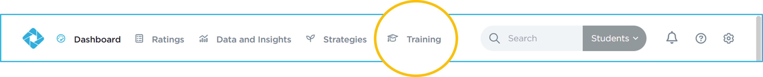
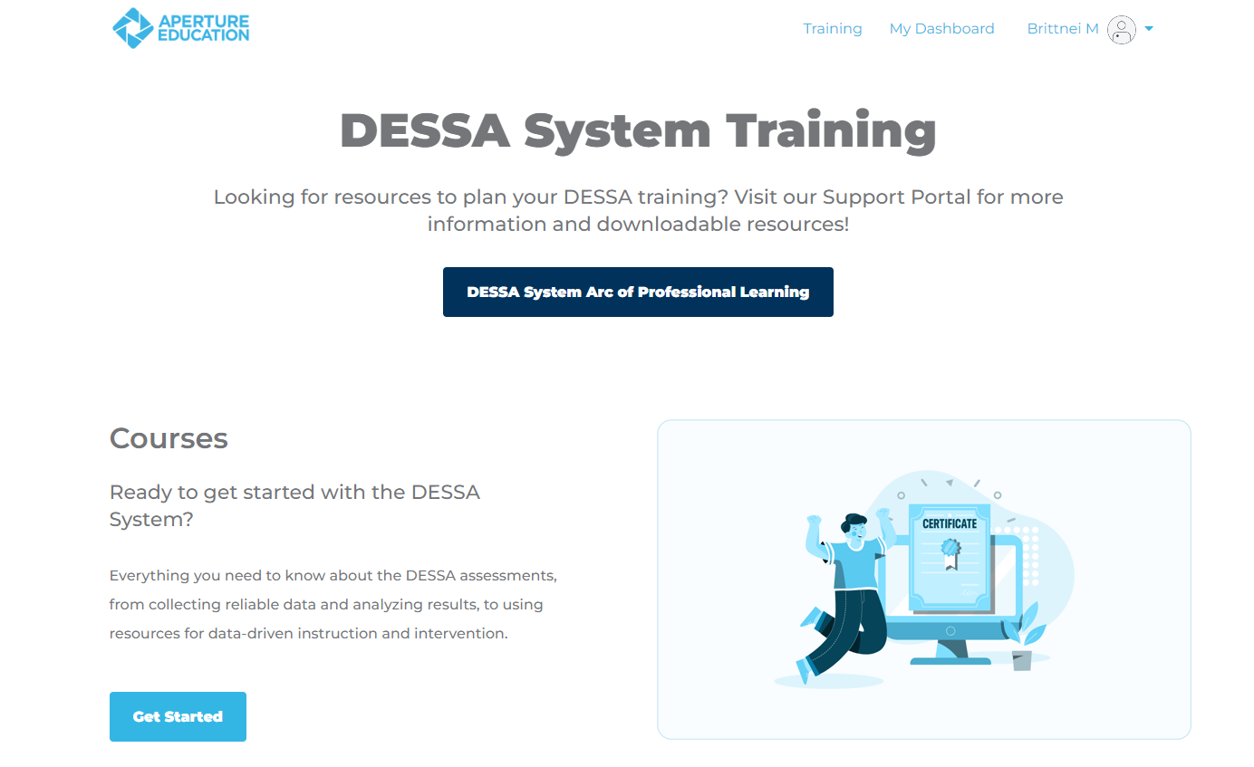


Training
Notes:
The last tab to review within the Educator Portal is the Training Tab. The Training tab allows you to choose more learning options.
There are self-paced courses for individuals who are new to the DESSA or those who just need a refresher.
The on-demand video library provides short self-service videos that help users with DESSA implementation, and we offer live monthly office hours on pre-selected topics as well.
The Support Portal is open 24/7, offering resources to help guide users through the DESSA system.

Slide 67
Wrapping Up
Any remaining questions to address?
Notes:
Talking Points
We are at the point where we wrap up for this training session – we have covered a lot and want to make sure we can address any remaining questions that you may have before we offer an optimistic closing prompt and your next steps.
(allow time for final questions)

Slide 68
Optimistic Closure
Strengths-based approach:
Based on what you learned today, what is a main take-away for you?
Notes:
Before we share your “exit ticket” for today’s session, let’s pause one last time – this time for an optimistic closure. Based on what you learned today, what will you do more, less, better, or differently?

Slide 69

Thank You!
Training Survey
Click the Training Feedback Survey link in the chat or use the QR code.
Give us your honest feedback.
Please consider leaving descriptive feedback for constructive responses.
Notes:
https://apertureed.qualtrics.com/jfe/form/SV_250ioEurFXBmBUy

