Slide 1

Getting Started with the DESSA System
Teacher-Completed Assessments
Notes:
Facilitator Reminders:
Project the PPT in Presenter Mode
Open any other apps or documents that you will need for the session, such as the DEMO
Shut down all other applications and browser windows
Put Slack and phone/other devices on do not disturb to avoid interruptions
RECORD SESSION TO THE CLOUD
Talking Points:
Hello and welcome to Getting Started with the DESSA!

Slide 2
Goals for Today’s Session
By the end of today’s session, you will be able to:
Identify key components of the DESSA assessments.
Demonstrate best practices for completing ratings and interpreting the scoring result categories.
Explore key features of the Educator Portal.
Notes:
Talking Points
In this session, we will provide a high level overview of the teacher-completed DESSA assessments. Your district leadership has been very intentional and prepared in expanding this implementation after facilitating a pilot of it last year, and they will be providing grade-level specific directions, if they haven’t already. The training itself will focus on the assessment tool and the online platform, which is the DESSA System Educator Portal.
In our time together today, we will:
Identify key components of the DESSA assessments
Demonstrate best practices for completing ratings and interpreting the scoring result categories, and
Explore key features of the Educator Portal.

Slide 3
Session Structure
Introductory overview of the DESSA System and assessments
Put any questions in the chat for your leaders to address
Logistics:
  Session Length: 60 Minutes
  Halfway through, we will take a brief break!
Notes:
Talking Points
In terms of the session structure today, this training is meant to be an introductory session. However, as questions arise, feel free to put those in the chat so that we can share them out to your leadership afterward and ensure that they are addressed. The training content will last about 60 minutes, and halfway through we will take a brief break.

Slide 4
Today’s Agenda
Here’s how we’ll spend our time together today:
DESSA Overview
How to Complete Ratings
The Educator Portal
Optimistic Closure
Notes:
Talking Points
Let’s talk through how we’ll spend the rest of our time together:
We’ll share an overview of the DESSA
We’ll practice completing a rating,
We’ll walk through an overview of the Educator Portal, including the available data reports and instructional resources
And finally, we’ll close out with an optimistic closure and opportunity for feedback.

Slide 5
Opening Reflection
Strength-Based Mindset:
What has gone well so far since the start of the school year?
Notes:
Talking Points
Let’s start today by centering in a strength-based mindset.
It’s been a few months since the start of the school year, let’s reflect on the semester. I invite you pause and think about the successes so far – no matter how big or small. What has gone well so far since the start of the school year?
Please take a moment to add something in the chat, and we would love to hear from a couple folks by coming off mute to celebrate some successful call outs!
(offering think/participation time)
As we discuss the DESSA today, it will help to keep this strength-based approach front of mind, as the DESSA is rooted in this same approach. Whether this training is a refresher for you or it’s an introduction to the DESSA, approaching implementation with a solutions-based lens is key!

Slide 6

Video: DESSA System Overview
Notes:
Talking Points
We are going to start with a short video about the DESSA and the online platform where it is located, called the DESSA System. After the video, we will break down the key details about the assessment and its scores, so for now just sit back and watch this high-level overview.
(Press play- video embedded. Make sure sharing with sound)
If needed: Online Video Link: https://go.screenpal.com/watch/c0e0F5V4PMQ?redirect=true
Video Run time: 3:08

Slide 7
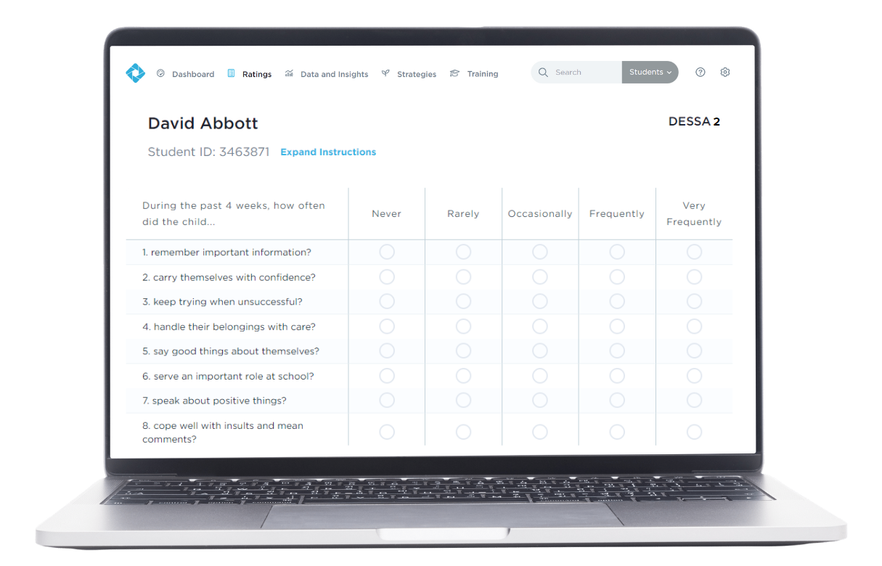
What is the DESSA?
An evidence-based social and emotional competency assessment to support student growth.
Notes:
Talking Points
That video gave us a great overview of the different components of the DESSA System. In these next few slides, we will expand on those areas, starting with: What is the DESSA?
In short, the DESSA is an evidence-based social and emotional competency assessment to support student growth, including a screening tool and a full diagnostic assessment that educators complete for their assigned students.
The DESSA is a behavior rating scale completed by educators and assesses social and emotional competencies in students grades K–12th. It is accompanied by the DESSA mini, a screener and progress monitoring tool of overall social and emotional competence. DESSA ratings, data reports, and intervention resources are located within the online Educator Portal.

Slide 8
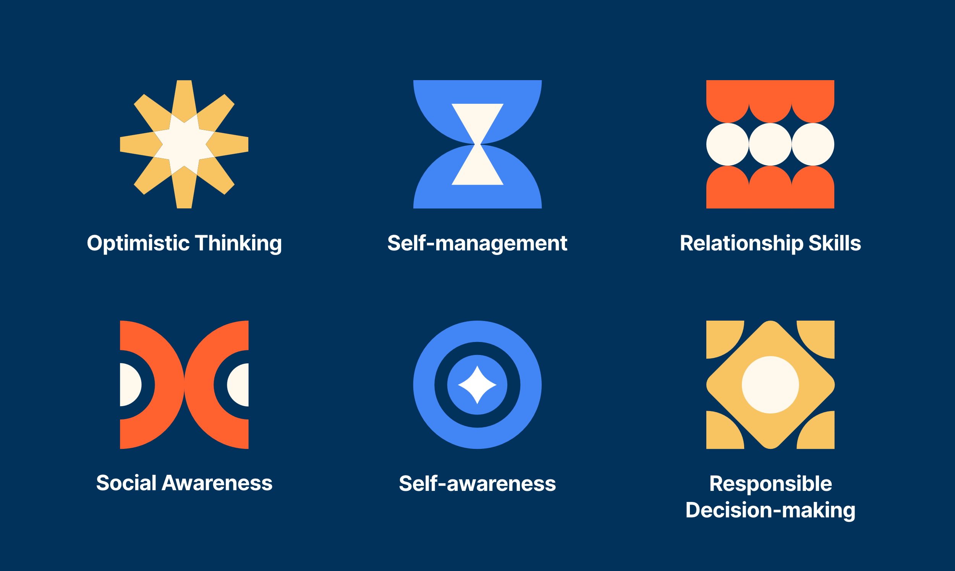
What does the DESSA measure?
Notes:
Talking Points
Let’s now go one level deeper. The DESSA measures 6 overall competencies: Optimistic Thinking, Self-Management, Relationship Skills, Social Awareness, Self-Awareness, and Responsible decision making. The DESSA was developed based on resilience theory, which is why the Optimistic Thinking competency is included in this assessment. The goal is to foster protective factors and resilience in students through skill strengths. If you’re interested in reviewing the exact definitions of these competency areas, we’ll drop a link in the chat for a Support Article that provides more detailed information. (add link in chat - https://info.apertureed.com/en/hc/dessa-ssr-scales-and-associated-items) For now, let’s look at the next slide that highlights how these areas can support student success.
---------------------------------------------------------------------------------------------------------------------------------------------------
(For reference – do not have to review these areas in detail):
Optimistic Thinking: the belief and demonstration of confidence, hopefulness, and positive thinking regarding oneself, others, and one’s life situations in the past, present, and future.
Self-management: the ability to manage emotions and behaviors across different situations and environments and to demonstrate agency as one works to set and achieve personal and collective goals.
Relationship Skills: the abilities to establish and maintain healthy and positive relationships including effective communication, collaborative problem-solving, negotiating conflict, and demonstrating helpful and supportive behaviors.
Social Awareness: the understanding of social norms for behavior; the ability to empathize with, respect, and take the perspectives of others; and the feeling of connection and belonging with family, peers, schools, and community groups.
Self-awareness: the ability to understand emotions, thoughts, and values and how they influence one’s behavior; recognize strengths and limitations; and develop healthy identities and a sense of purpose.
Responsible Decision-making: the ability to make careful, reliable, and constructive choices about personal and social behavior that are appropriate across diverse situations; to consider the personal, social, and collective impact of one’s actions; and to demonstrate curiosity and an open-mindedness to learning.

Slide 9
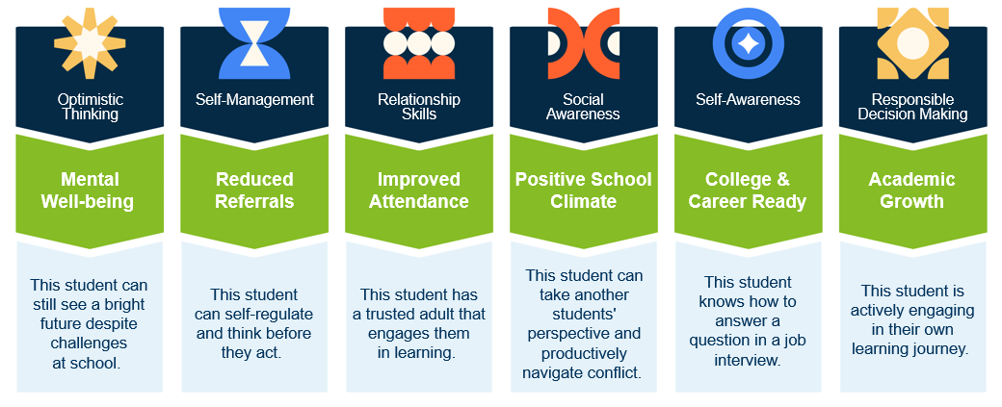
These skills are critical for students to be successful inside and outside the classroom
Reflect: Which of the competencies is resonating with you most right now
given your work with students and families?
Notes:
Talking Points
These skills – Optimistic Thinking, Self-Management, Relationship skills, etc - are critical for students to be successful inside and outside the classroom.
They are everyday observable behaviors that contribute to being a successful student, a successful classmate, a successful employee, volunteer, neighbor, human being.
When students able to demonstrate these skills consistently and independently, we see positive results. Examples for each competency are listed in the green section of this image, and the blue text box below.
For example, Optimistic Thinking supports mental well-being. A student can still see a bright future despite challenges at school. Self-Management skills support a reduced amount of referrals because students can self-regulate and think before they act. Relationship skills contribute to improved attendance. Take a minute or so here to review the competencies and impacted areas on listed on this slide.
(Click) Reflect: As you review this slide, I encourage to reflect on which of the competencies is resonating with you most right now given your work with students and families?
(Click) Reflect: As you review this slide, I encourage to reflect on which of the competencies is resonating with you most right now given your work with students and families?

Slide 10
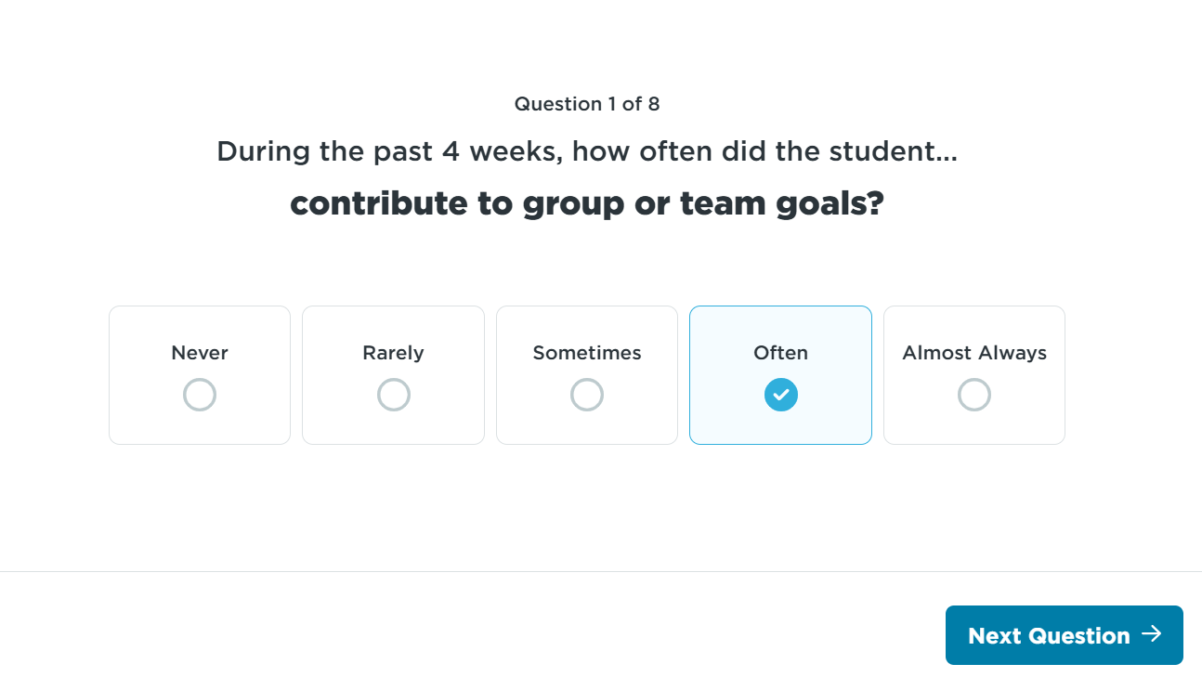
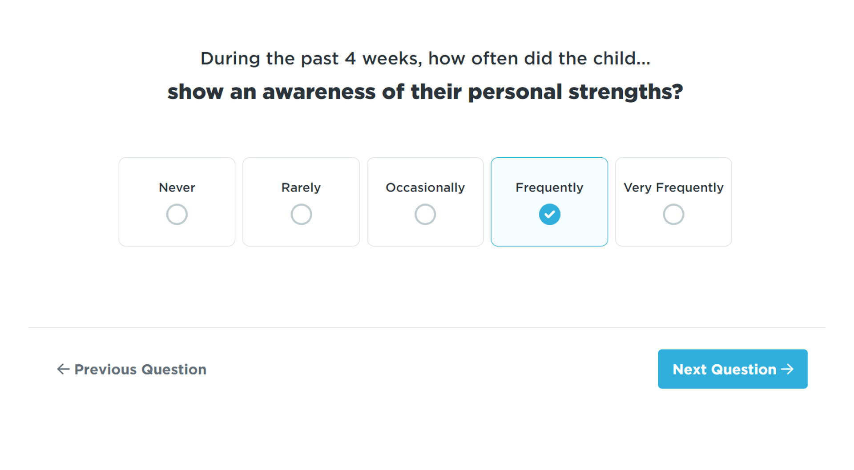
DESSA Items
Notes:
As a strength-based assessment, the DESSA includes items (questions) that are positively phrased, desirable behaviors. Ratings are completed using a Likert scale based on the frequency in which the behaviors listed are observed by the rater within the past four weeks. Some examples include:
(read screenshots)

Slide 11
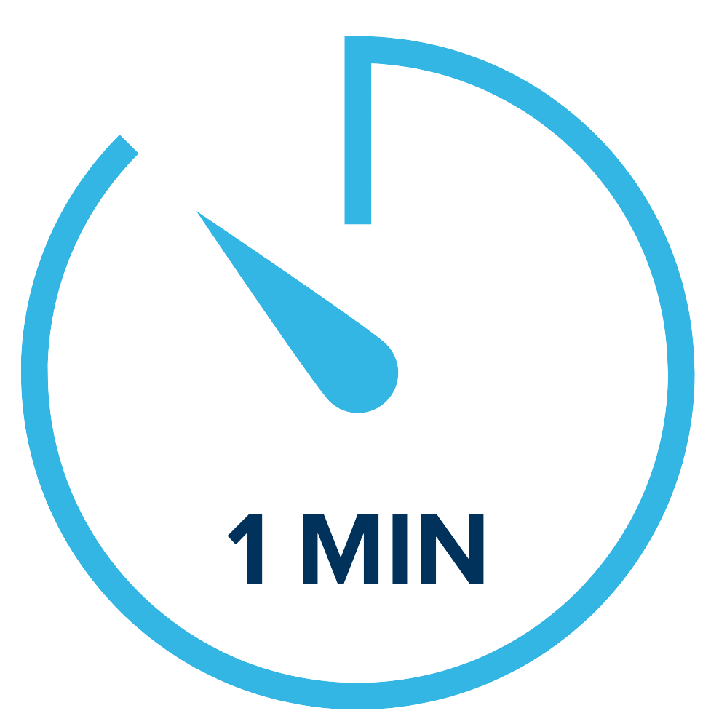
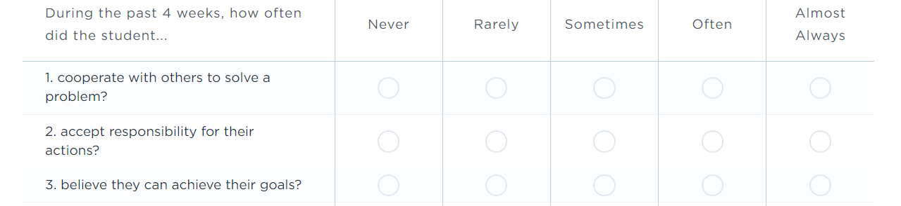
DESSA 2 mini
Universal Screener
4 Forms
Score:
Social-Emotional Total (SET)
Educators Complete
Notes:
The DESSA includes different versions of the educator and student completed assessments. For this session, we will focus on the DESSA 2 mini (screener) and DESSA 2 (full assessment).
The DESSA 2-mini is a universal screener of social and emotional competence designed for all students. It has 8 questions and takes about 1 minute per student for an educator (or rater) to complete.
The primary purpose of the “mini” screener is to quickly and accurately identify which students may be at risk of academic and behavioral difficulties based on their social and emotional development.
The screener is completed online after at least 4 weeks, or a cumulative of 24 hours over a 4-week period of interaction and observation of the student. There are 4 different forms that can be utilized for progress monitoring throughout the school year.
The results from the DESSA-mini produce a Social-Emotional Total (SET) score that provides an indication of a student’s overall social and emotional competence at the time of assessment.
This data can help educators plan how best to strengthen, readjust, or add universal supports. This screener can also help to identify students that may benefit from additional assessment.

Slide 12
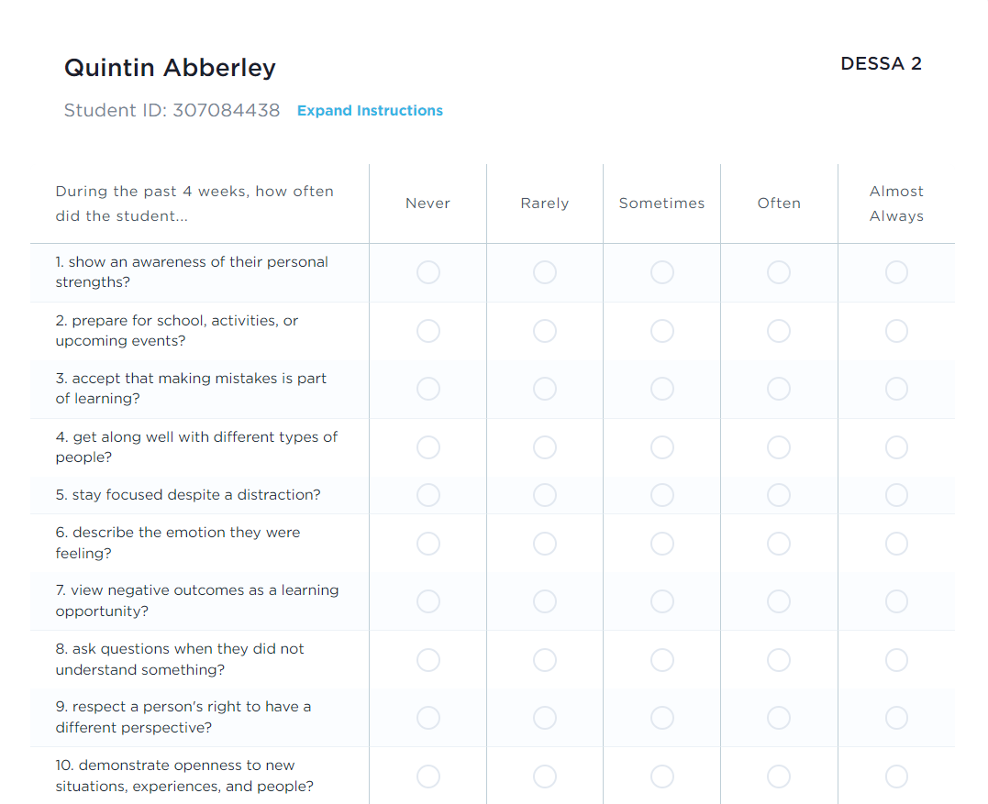
DESSA 2
K-8
Assessment of 6 competency areas
Educators Complete
Scores:
Social and Emotional Composite (SEC)
6 competency areas
Notes:
The DESSA 2 is a full assessment of students' social and emotional competencies. It takes about 5 minutes for an educator to complete, and it is typically completed as a follow-up assessment after the DESSA-mini for certain students, if needed. We will look at that conditional process in just a moment.
The results of the DESSA produce one total score, the Social and Emotional Composite (“SEC”) score, and a score for each of eight social and emotional competencies per student.
Similar to the DESSA-mini, each question on the DESSA is a positively worded, desirable behavior and offers the educator (or rater) the same Likert frequency scale to select their answer.
The DESSA data provides an indication of student strengths and needs across multiple competencies, it can help educators plan how best to strengthen, readjust, or add universal and tiered supports in specific areas.

Slide 13
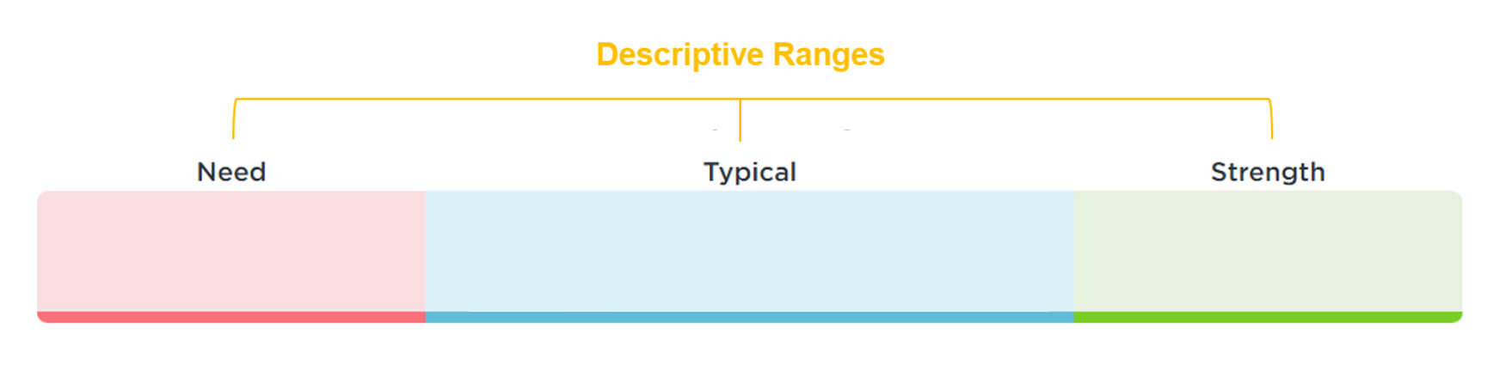
DESSA Results
T-scores are categorized into 3 descriptive ranges
T-scores:
28-40
T-scores:
41-59
T-scores:
60-72
Notes:
Next, we’ll move into the results for the DESSA. The DESSA assessments report results using T-scores:
T-scores are categorized into three descriptive ranges, and as strength-based measures, higher T-scores mean a higher level of social and emotional competence.
Scores of 60 and above are considered a strength; scores between 41-59 inclusive are considered typical (demonstrating typical patterns of development); and scores of 40 and below indicate a need for instruction.
A common implementation practice includes completing a DESSA-mini screener for all students. For the students who demonstrate a need for instruction on the DESSA-mini, a full DESSA assessment is then completed.
The term need for instruction was thoughtfully chosen to convey that the student needs support and instruction in this area. That is, it reflects that the student has not YET acquired these skills – indicating a lack of skill acquisition.
So, the goal is not to label or stigmatize students within the “Need” range, but instead, it’s used to increase our awareness as educators that a student needs our instruction, assistance, and support in acquiring and practicing these important skills.
Once we’ve identified a need for instruction, it’s OUR responsibility to have a system or plan in place to support skill development and provide that instruction.
We use the information from the follow-up DESSA assessment to gather really specific information on a student so that we can support them moving forward.

Slide 14
DESSA Norms
All DESSA assessments are norm-referenced and standardized
All DESSA assessments have a psychometrically sound foundation
All DESSA assessment meet standards for reliability and validity
Norms
16%
68%
16%
Notes:
In terms of the assessment development, it’s important to note that:
All DESSA assessments are norm-referenced and standardized.
All DESSA assessments have a psychometically sound foundation, meaning →
All DESSA assessment meet standards for reliability and validity .
From the standardization sample, we can anticipated that the majority of students will score within the Typical range (68%) and that there will be about equal amounts of students in both the Strength and Need for Instruction ranges (16% each). We can use this information to compare the results collected to the expected norms, and to guide our data-driven making decisions about how to support students in developing these important skills.
If you are interested in these details, the technical manual for each version of the DESSA is available in our online Support Portal. Chapters 2 and 3 provided the information regarding assessment development, standardization, psychometric properties, reliability, and validity of the DESSA.

Slide 15
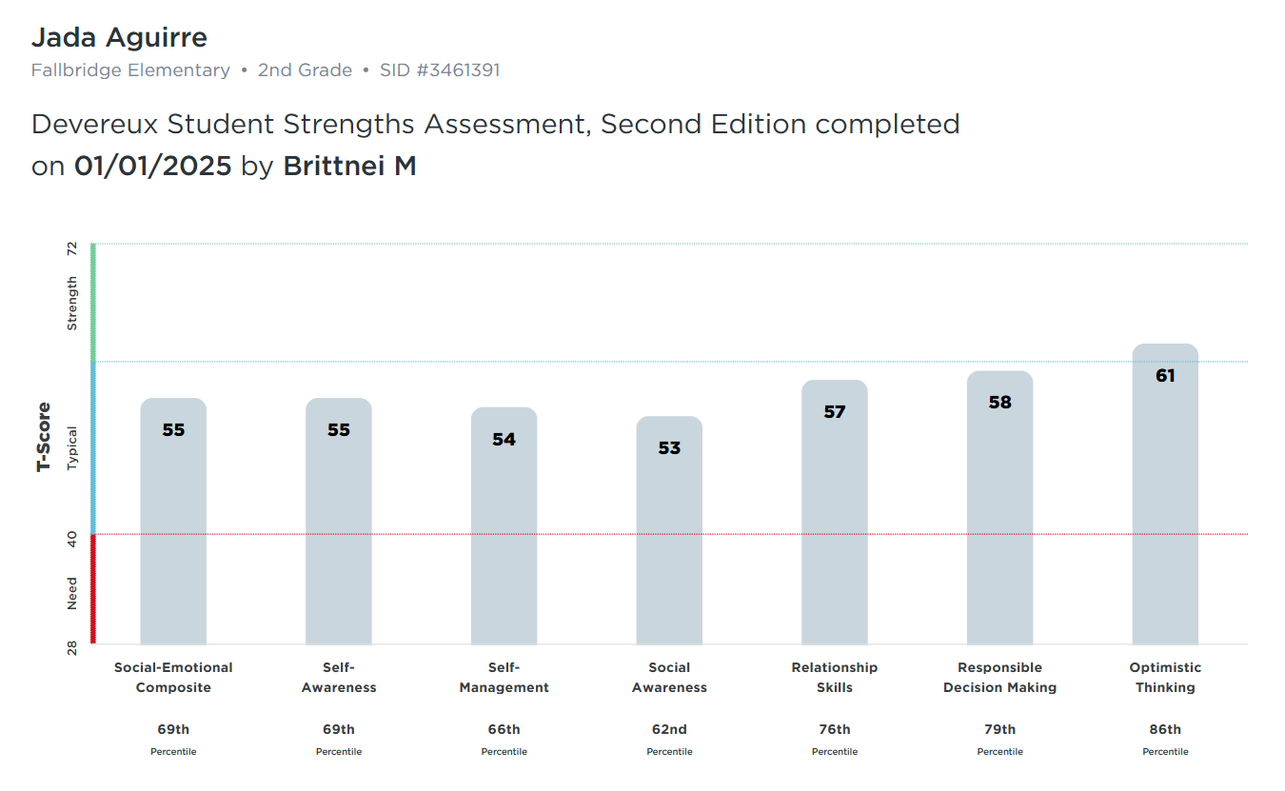
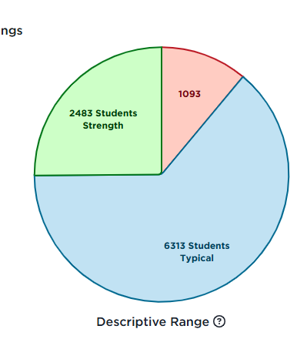
DESSA Results in the Educator Portal
Notes:
Talking Points
we’ll take a look at more report options later in this session, but at a high-level, the results are available in real time within the DESSA System educator Portal. There are many interactive reports that can be used to generate reports for whole group (either school wide or classroom wide), small group (such as an intervention group), and for individual students.

Slide 16
General Implementation Overview
Pre-Assessment
Post-Assessment
End of School Year
Start of
School Year
Ongoing, universal, and data-driven SEL Instruction
Targeted intervention and individualized instruction, as needed
Notes:
As I mentioned at the start of the session, your district has implemented a pilot of the DESSA last year and is now expanding district wide. Your leadership team is very detailed oriented with all of the pieces needed for a successful implementation and will provide some internal FAQ and implementation resources for your group specifically. Generally speaking, here’s what a yearlong DESSA implementation typically looks like
A pre-assessment is completed towards the start of the school year. All students are screened using the DESSA-mini. A follow-up DESSA assessment is typically completed if a student demonstrates a need for instruction based on the DESSA-mini results.
A post-assessment following this same process is completed prior to the end of the school year. There is the option for a mid-assessment, as well.
Throughout the school year, ongoing, universal, and data-driven instruction of social and emotional skills is provided to all students, and targeted intervention and/or individualized instruction is provided to students who demonstrate a need for further support in specific skills areas, typically in the small group or individual setting.
Additionally, throughout the school year, staff are having discussions about the data they collect or best practices for supporting students.
Educators are constantly teaching these skills, whether it’s through explicit instruction, modeling, or relationship building with students. Students are constantly learning from each other, about themselves, and by interacting with adults within their school environment.
A key point to keep in mind is that the teaching and learning of social and emotional competencies are continuous. It’s not just during the rating windows of collecting data that we are actively involved in this process; it’s all year round.

Slide 17

Q & A
Notes:
Talking Points
Okay we have covered A LOT of overview info right off the bat. Let’s take some time to address any questions that have come up for your during the session so far. You can use the chat or come off mute.

Slide 18

In the chat:
How might a strength-based approach improve:
-Conversations about students?
-Culture and climate?
-Engagement with families?
Notes:
Talking Points
We’ve talked a lot about a strength-based approach and how DESSA can support that mindset.
In the chat, I will invite you to consider this prompt: how might a strength-based approach improve conversations about students? How might it impact culture and climate? And how can it influence conversations with families?
Take a moment to consider one of these questions and add your response to the chat.

Slide 19

Take a break!​
Let’s meet back in 3 minutes

Slide 20
How to Complete a Rating
Notes:
Talking Points
Now that we know what the DESSA is, let’s practice completing a rating. For this section, we will remain in the slide deck using some screenshots of a DESSA rating.

Slide 21
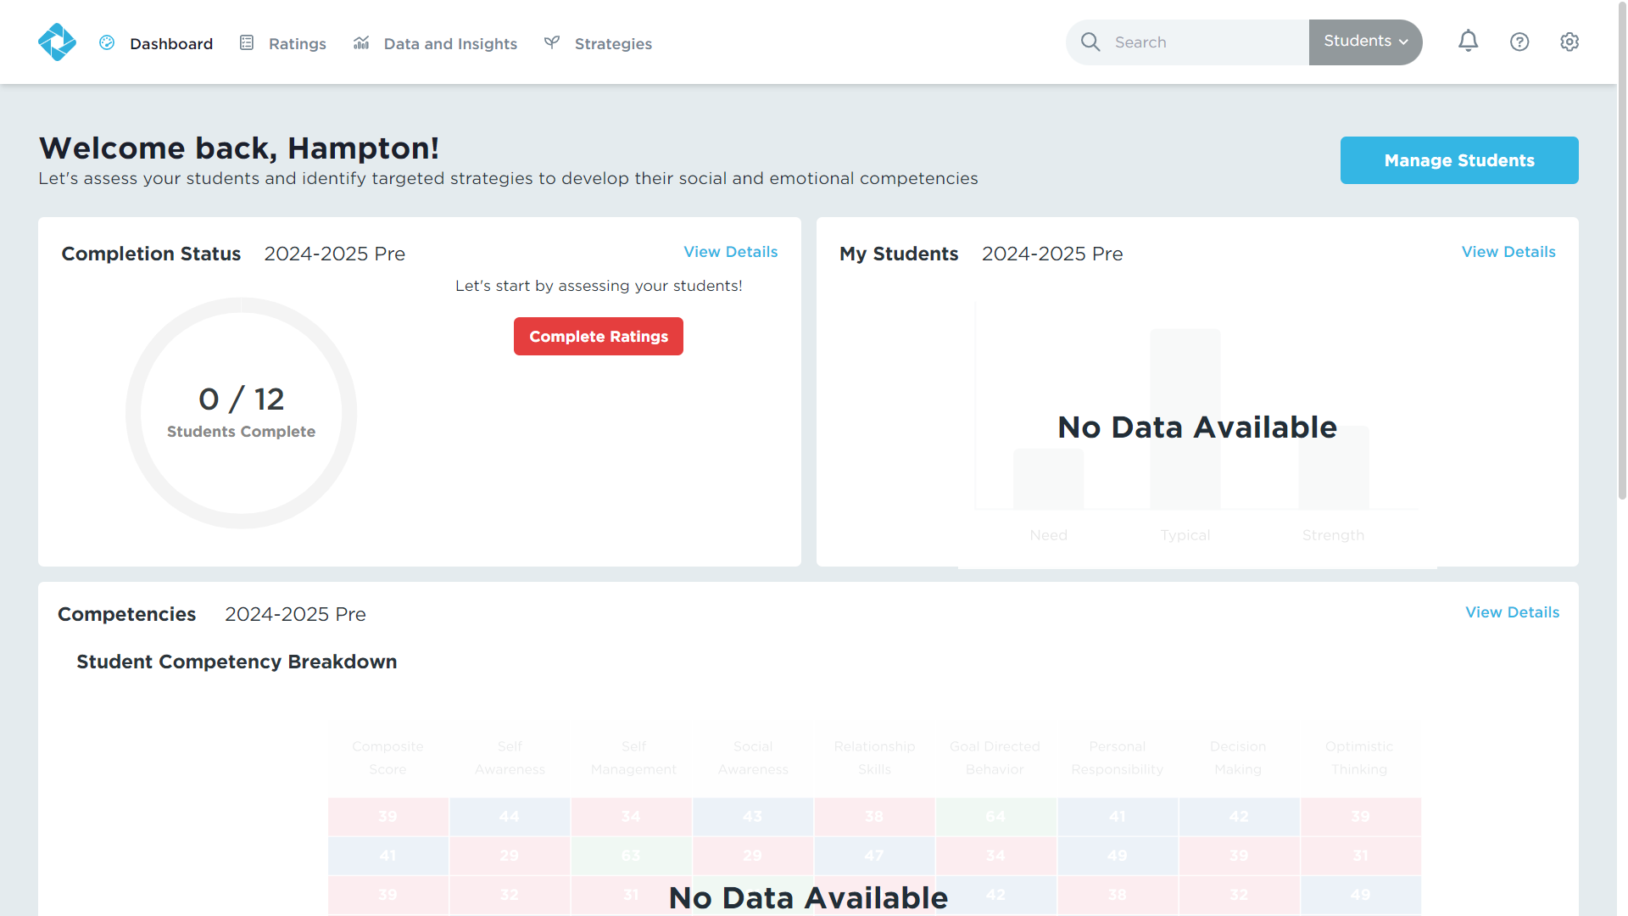
Ratings in the DESSA System
Notes:
Educators complete DESSA ratings within the DESSA System for their assigned roster of students. Your district will have your individual rosters integrated into this platform, so that when a rating window is open, you will have access to the list of students you need to complete ratings for. Let’s consider some best practices for completing these ratings.

Slide 22

Tips for Educators Preparing to Rate
Be intentional in observation.
Get familiar with the DESSA items.
Don’t overthink it.
Stick to your facts.
Plan your rating time:
  Kennett Consolidated School District staff will complete ratings at the end of this training
Notes:
Talking Points
First, it’s important to be intentional with observations. Doing this helps you to get to know your students better, puts on a positive lens to look for strength-based behaviors, and also helps you to understand more about social and emotional competence. It also allows for you to be less biased when observing your students.
Next, familiarize yourself with the DESSA assessment questions. The more you know about the assessment, the easier your intentional observation will be and the more accurately you will be able to complete your rating. You can download the DESSA-mini/DESSA you will use from the support portal. I will show you where to find it later when we look at the online system. Read it over, think about the behaviors it asks about, and when and how you might observe them.
Try not to overthink or overanalyze, especially when completing the rating for the DESSA-mini. Ask yourselves simple questions like this: What can students do on their own? How often do they do it? Your first response is often the most reliable response.
Stick to your facts. Raters will base their rating on the last 4 weeks with the student, not an interpretation or what they have “heard” about the student. Remember an intentional observation and accurate rating will be unbiased and based only on what the rater views during the observation period.
Finally, it’s important to plan your rating time. For your specific district, there has been time alotted today at the end of this training to complete your assigned ratings.

Slide 23
Let’s Practice a Rating
Imagine your school-aged self or someone you know. You can even imagine your favorite book character.
Answer each question according to that person’s behavior.
Notes:
Talking Points
Now it’s time to practice a rating! In just a moment, we will have an example of the DESSA on the screen.
You will imagine your school-aged self or someone you know. You can even imagine your favorite book character.
Answer each question according to that person’s behavior.

Slide 24
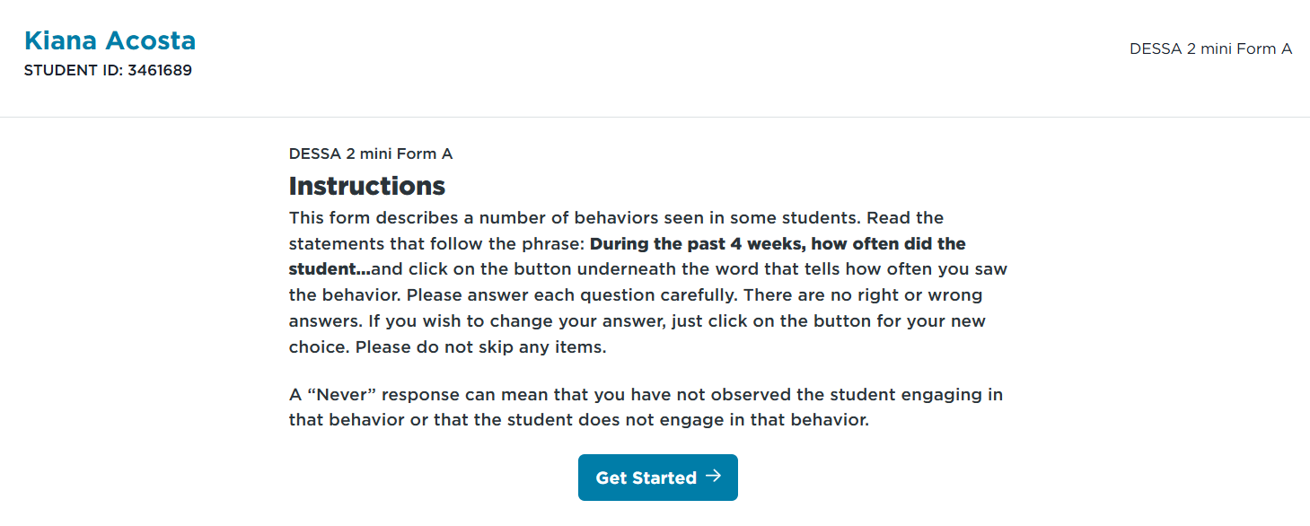
Let’s Practice a Rating
Notes:
First, the directions for each student will read:
(read directions on the screen)

Slide 25
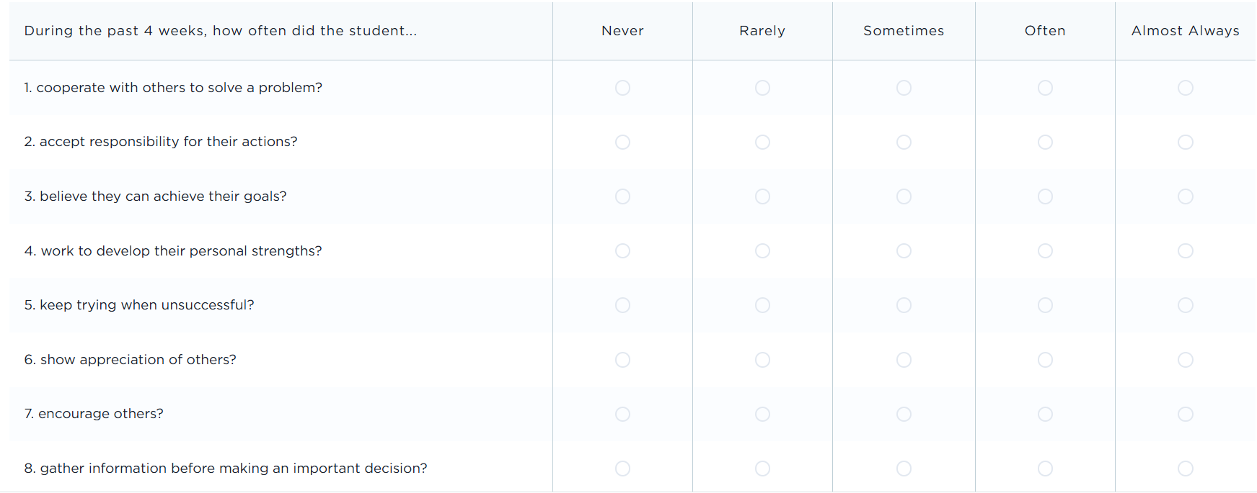
Let’s Practice a Rating
Notes:
Here’s the DESSA mini screener for our practice rating. The answer options are: Never, Rarely, Sometimes, Often, and Almost Always.
(Facilitation – read the items and allow time for attendees to “complete” their rating based on the person they have in mind.”

Slide 26
Pause:
Any “ah ha!” or additional questions after completing a practice rating?
Notes:
Before we switch gears and look at the online platform, let’s pause: are there any “ah ha!” moments or other questions that came up for you while completing this practice rating?

Slide 27
Student Example Scores
T-scores:
28-40
T-scores:
41-59
T-scores:
60-72
Notes:
Now that we’ve completed a practice version of the DESSA, let’s return to the scores that we talked about in the beginning of the training.
The results for a screener and full assessment will be available in real time, so as soon as a rater submits the assessment. You’ll see the t-score and one of the 3 categories – Strength, Typical, or Need for Instruction.
Let’s take a closer look at some student examples for each category.

Slide 28
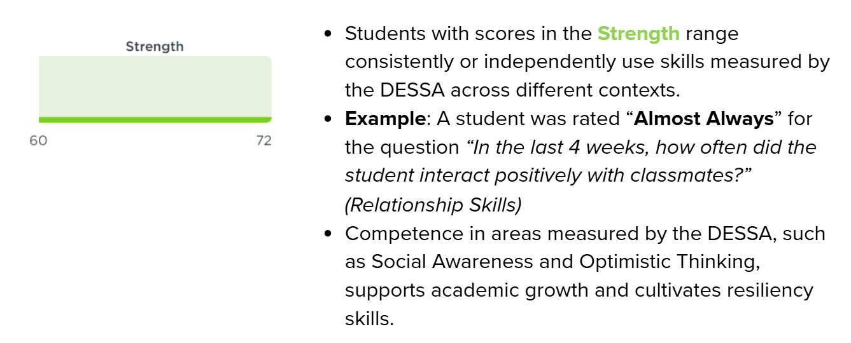
Student Example Scores

Slide 29
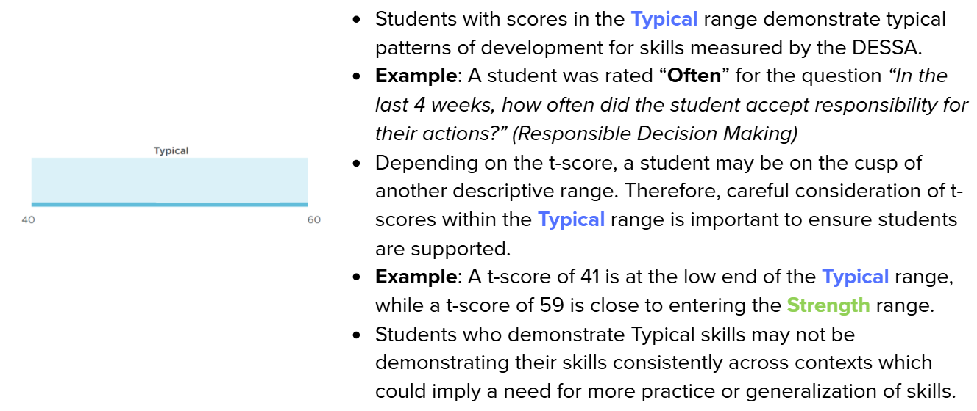
Student Example Scores

Slide 30
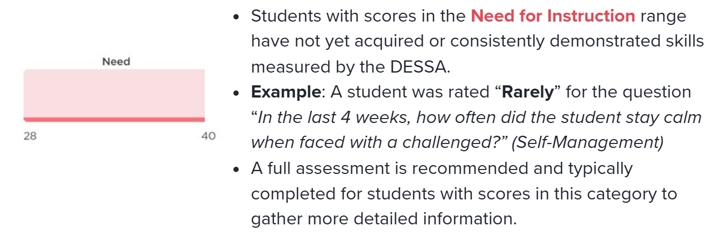
Student Example Scores

Slide 31

The Educator Portal
Notes:
From here, we are going to continue discussing the DESSA implementation through the online platform, the DESSA System Educator Portal. You may have already had time to explore this platform, but this is where everything lives for the DESSA – the ratings, the assessment results and data reports, instructional materials, and other resources.

Slide 32



User Roles in the DESSA System
Can generate and view all reports for the program, sites, and students.
Can generate and view reports from their site only.
Can generate and view reports for their assigned students.
Notes:
There are 3 different types of user access. The user access in the Educator Portal dictates what information is displayed on the dashboard and the types or amount of data viewable in your DESSA account.
First, the Program Administrator access is typically provided to district leaders or other staff responsible for setting up rostering, assessment windows, and rating assignments. Program administrator access will allow the user to view data for all sites within their district.
Next, the Site Leader access is generally provided to school or site-based leaders, including Principals and Assistant Principals, as well as other leaders that may need access to data across the campus, such as School Counselors, School Psychologists, Social Workers, etc. Site Leader access will allow the user to access to data for their specific site.
Finally, the Rater access is provided to educators that are assigned to complete ratings within the Educator Portal. The Rater access allows for educators to complete DESSA assessment for the students that they have been assigned to rate and view the data for their assigned students.

Slide 33
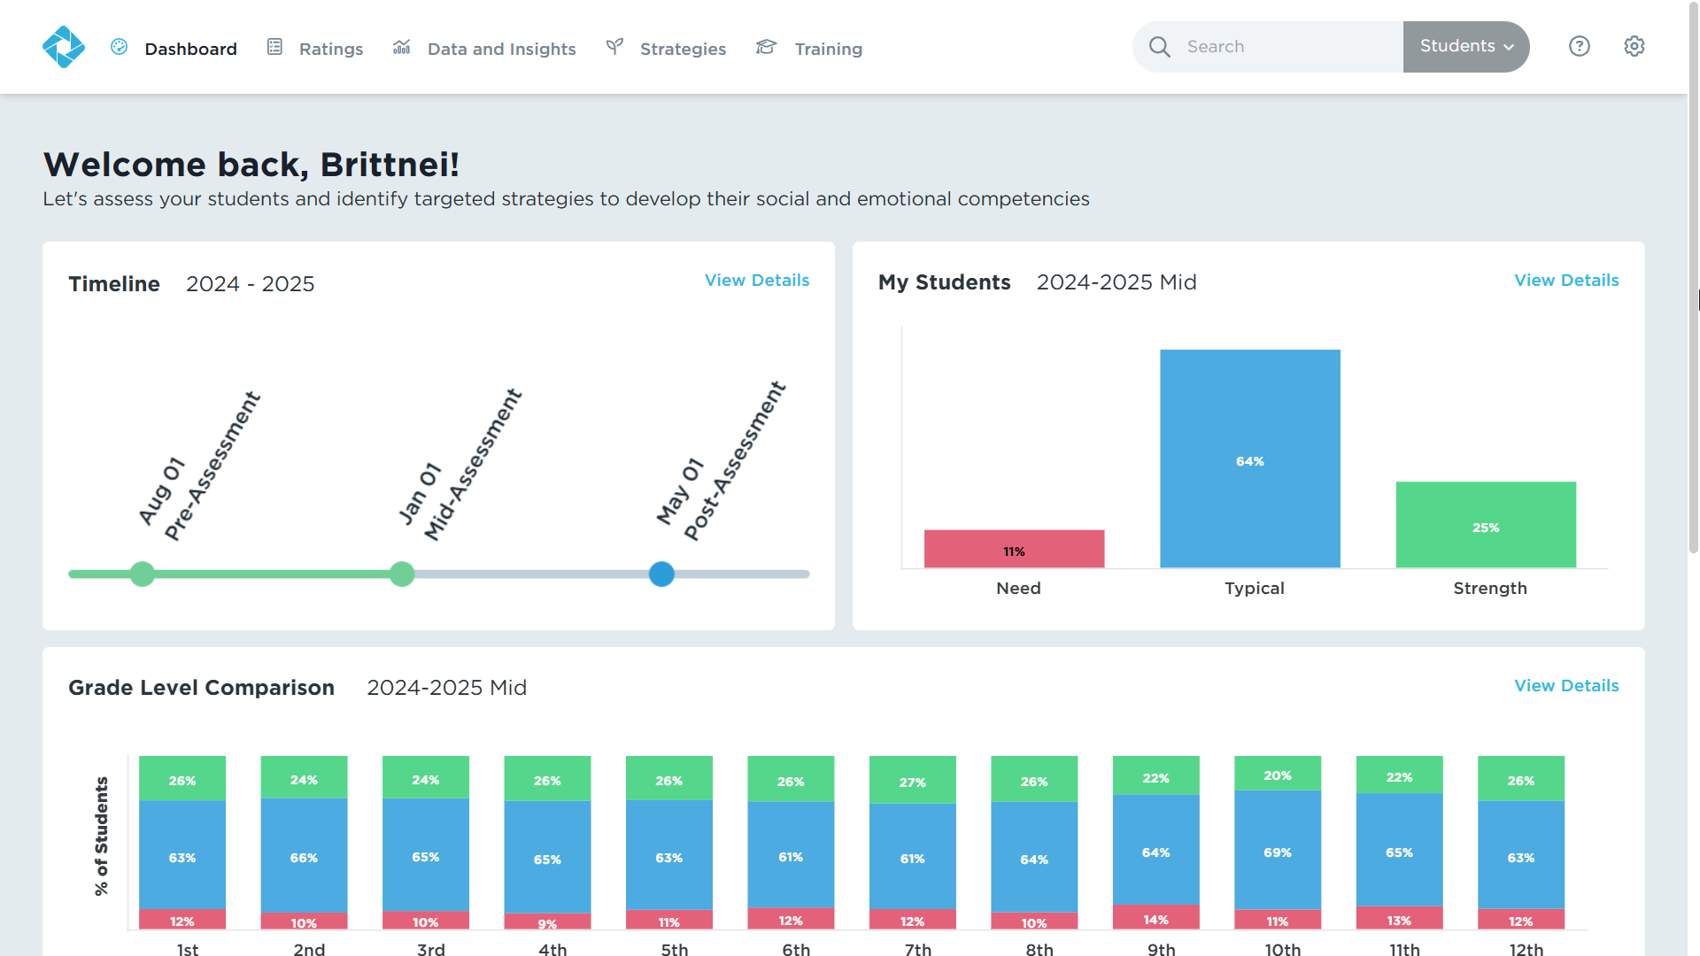
Site Leader Dashboard
Notes:
All users will land on their dashboard when they log into the Educator Portal. There 5 tabs across the top of the screen that we will navigate through.
When Site Leaders log in to their account, the dashboard will provide a quick snapshot of the rating window timeline, a preview of the My Students report, which displays an overview of student performance. On the bottom of the screen, they will see a grade-level comparison of all the grades in their building.

Slide 34
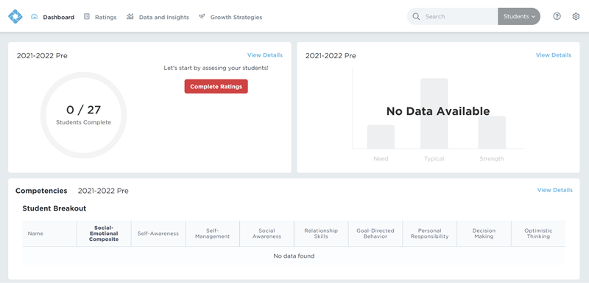
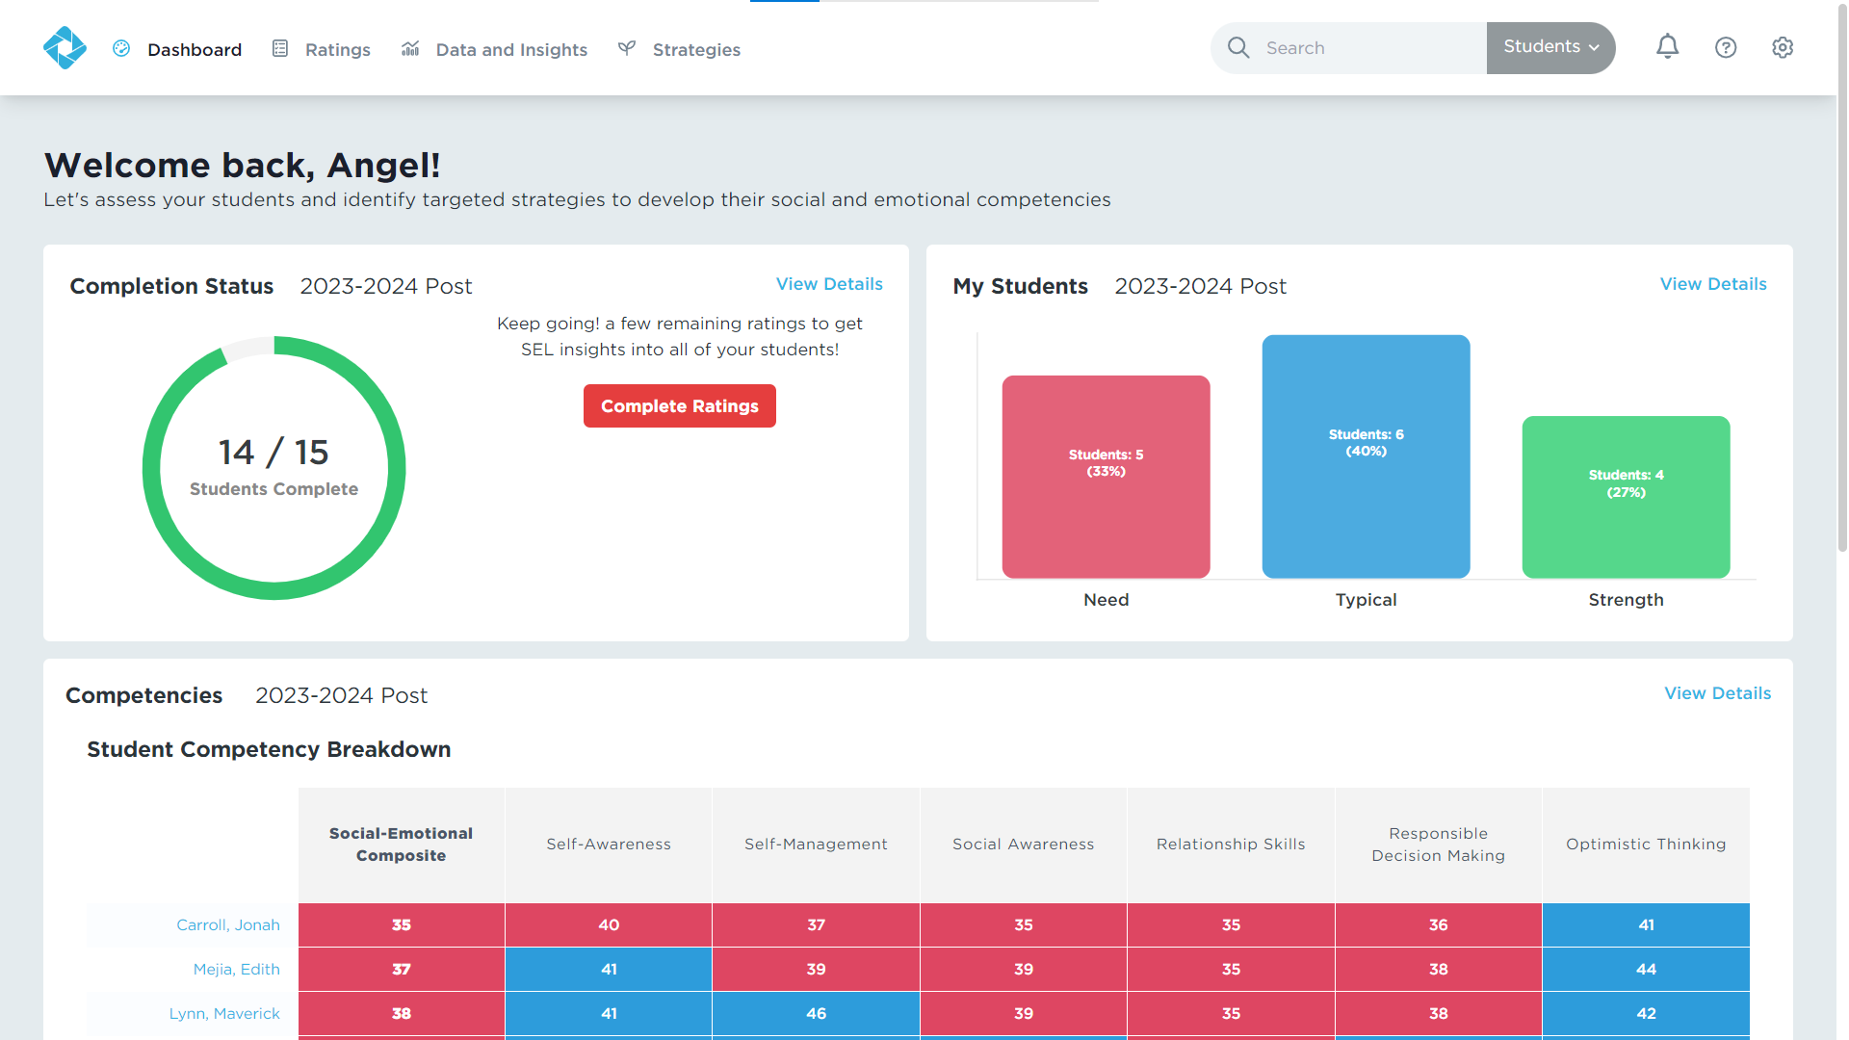
Educator Dashboard
Notes:
When a user first logs into the Educator Portal, the dashboard will likely appear blank since there won’t be any ratings completed yet and therefore, there won’t be any data in the system.
Once ratings begin to occur that data will populate in the system and be able to be viewed here as well in the data and insights tab, which we will go over in more detail in a few moments.
Educators will see a quick snapshot of the rating progress and data that has been collected based on the current or most recent rating window, an overview of the student performance on the right side, and a breakdown of student scores who received a DESSA 2 assessment at the bottom of the screen. Educators will only see data for the students in their classroom or on their roster.

Slide 35
Ratings Tab
Login to your Educator Portal.
Click the Ratings tab.
Notes:
Next, is the ratings tab. As an educator, this is where you will see the roster of students you have been assigned to rate. The system is very easy to use and should be relatively intuitive; just follow the prompts to complete the all the ratings for your students.

Slide 36
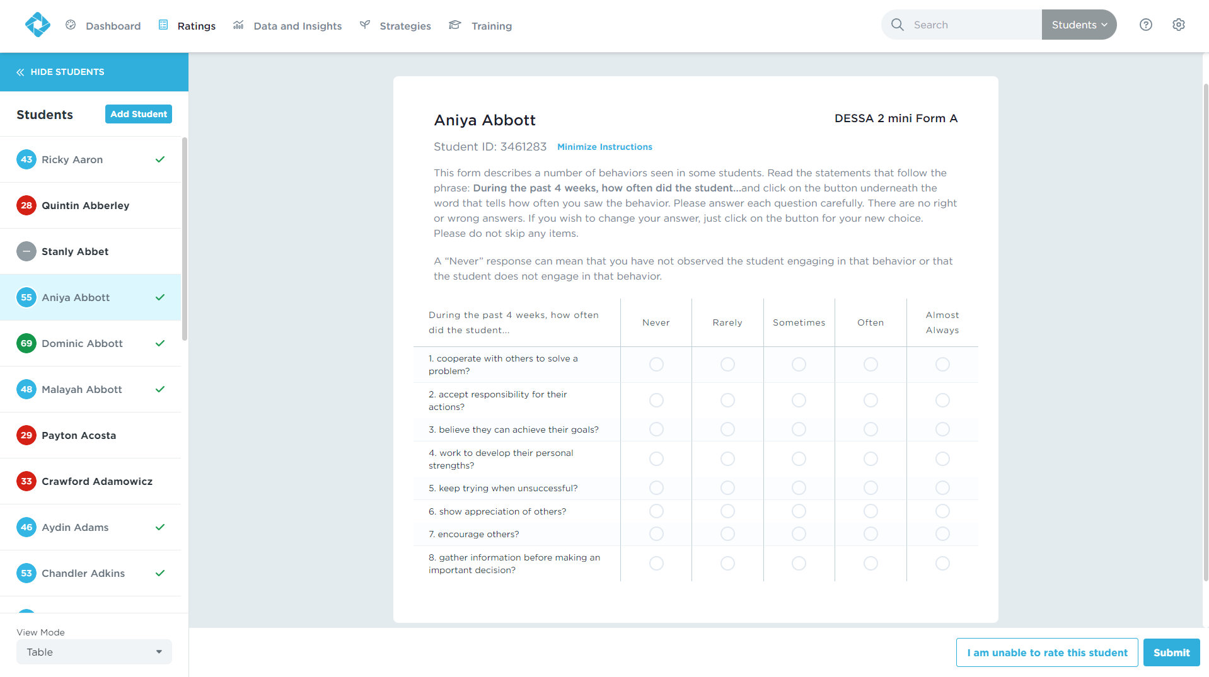
Ratings Tab
The Ratings tab shows the assigned roster of students.
Answer all DESSA 2 mini questions.
Educators can skip up to 2 questions on DESSA 2
Notes:
For the screener, you have to answer all 8 questions on a DESSA-mini. You can skip a question and come back to it; however, you cannot skip a question and complete the rating.
The circles on the left side of the student names indicate whether or not they’ve been rated, and the descriptive range in which they scored.
Gray signifies that they have not been rated, red means they have a need for instruction, blue means they scored in the typical range, and green means they scored in the strength range.
Students with a check mark do not need any further assessment.
Clicking on a student with a red circle and no check mark will automatically initiate a full assessment.
Clicking on a student with a blue or green circle and no check mark, will show you their T-Score and give you the option to progress monitor.

Slide 37
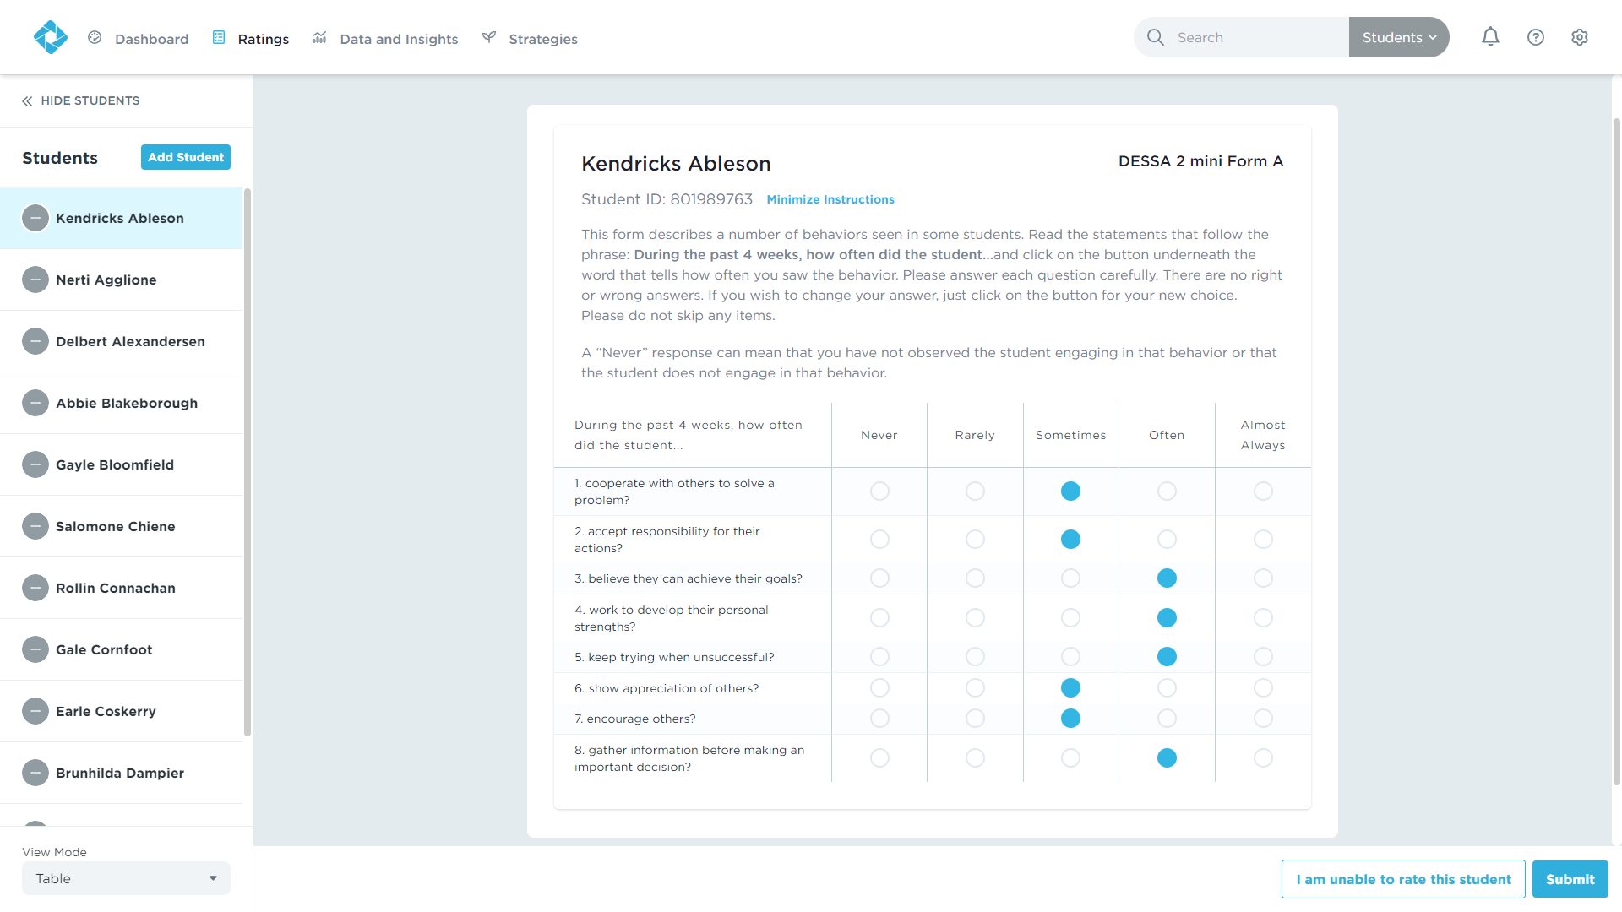
Ratings Tab
Select a student to rate.
Read the instructions.
Answer every question as honestly as possible.
Click “Submit”.
Notes:
As we’ve discussed already, you will complete the ratings to the best of your ability based on what you have observed for each student (not in comparison to other students). To complete a rating:
Select a student to rate.
Read the instructions.
Answer every question as honestly as possible.
Click “Submit”.

Slide 38
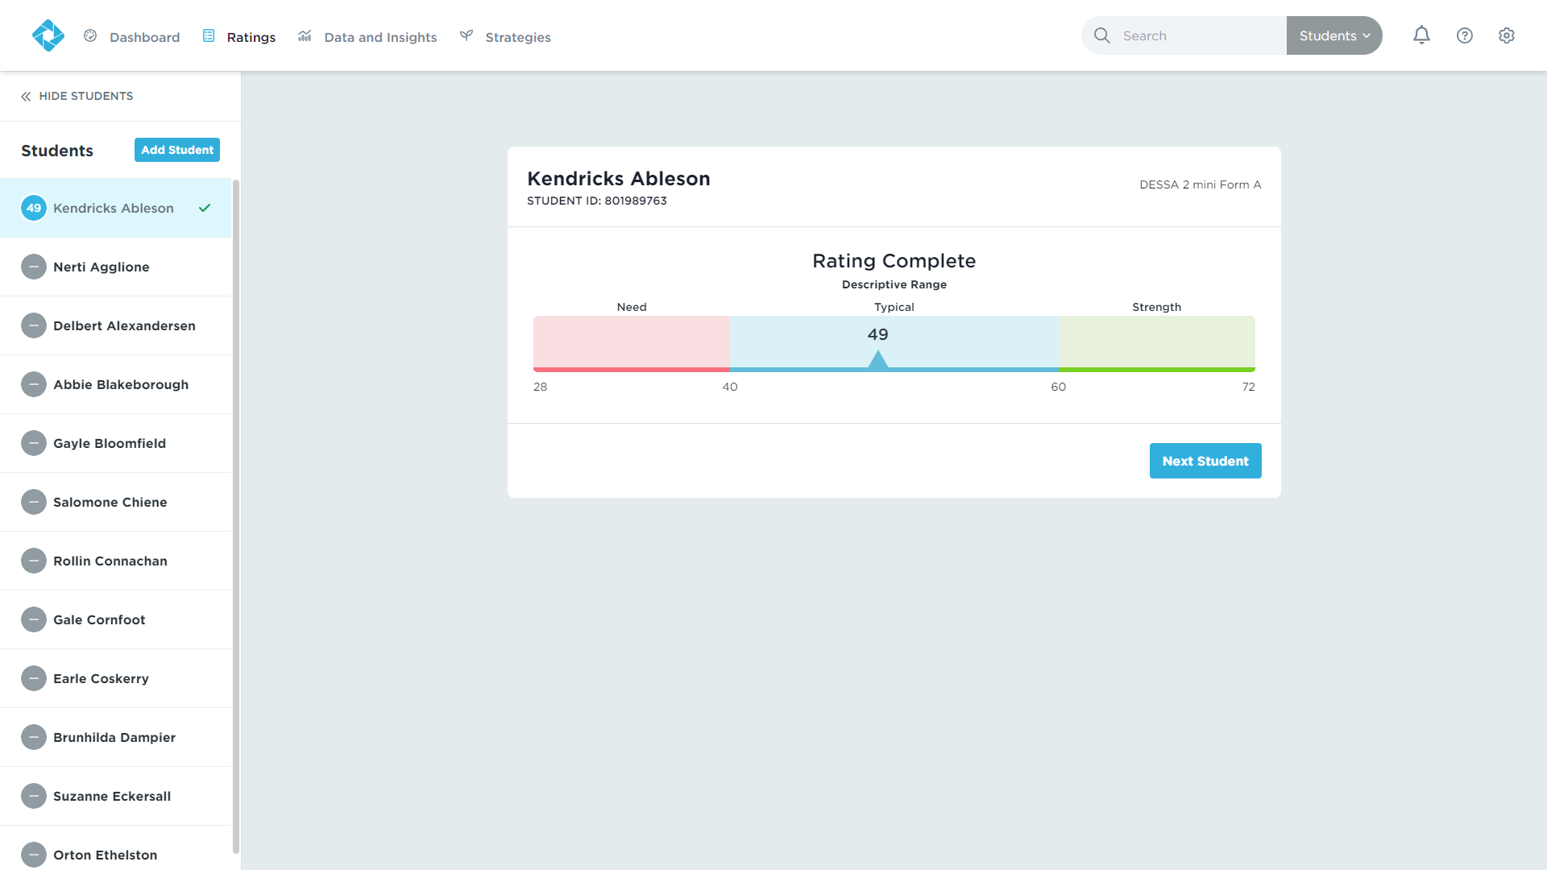
Ratings Tab
Results will be available immediately.
Continue rating the remainder of your student roster.
Notes:
Results for an individual student will be available immediately after submitting your rating.
Continue rating the remainder of your student roster.

Slide 39
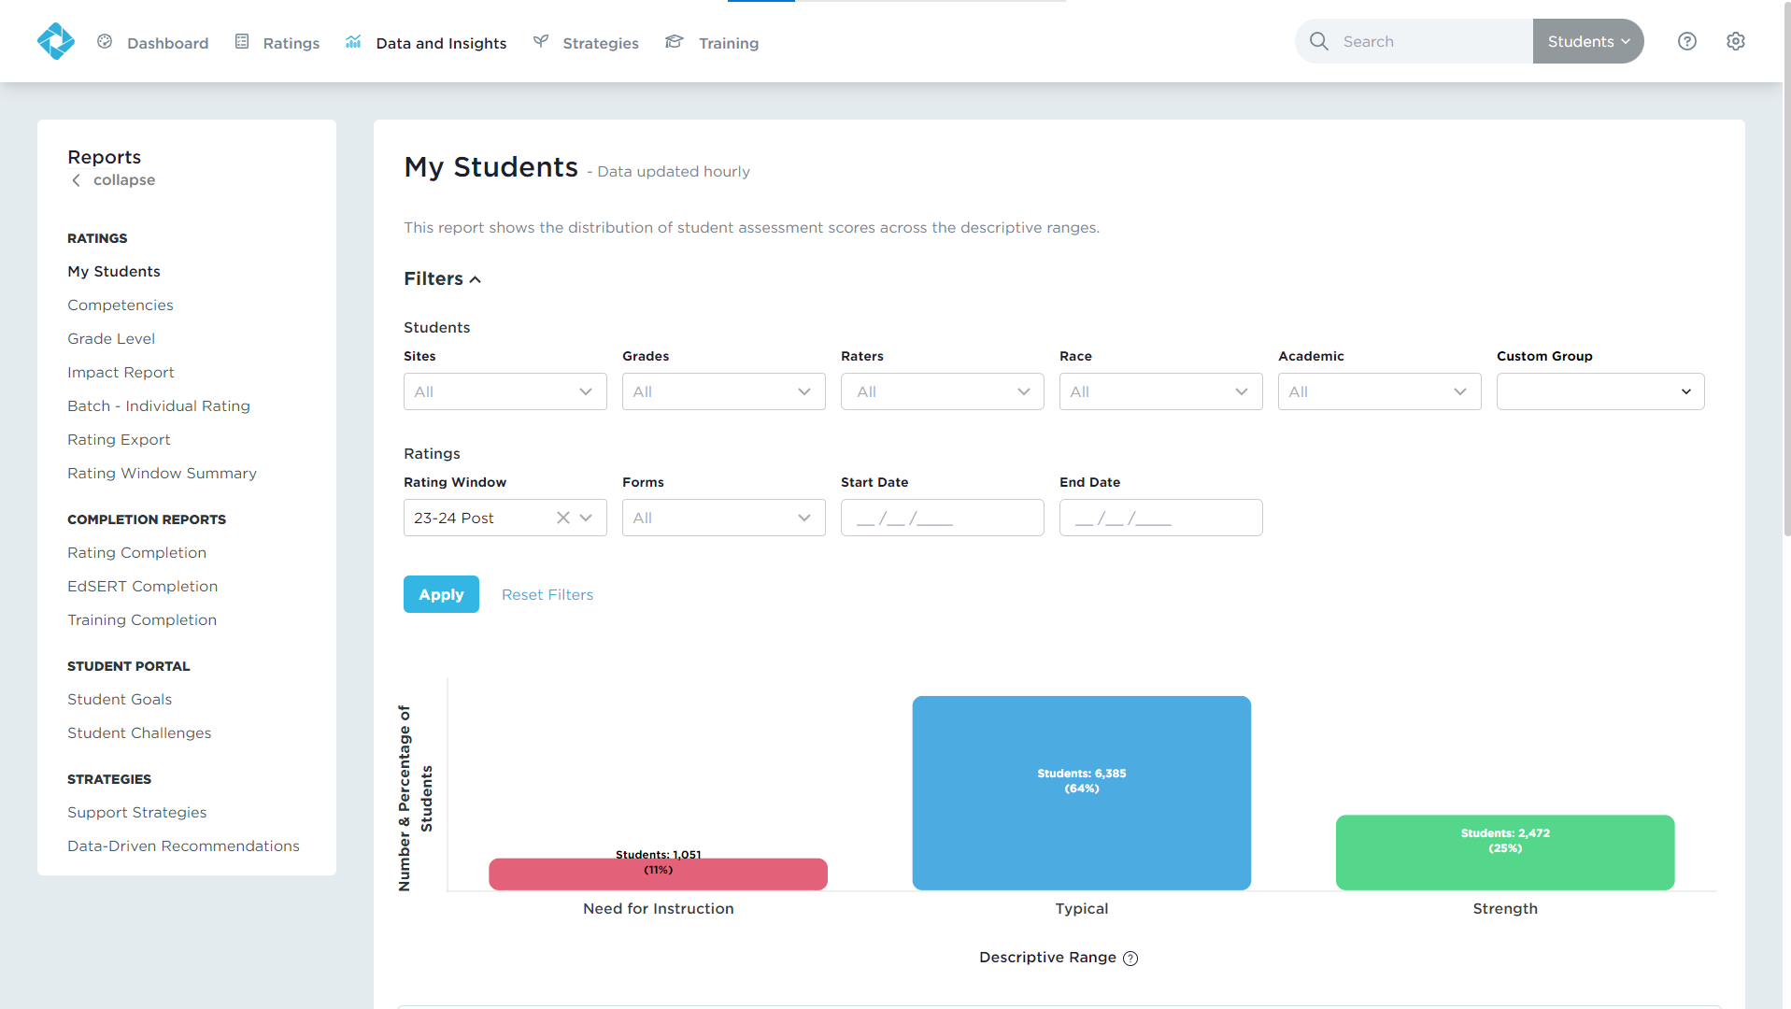
Data and Insights Tab
Real-time results
Interactive, filterable charts
Downloadable reports
Notes:
Data and Insights will give you just that: data from the DESSA assessments and insights into how you can support your students.
You’ll get Real-time results, Interactive, filterable charts, and Downloadable reports. You can use the filters to generate reports for subgroups of students or use the search bar to locate an individual student by typing in their name or student ID.
We wont be going into the details of all the Data and Insights reports during this session – that is for another training after you have collected your ratings data.

Slide 40
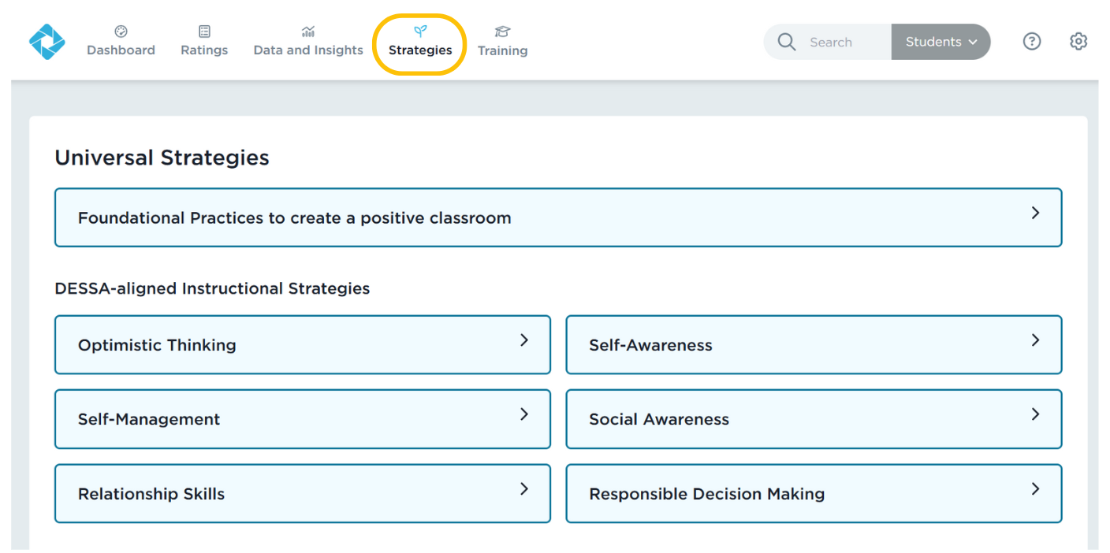
Strategies Tab
Notes:
Next over on the tabs list is the Strategies tab.
The DESSA System includes lessons, activities, and resources for data-driven instruction and intervention. Under the Strategies tab, there are a variety of materials available to all users:
Foundational Practices: The Foundational Practices are best practices that are easy to implement consistently at the universal level. These activities create a supportive and positive learning environment throughout a school and within a classroom.

Slide 41
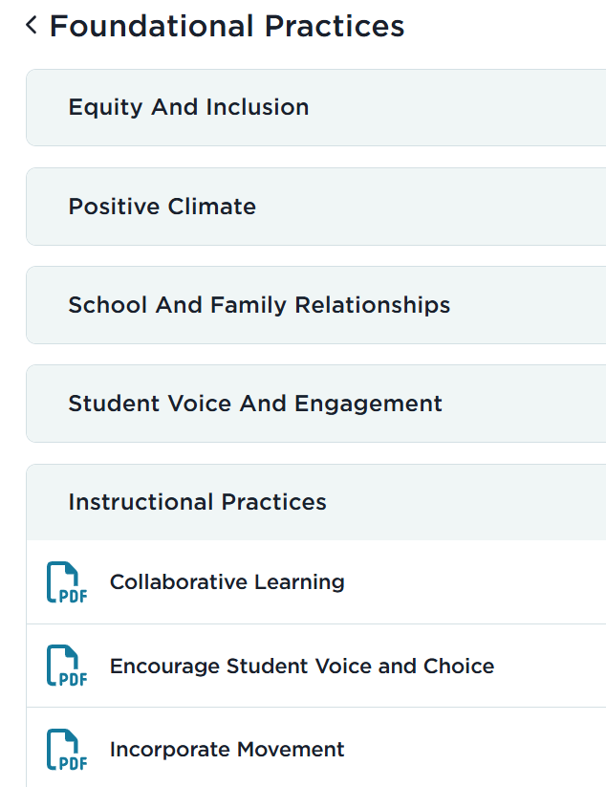
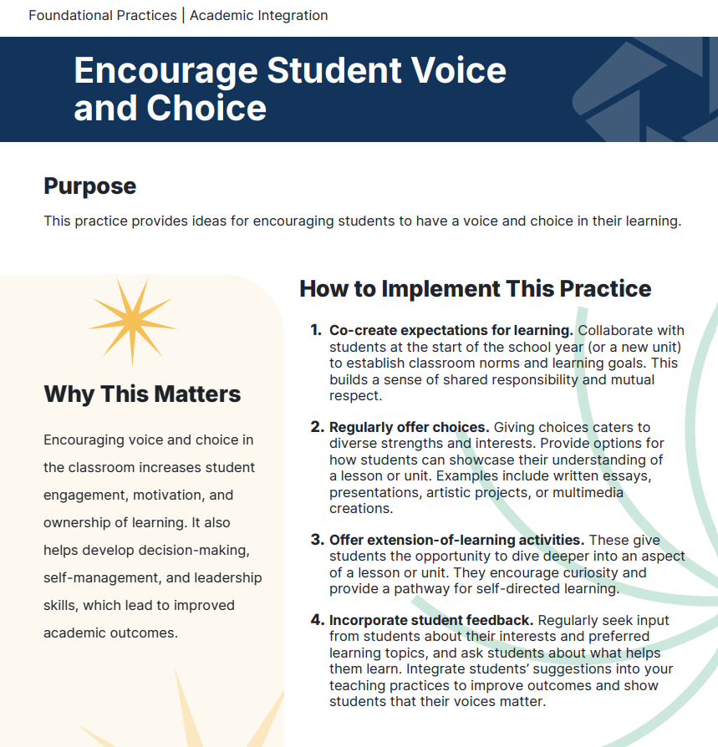
Foundational Practices
Notes:
Foundational Practices: The Foundational Practices are best practices that are easy to implement consistently at the universal level. These activities create a supportive and positive learning environment throughout a school and within a classroom.

Slide 42
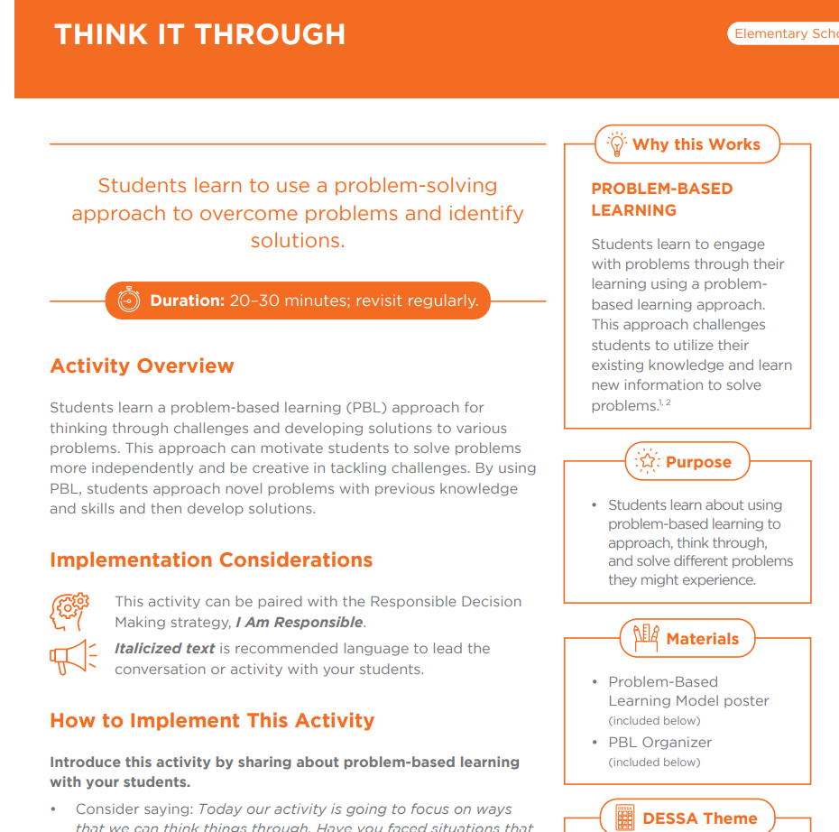
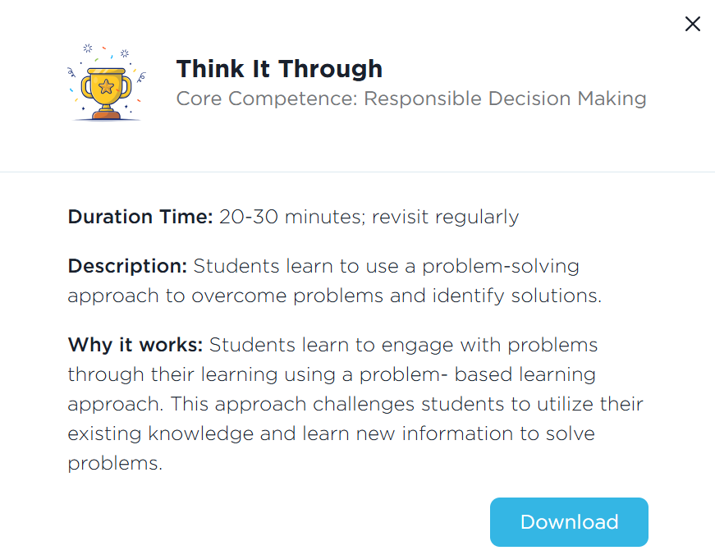
Strategies
Notes:
Strategies: These lessons are research-based, DESSA-aligned materials that provide direct instruction of social and emotional skills. The Strategies are designed for universal instruction and include step-by-step directions for facilitation, along with extension activities and modifications for differentiated instruction. Student and educator reflection prompts are included in each strategy.

Slide 43
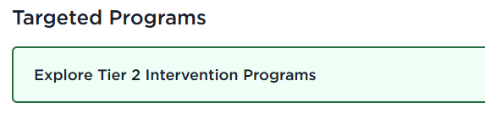
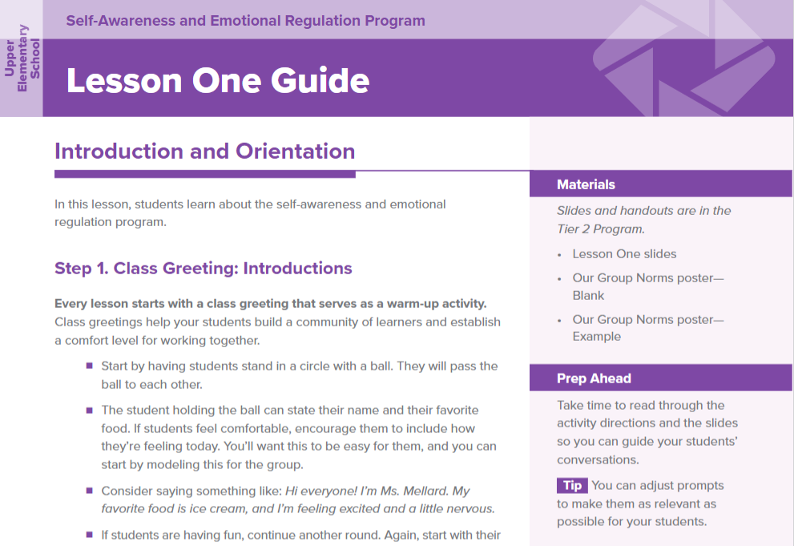
Tier 2 Intervention Programs
Sequenced, intensive lessons to develop student resilience skills with a focus on:​
Self-Awareness and Emotional Regulation
Social Awareness and Behavior Regulation
Social and Emotional Skill Development integrated with Academic Intervention
Responsible Decision Making
Relationship Skills
Notes:
Talking Points
The Tier 2 Intervention Programs consist of five multi-week programs designed for targeted, small group instruction for students who need intensive skill building.
Lessons within the Tier 2 Intervention Programs are designed to be delivered in a scope and sequence that builds skills through repeated practice and active engagement.
All of the intervention programs are available within the DESSA System, also under the Strategies tab.
The programs are grouped by grade bands: Early Elementary, Upper Elementary, Middle School, and High School.

Slide 44
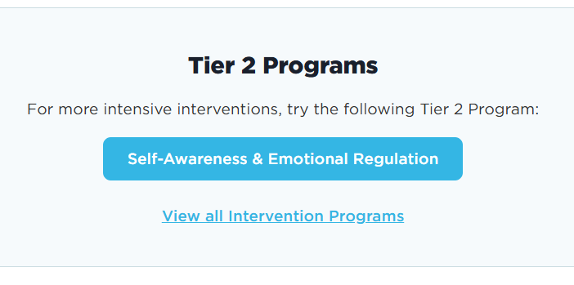
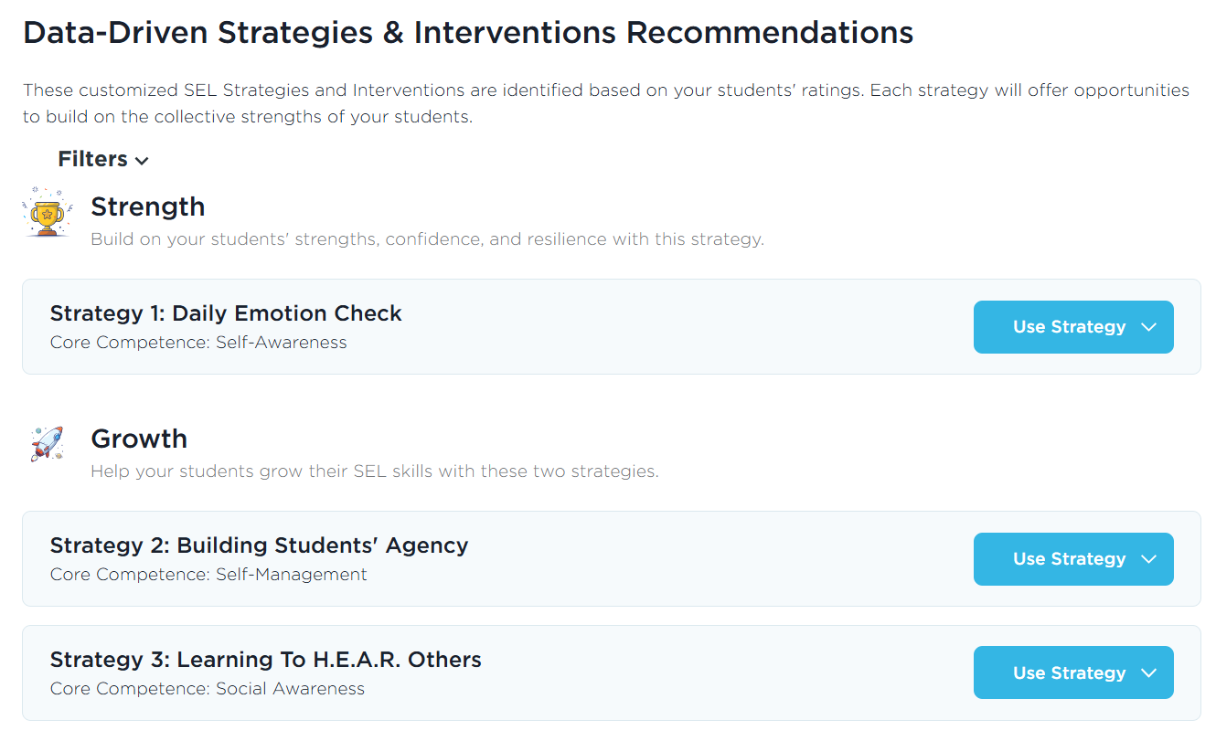
Data-Driven Recommendations
Notes:
The one report we do call out in this session is the Data-Driven Recommendations. This report is located under the Data and Insights tab and it connects your DESSA results to the strategies resources under the Strategies tab. It takes the “guess work” out of it for you – based on your data, it will recommend DESSA-aligned instructional materials to use with your students.
Once you generate this report for your students, three strategy recommendations will be presented: The first strategy is based on students' strengths, and the second and third strategies will help you build students' growth in lower-scoring competencies. You can view the overview of the strategy lesson and download a PDF copy. Then it will also recommend a specific Tier 2 Intervention Program to use with your students (that’s the longer, full scope/sequence program), again based on their DESSA results.

Slide 45
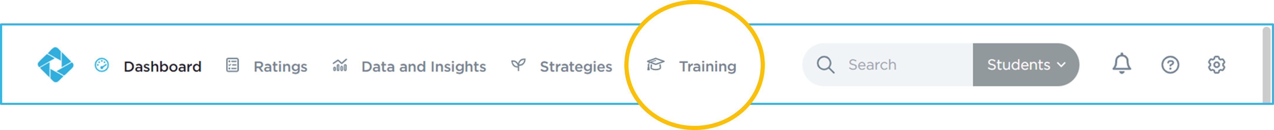
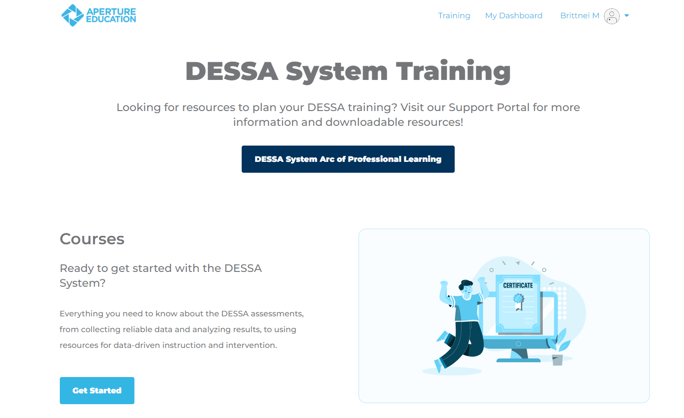
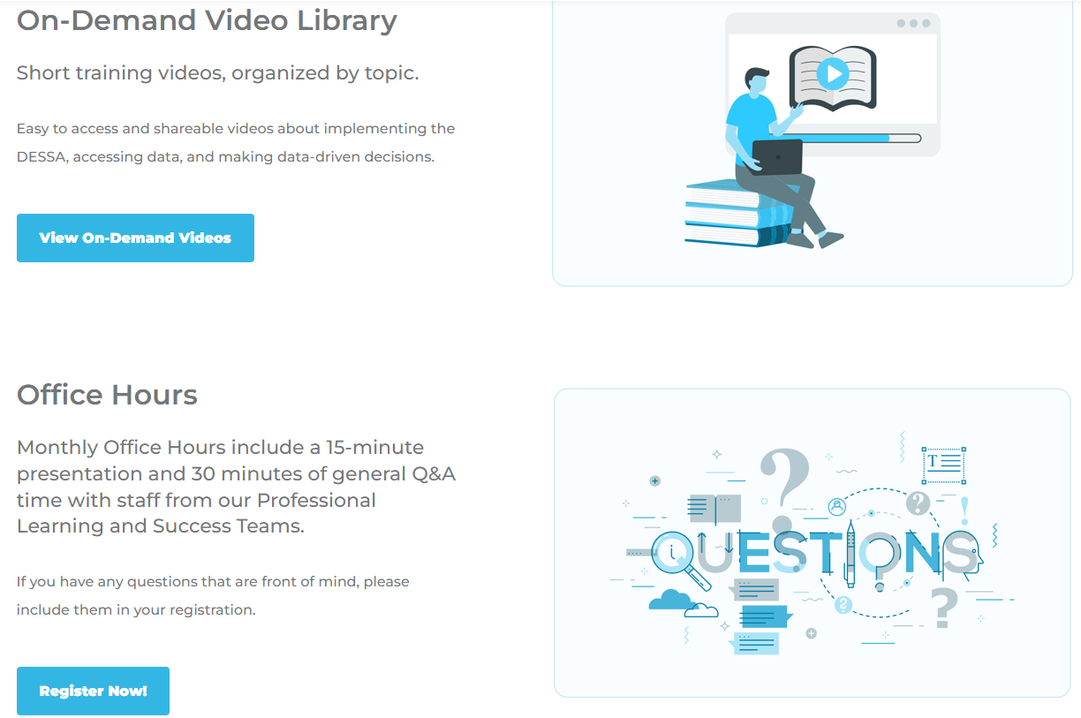
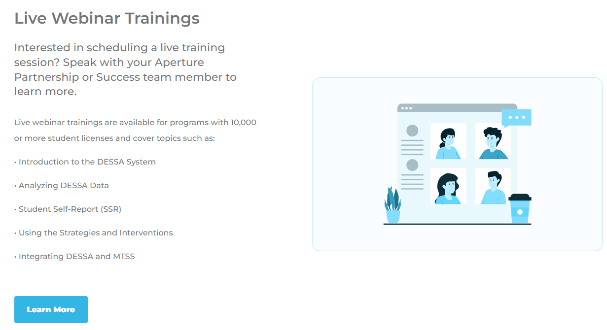
Training and Support Portal
Notes:
Talking Points:
The last tab to review within the Educator Portal is the Training Tab. The Training tab allows you to choose more learning options. There are self-paced courses for individuals who are new to the DESSA or those who just need a refresher.
The On-Demand Video Library provides short self-service videos that help users with DESSA implementation, and we offer live monthly office hours on pre-selected topics as well.
You can also register for monthly office hours with our DESSA team under the Training tab.
Additionally, the Educator Portal has an extensive Support Portal, complete with articles, resources, templates, and information for all-things DESSA implementation. To access the Support Portal, click on the circle with a question mark in it, always located in the top right side of the Educator Portal.
The Support Portal is open 24/7, offering resources to help guide users through the DESSA system.

Slide 46
Wrapping Up
Any remaining questions to address?
Notes:
Talking Points
We are at the point where we wrap up for this training session – we have covered a lot and want to make sure we can address any remaining questions that you may have before we offer an optimistic closing prompt and your next steps.
(allow time for final questions)

Slide 47
Optimistic Closure:
What are looking forward to with implementing the DESSA?
Notes:
Talking Points
In thinking about the hopes you identified at the beginning of today’s session and using a strength-based approach, What are you looking forward to most about implementing the DESSA assessment and resource? You can add your response in the chat or feel free to come off mute.
[Provide think time]

Slide 48
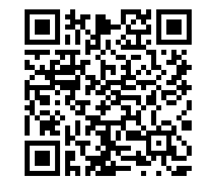
Exit Ticket: Complete Training Survey
Log in to your Educator Portal to complete your DESSA ratings:
Thank you!
https://apertureed.qualtrics.com/jfe/form/SV_250ioEurFXBmBUy
Notes:
Talking Points:
Thank you so much for your time and attention today! We have reached the end of our training for today. We hope to see your program back for the “Part 2” with the “Analyzing SSR Data” training after your students have completed their ratings.
Your exit ticket is to complete the DESSA Training survey. I’ll add the link in the chat now and you can also use the QR code on screen. https://apertureed.qualtrics.com/jfe/form/SV_250ioEurFXBmBUy
Once you complete that, you can hop off the Zoom. I’ll remain on here for a few more minutes in case there are any questions.

