Slide 1

Introduction to the DESSA Student Self-Report (SSR) Student-Completed Assessment
Notes:
Facilitator Reminders:
Project the PPT in Presenter Mode
Open any other apps or documents that you will need for the session, such as the DEMO (Educator and Student Portal)
Shut down all other applications and browser windows
Put Slack and phone/other devices on do not disturb to avoid interruptions
RECORD SESSION TO THE CLOUD
Talking Points:
Hello and welcome to Introduction to the DESSA Student Self-Report (SSR) training. This session will provide an overview of the student-completed version of the DESSA assessment.

Slide 2
Goals for Today’s Session
By the end of today’s session, you will be able to:
Identify key components of the DESSA SSR.
Demonstrate best practices for collecting ratings data and interpreting the results.
Explore key features of the Educator Portal and the Student Portal.
Notes:
Talking Points
Our goals for today will be to:
Identify key components of the DESSA SSR.
Demonstrate best practices for collecting ratings data and interpreting the results.
Explore key features of the DESSA System online platforms– the Educator Portal and the Student Portal

Slide 3
Session Structure
Introductory overview focused on the assessment and platforms
Put any questions in the chat for your leaders to address
Logistics:
Session Length: 60 Minutes
Halfway through, we will take a brief break
Notes:
Talking Points
In terms of the session structure today, this training is meant to be an introductory session. We will be focusing on the products – the DESSA assessment and the platforms for educators and students. Specific implementation details for your district will not be shared, as those details will come directly from your leadership team (if they haven’t already).
With that said, we know there will be questions and you’re welcome to add those to the chat as we go through the session. If we can answer them, that is helpful for the whole group and if we can’t, we will defer to your leadership team. Either way, it helps to have your questions out there in order to make the most of this implementation.
The training itself is 60 minutes. Halfway through we will plan to take a brief break.

Slide 4
Today’s Agenda
Here’s how we’ll spend our time together today:
DESSA Overview: SSR
Student Portal features
The Educator Portal
Optimistic Closure
Notes:
Talking Points
Let’s talk through how we’ll spend the rest of our time together:
We’ll share an overview of the DESSA. Again today’s training focuses on the version that students complete, called the Student Self-Report or SSR (for short)
Then we will highlight the different features for student-driven learning within the Student Portal
We’ll walk through an overview of the Educator Portal, including the available data reports and instructional resources
And finally, we’ll close out with an optimistic closure and opportunity for feedback.

Slide 5
Opening Reflection
Strength-Based Mindset:
What has gone well so far since the start of the school year?
Notes:
Talking Points
Let’s start today by centering in a strength-based mindset.
It’s been a few months since the start of the school year, let’s reflect on the semester. I invite you pause and think about the successes so far – no matter how big or small. What has gone well so far since the start of the school year?
Please take a moment to add something in the chat, and we would love to hear from a couple folks by coming off mute to celebrate some successful call outs!
(offering think/participation time)
As we discuss the DESSA today, it will help to keep this strength-based approach front of mind, as the DESSA is rooted in this same approach. Whether this training is a refresher for you or it’s an introduction to the DESSA, approaching implementation with a solutions-based lens is key!

Slide 6

Video: DESSA System Overview
Notes:
Talking Points
We are going to start with a short video about the DESSA and the online platform where it is located, called the DESSA System. After the video, we will break down the key details about the SSR assessment and its scores, so for now just sit back and watch this high-level overview.
(Press play- video embedded)
If needed: Online Video Link: https://go.screenpal.com/watch/c0e0F5V4PMQ?redirect=true
Video Run time: 3:08

Slide 7
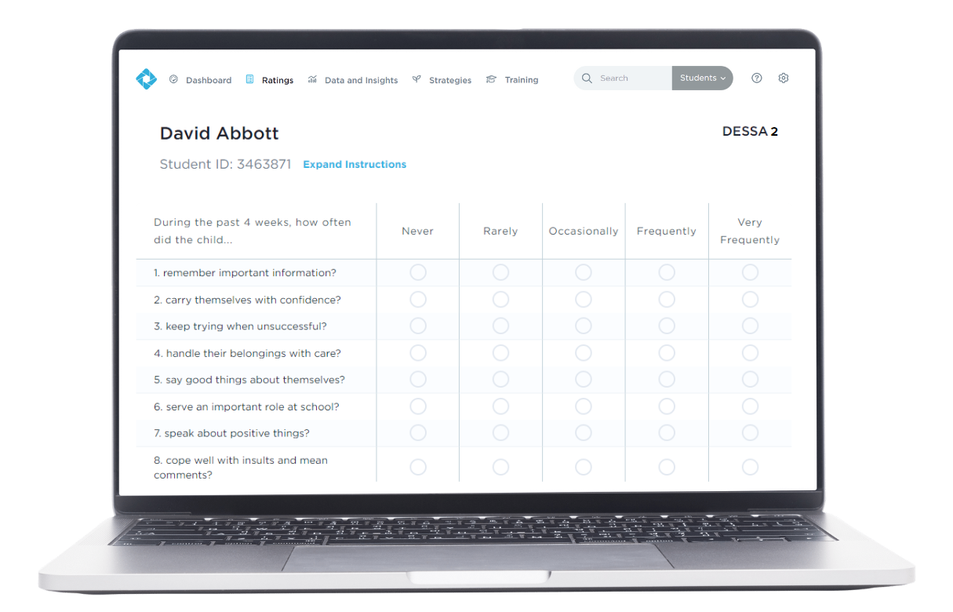
What is the DESSA?
An evidence-based social and emotional competency assessment to support student growth.
Notes:
Talking Points
That video gave us a great overview of the different components of the DESSA System. In these next few slides, we will expand on those areas, starting with: What is the DESSA?
In short, the DESSA is an evidence-based social and emotional competency assessment to support student growth, including a screening tool and a full diagnostic assessment that educators complete for their assigned students.
The DESSA is a behavior rating scale completed by educators and assesses social and emotional competencies in students grades K–12th. There are versions that are completed by educators and the student self-report (SSR) is completed by middle and high school students. DESSA ratings, data reports, and intervention resources are located within the online Educator Portal.

Slide 8
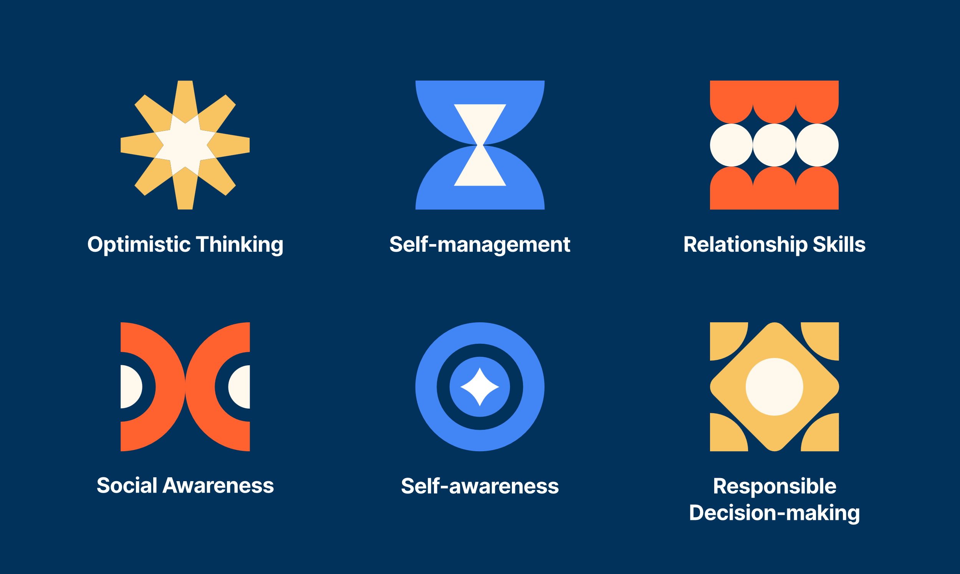
What does the DESSA measure?
Notes:
Talking Points
Let’s now go one level deeper. The DESSA measures 6 overall competencies: Optimistic Thinking, Self-Management, Relationship Skills, Social Awareness, Self-Awareness, and Responsible decision making. The DESSA was developed based on resilience theory, which is why the Optimistic Thinking competency is included in this assessment. The goal is to foster protective factors and resilience in students through skill strengths. If you’re interested in reviewing the exact definitions of these competency areas, we’ll drop a link in the chat for a Support Article that provides more detailed information. (add link in chat - https://info.apertureed.com/en/hc/dessa-ssr-scales-and-associated-items) For now, let’s look at the next slide that highlights how these areas can support student success.
---------------------------------------------------------------------------------------------------------------------------------------------------
(For reference – do not have to review these areas in detail):
Optimistic Thinking: the belief and demonstration of confidence, hopefulness, and positive thinking regarding oneself, others, and one’s life situations in the past, present, and future.
Self-management: the ability to manage emotions and behaviors across different situations and environments and to demonstrate agency as one works to set and achieve personal and collective goals.
Relationship Skills: the abilities to establish and maintain healthy and positive relationships including effective communication, collaborative problem-solving, negotiating conflict, and demonstrating helpful and supportive behaviors.
Social Awareness: the understanding of social norms for behavior; the ability to empathize with, respect, and take the perspectives of others; and the feeling of connection and belonging with family, peers, schools, and community groups.
Self-awareness: the ability to understand emotions, thoughts, and values and how they influence one’s behavior; recognize strengths and limitations; and develop healthy identities and a sense of purpose.
Responsible Decision-making: the ability to make careful, reliable, and constructive choices about personal and social behavior that are appropriate across diverse situations; to consider the personal, social, and collective impact of one’s actions; and to demonstrate curiosity and an open-mindedness to learning.

Slide 9
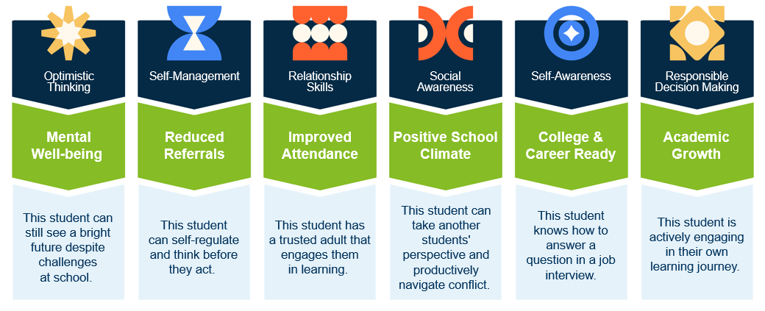
These skills are critical for students to be successful inside and outside the classroom
Reflect: Which of the competencies is resonating with you most right now given your work with students and families?
Notes:
Talking Points
These skills – Optimistic Thinking, Self-Management, Relationship skills, etc - are critical for students to be successful inside and outside the classroom.
They are everyday observable behaviors that contribute to being a successful student, a successful classmate, a successful employee, volunteer, neighbor, human being.
When students able to demonstrate these skills consistently and independently, we see positive results. Examples for each competency are listed in the green section of this image, and the blue text box below. For example, Optimistic Thinking supports mental well-being. A student can still see a bright future despite challenges at school. Self-Management skills support a reduced amount of referrals because students can self-regulate and think before they act. Relationship skills contribute to improved attendance. Take a minute or so here to review the competencies and impacted areas on listed on this slide.
(Click) Reflect: As you review this slide, I encourage to reflect on which of the competencies is resonating with you most right now given your work with students and families?

Slide 10
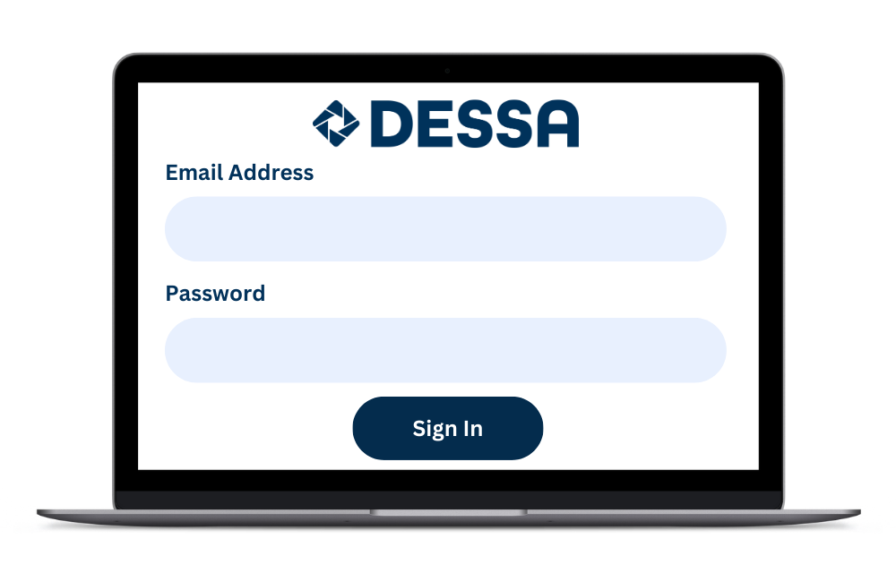
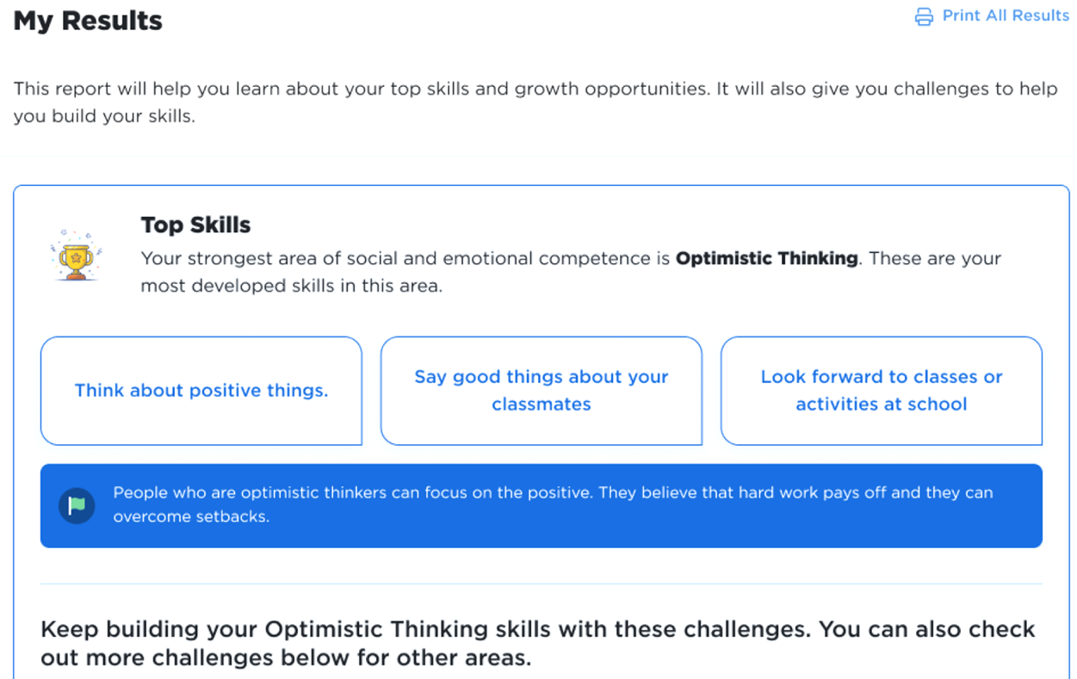
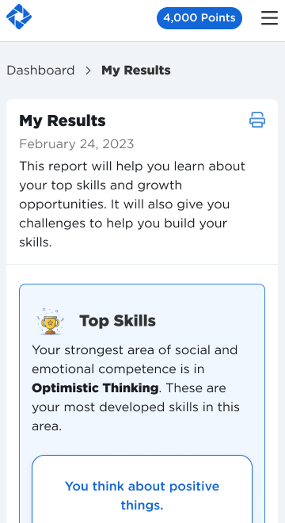
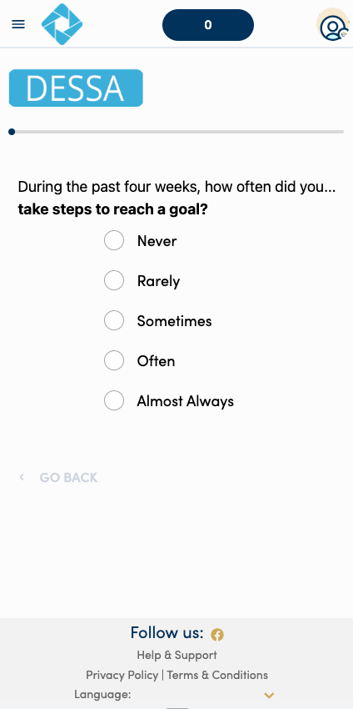
DESSA Student Self-Report (SSR) (Student- Completed)
Data & Insights:
Educators access
SSR data and view students’ progress
Assessments are completed by students in the Student Portal, and there are opportunities for challenges and goal setting.
Notes:
Talking Points:
Let’s now talk more about the SSR version of the assessment.
The DESSA Student Self-Report (SSR) is completed by students in grades 6-12. It is a self-assessment geared for middle and high school students to rate themselves on social emotional competencies and takes most students less than 7 minutes to complete.
Students complete assessments in their own Student Portal and they’re able to use that data to set goals or select challenges (activities) where they can harness and grow their social and emotional skills.
Educators can view the data or any progress that students are making in their Educator Portal.

Slide 11
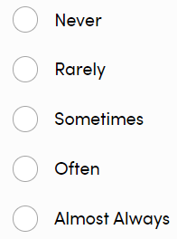
Sample Student Self-Report Questions
Do your best to rate yourself.
I can recognize my own strengths. (Self-Awareness)
I stay focused despite a distraction. (Self-Management)
I make others feel welcome or included. (Social Awareness)
I am able to resolve conflicts positively. (Relationship Skills)
I gather information before making an important decision. (Responsible Decision Making)
I believe I can overcome setbacks. (Optimistic Thinking)
Answer Selection Options
Notes:
Talking Points
Here are some examples of the items (questions) on the SSR.
As you can see, all of them are formed into “I” statements because this helps students evaluate themselves.
You’ll also notice that all of the items are asking students how often they are engaging in positive prosocial skills.
Students then select one of the frequency options based on how often they feel they demonstrate that particular behavior or skill.
I’ll read through these examples for each of the competency areas -- (read examples on the slide)

Slide 12
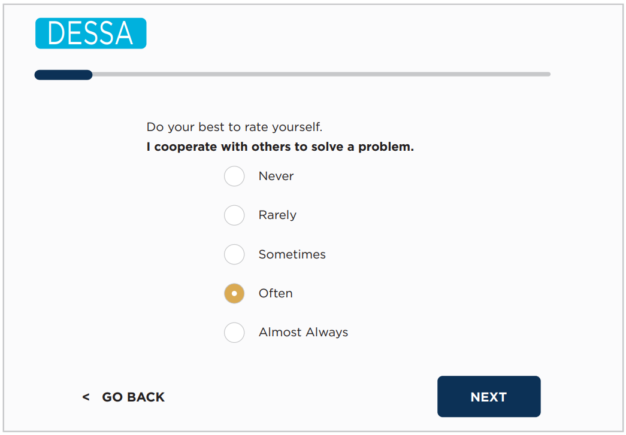
Sample Student Self-Report Questions
Notes:
Talking Points:
The questions are presented to students one at a time. Students can go back to change an answer if they need to and their progress is shown in the bar at the top. When they are finished, there is a “Submit” button that ends the assessment.
The directions “Do your best to rate yourself” will always be at the top, with an “I” statement related to a specific skill below.
Below the “I” statement, the student has the same set of frequency options to choose from for each question. The example on screen shows the student selecting “often” for how frequently they cooperate with others to solve a problem.

Slide 13
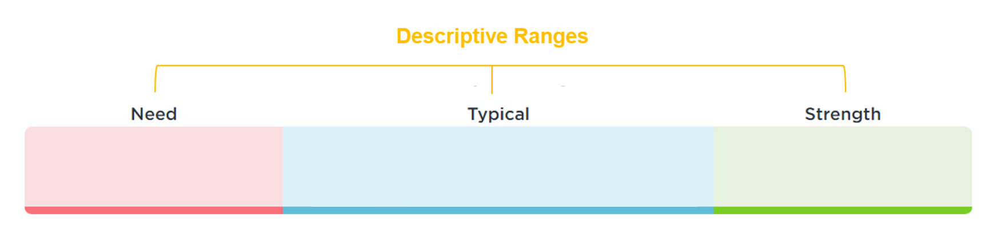
DESSA Results
T-scores are categorized into 3 descriptive ranges
T-scores:
28-40
T-scores:
41-59
T-scores:
60-72
Notes:
Talking Points:
Next, we’ll move into the results for the DESSA. The DESSA assessments report results using T-scores:
T-scores are categorized into three descriptive ranges, and as strength-based measures, higher T-scores mean a higher level of social and emotional competence.
Scores of 60 and above are considered a strength; scores between 41-59 inclusive are considered typical (demonstrating typical patterns of development); and scores of 40 and below indicate a need for instruction.
The term need for instruction was thoughtfully chosen to convey that the student needs support and instruction in this area. That is, it reflects that the student has not YET acquired these skills. It is simply a lack of skill acquisition.
So, the goal is not to label or stigmatize students within the “Need” range, but instead, it’s used to increase our awareness as educators that a student needs our instruction, assistance, and support in acquiring and practicing these important skills.

Slide 14
DESSA Norms
All DESSA assessments are norm-referenced and standardized
All DESSA assessments have a psychometrically sound foundation
All DESSA assessment meet standards for reliability and validity
Norms
16%
68%
16%
Notes:
Talking Points:
In terms of the assessment development, it’s important to note that:
All DESSA assessments are norm-referenced and standardized.
All DESSA assessments have a psychometically sound foundation, meaning →
All DESSA assessment meet standards for reliability and validity .
From the standardization sample, we can anticipate that the majority of students will score within the Typical range (68%) and that there will be about equal amounts of students in both the Strength and Need for Instruction ranges (16% each). We can use this information to compare the results collected to the expected norms, and to guide our data-driven making decisions about how to support students in developing these important skills.
If you are interested in these details, the technical manual for each version of the DESSA is available in our online Support Portal. Chapters 2 and 3 provided the information regarding assessment development, standardization, psychometric properties, reliability, and validity of the DESSA.

Slide 15
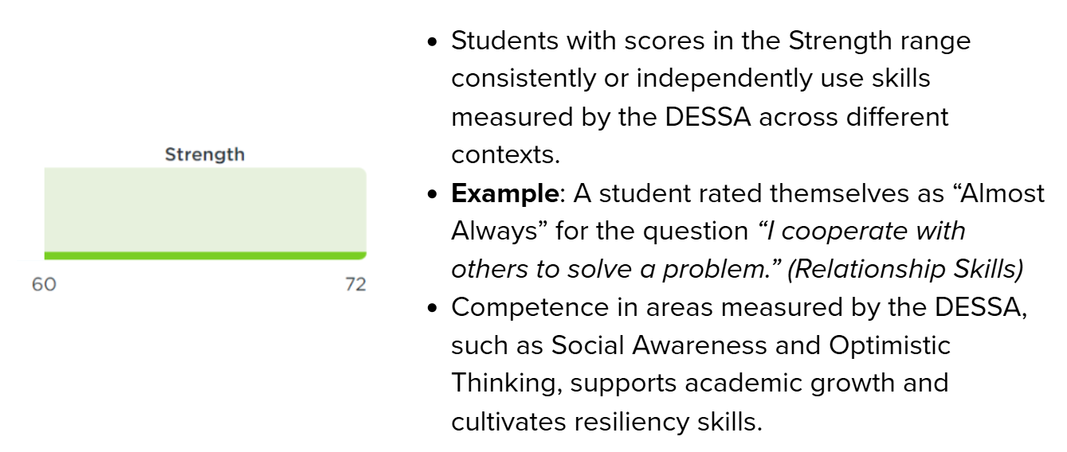
Descriptive Ranges: Student Examples
Notes:
Talking Points:
The next few slides look at examples of students within each of the descriptive ranges.
Students with scores in the Strength range consistently or independently use skills measured by the DESSA across different contexts.
Example: A student was rated “Almost Always” for the question “In the last 4 weeks, how often did the student interact positively with classmates?” (Relationship Skills)
Competence in areas measured by the DESSA, such as Social Awareness and Optimistic Thinking, supports academic growth and cultivates resiliency skills.

Slide 16
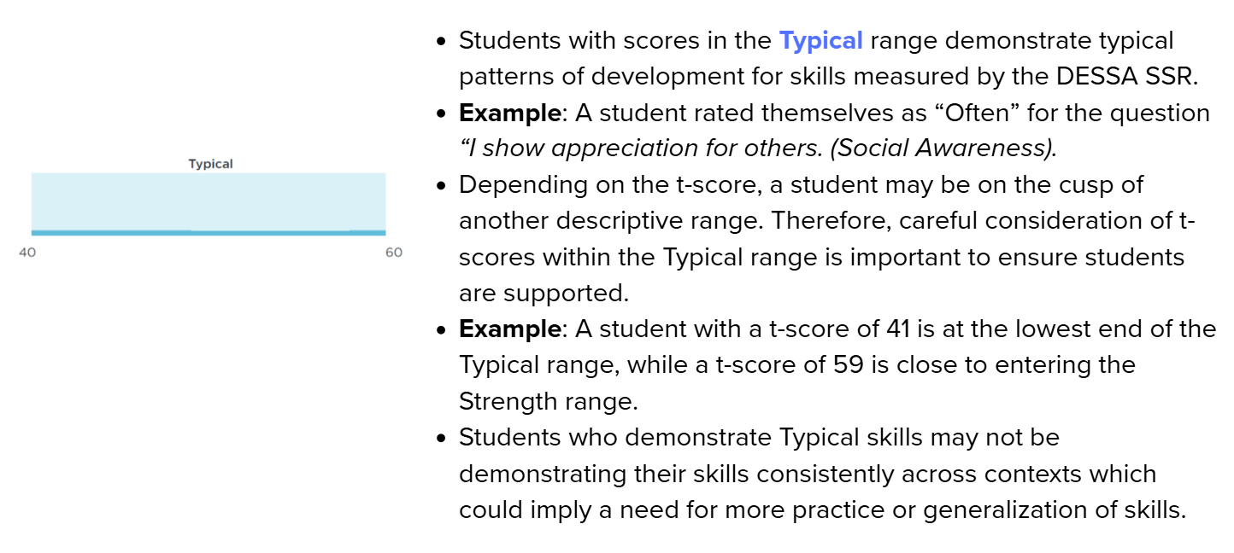
Descriptive Ranges: Student Examples
Notes:
Talking Points:
Students with scores in the Typical range demonstrate typical patterns of development for skills measured by the DESSA.
Example: A student was rated “Often” for the question “In the last 4 weeks, how often did the student accept responsibility for their actions?” (Responsible Decision Making)
Depending on the t-score, a student may be on the cusp of another descriptive range. Therefore, careful consideration of t-scores within the Typical range is important to ensure students are supported.
Example: A t-score of 41 is at the low end of the Typical range, while a t-score of 59 is close to entering the Strength range.
It’s important to note that students who demonstrate Typical skills may not be demonstrating their skills consistently across contexts which could imply a need for more practice or generalization of skills.

Slide 17
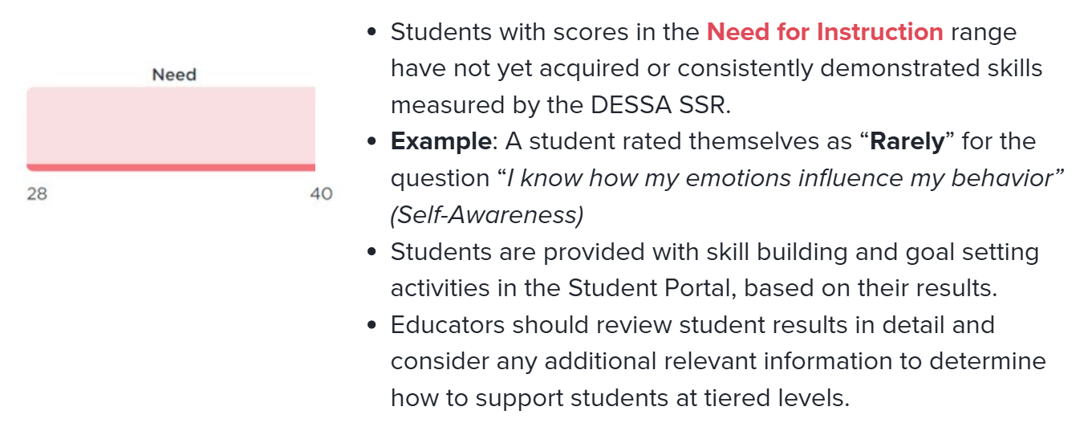
Descriptive Ranges: Student Examples
Notes:
Talking Points:
Students with scores in the Need for Instruction range have not yet acquired or consistently demonstrated skills measured by the DESSA.
Example: A student was rated “Rarely” for the question “In the last 4 weeks, how often did the student stay calm when faced with a challenged?” (Self-Management)
A full assessment is recommended and typically completed for students with scores in this category to gather more detailed information.
This training focuses in on the results for students in the Tier 3 level. Students that may be eligible for or who already receive individual instruction, intervention, services and supports may have lower scores on the DESSA, resulting in T-scores in this Need for Instruction range.

Slide 18
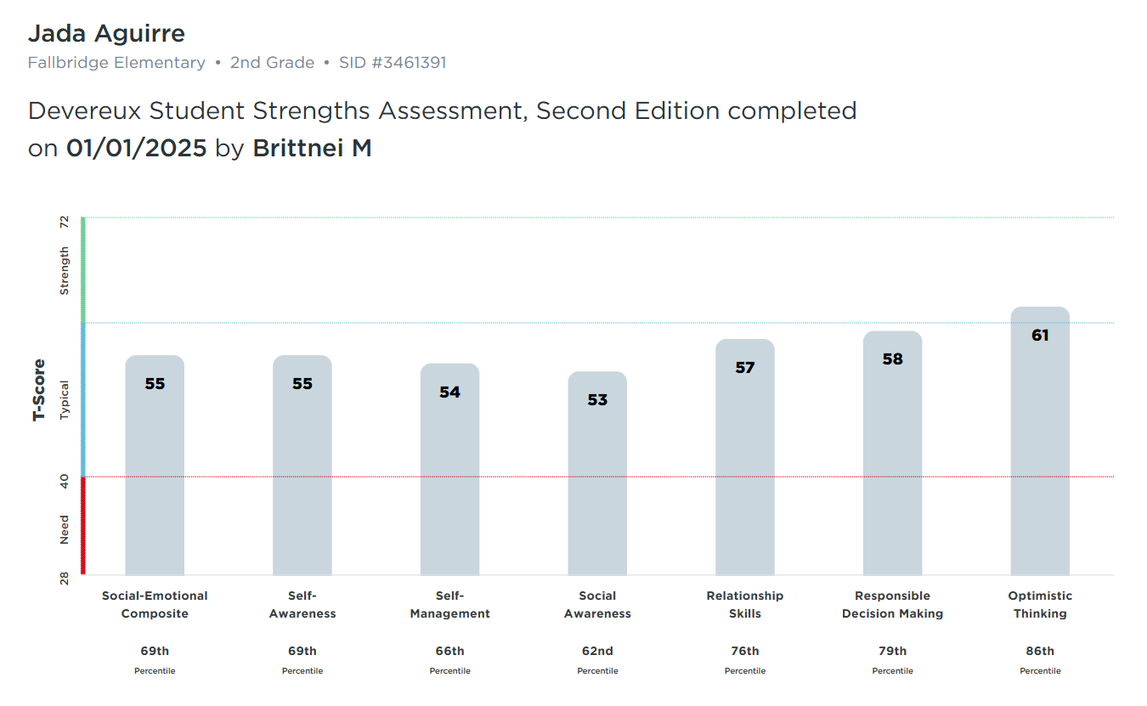
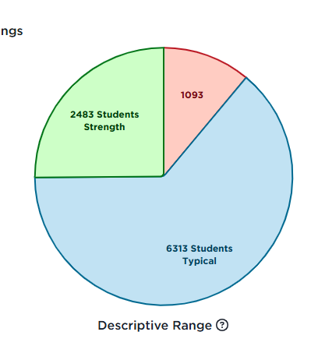
DESSA Results in the Educator Portal
Notes:
Talking Points
We’ll take a look at more report options later in this session, but at a high-level, the results are available in real time within the DESSA System educator Portal.
There are many interactive reports that can be used to generate reports for whole group (either school wide or classroom wide), small group (such as an intervention group), and for individual students.

Slide 19
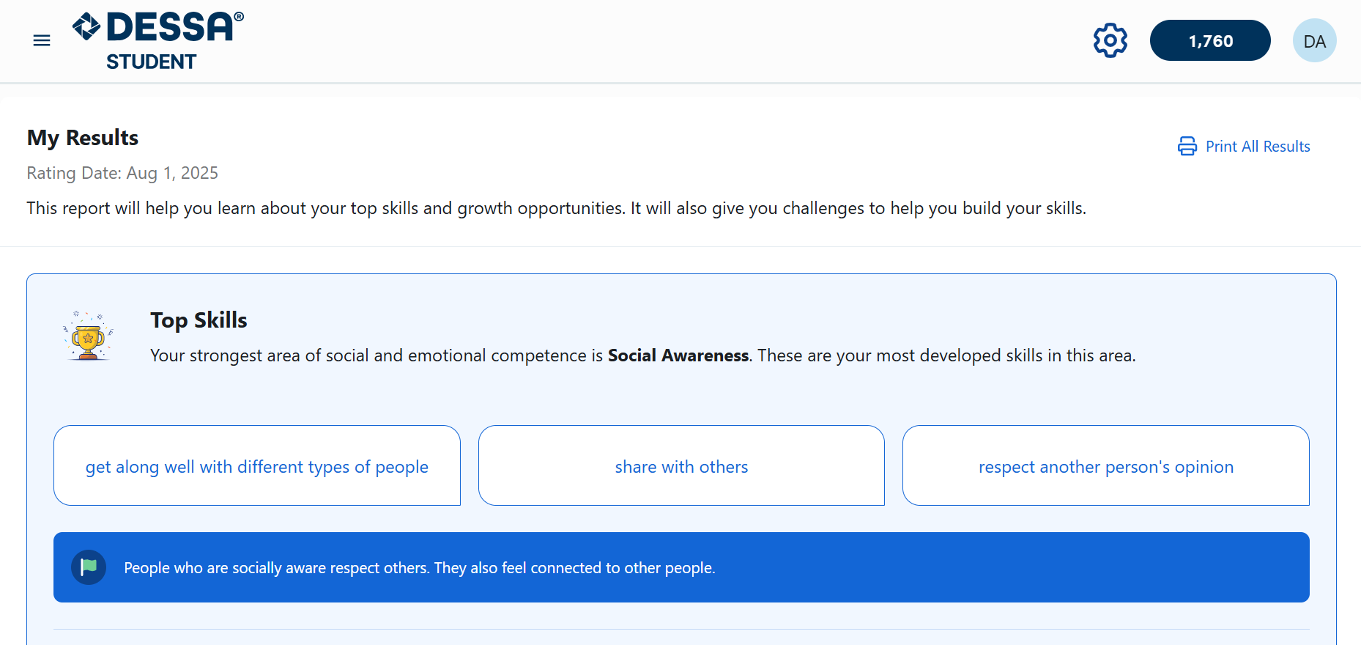
DESSA SSR: Student-Completed Results
Student View
Notes:
Talking Points:
As previously mentioned, students do not see their results in the same way that educators do.
Instead, they are presented with their real time results in explanations, examples, and “battery pack” views of their overall scores.
This is a quick snapshot of the first results section in the Student Portal. Students get to see their “Top Skill” highlighted first, with examples of specific skills from their assessment and additional context about what that competency area can look like.

Slide 20
General Implementation Overview
Pre-Assessment
Post-Assessment
End of School Year
Start of
School Year
Ongoing, universal, and data-driven Instruction
Targeted intervention and individualized instruction, as needed
Notes:
Talking Points:
As I mentioned at the start of the session, your district leadership is responsible for sharing the implementation details for your school.
Generally speaking, here’s what a yearlong DESSA implementation typically looks like:
Educators are assigned a roster of students to support in accessing their Student Portal and completing their SSR. Rating windows are designated times when students are able to go into their Student Portal and complete their assessment. Each Rating Window is typically 2-4 weeks long so that data is collected during a similar time frame.
A pre-assessment is completed towards the start of the school year and a post-assessment following this same process is completed prior to the end of the school year. There is the option for a mid-assessment, as well.
Throughout the school year, ongoing, universal, and data-driven instruction is provided to all students, and targeted intervention and/or individualized instruction is provided to students who demonstrate a need for further support in specific skills areas, typically in the small group or individual setting.
Additionally, students are able to access their Challenges and Goals activities in the Student Portal any time after they complete their assessment. Often, educators will provide designate time for students to access the self-paced learning opportunities in the Student Portal.
A key point to keep in mind is that the teaching and learning of social and emotional competencies are continuous. It’s not just during the rating windows of collecting data that we are actively involved in this process; it’s all year round.

Slide 21

Q & A
What questions, curiosities, or big ideas would you like to share regarding any of the DESSA assessments?
Notes:
Talking Points:
We have covered a lot in this intro section – at this time, what questions, curiosities, or big ideas would you like to share regarding any of the SSR?
You are welcome to come off mute or enter your questions in the chat. I’ll also take a look at the chat to see if I’ve missed any questions or comments that have come in.

Slide 22

In the chat: How might a strength-based approach improve: -Conversations about students? -Culture and climate? -Engagement with families?
Notes:
Talking Points
In just a moment we are going to take a brief break. Before we do, I invite you to enter a response to this prompt in the chat:
We’ve talked a lot about a strength-based approach and how DESSA can support that mindset. How might a strength-based approach improve conversations about students? How might it impact culture and climate? And how can it influence conversations with families?
Take a moment to consider one of these questions and add your response to the chat.
(Offer wait time and read few that come in, then thank attendees for participating before moving on to the next slide)

Slide 23

Take a break!​
Let’s meet back in 3 minutes
Notes:
Talking Points:
We will pause here for a 3-minute break. Please take time to stretch, grab a drink, or just take a screen break. The timer will count us down and we will move on with the training after it’s done.
(Facilitator - Can choose to go off camera for this break)

Slide 24
Student Portal
Notes:
Talking Points:
Welcome back!
In this next section, we are going to review the Student Portal.
We will end our session with looking at the Educator Portal, which houses everything you need as the educator.

Slide 25

Notes:
Talking Points
We’ll start by viewing this video that will share an overview of the Student Portal. This video is shared with students when they log into their Student Portal and it’s a help introduction to both the assessment and platform.
https://www.youtube.com/watch?v=EWt1YMYDLLs

Slide 26
Accessing the Student Portal
Access through website login with user name and password or SSO login
District leadership manages the integration and assignments
Educators are assigned a roster of students to support
Notes:
Talking Points:
There are different ways students can access their student portal, including a website login with username and password or through an SSO login, such as Clever or ClassLink. These integration details of adding students into the DESSA System and the method for accessing their own Student Portal account is managed by designated district leadership.
Once that is set up, educators are typically assigned a roster of students to support for accessing and completing the SSR, as well as continuing their growth using the Student Portal activity features.

Slide 27
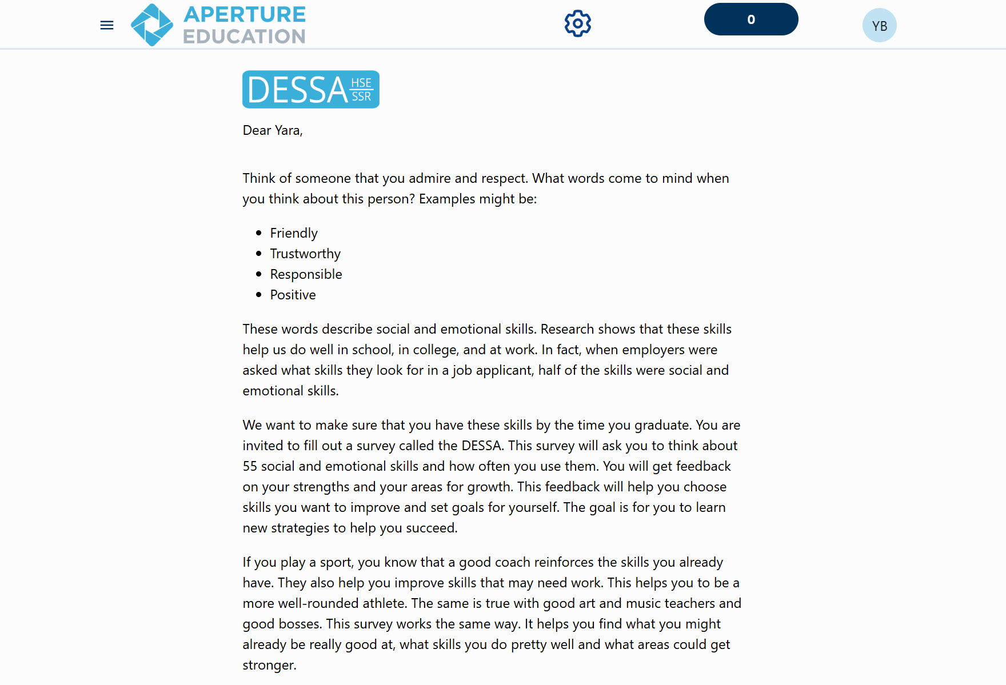
After students register and log in, they will be met with a welcome letter and can follow the prompts to the assessment.
Notes:
Talking Points:
When a Rating Window is open and students login to their Student Portal account for the first time, they will be met with a welcome letter and can follow the prompts to the assessment.

Slide 28
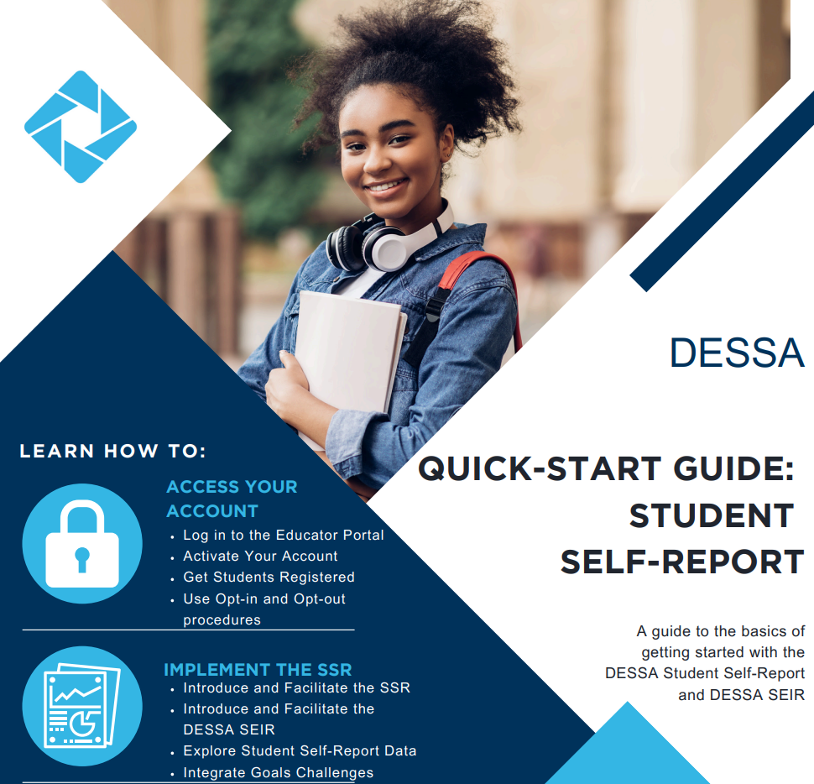
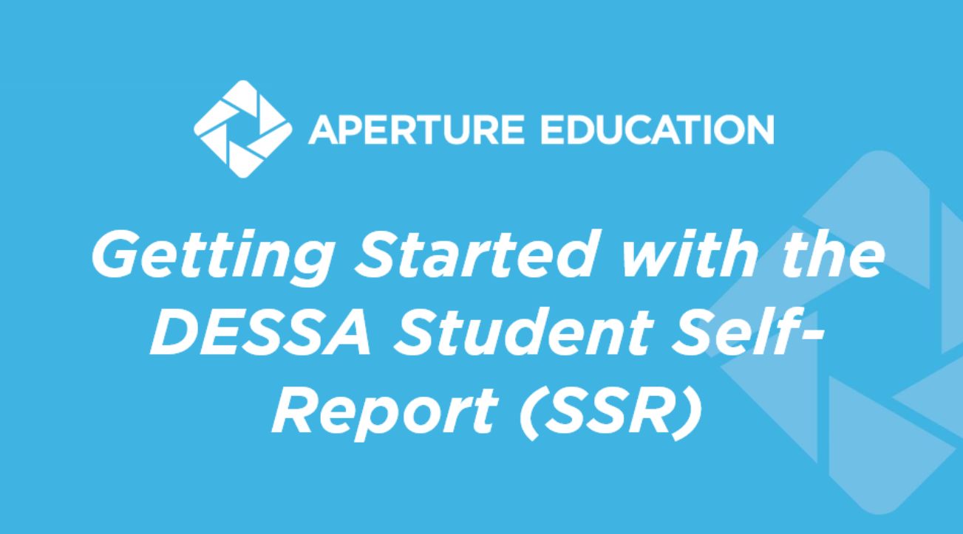
Implementation Resources
Notes:
Talking Points
To support the implementation in the classroom, we recommend using the ready-to-use materials available within the Support Portal.
The PowerPoint slide deck is an in-classroom resource can be used by teachers to introduce the SSR to students and guide them in the process of Registering and Accessing the Student Portal.
The quick start guide provides an overview of the main components needed to successfully collect SSR data.
There is also a one-page resource that is student-facing that connects the skills measured by the DESSA to their overall development and growth.
https://info.apertureed.com/en/hc/getting-started-with-the-dessa-student-self-report-ssr-educator-and-student-facing-resources

Slide 29
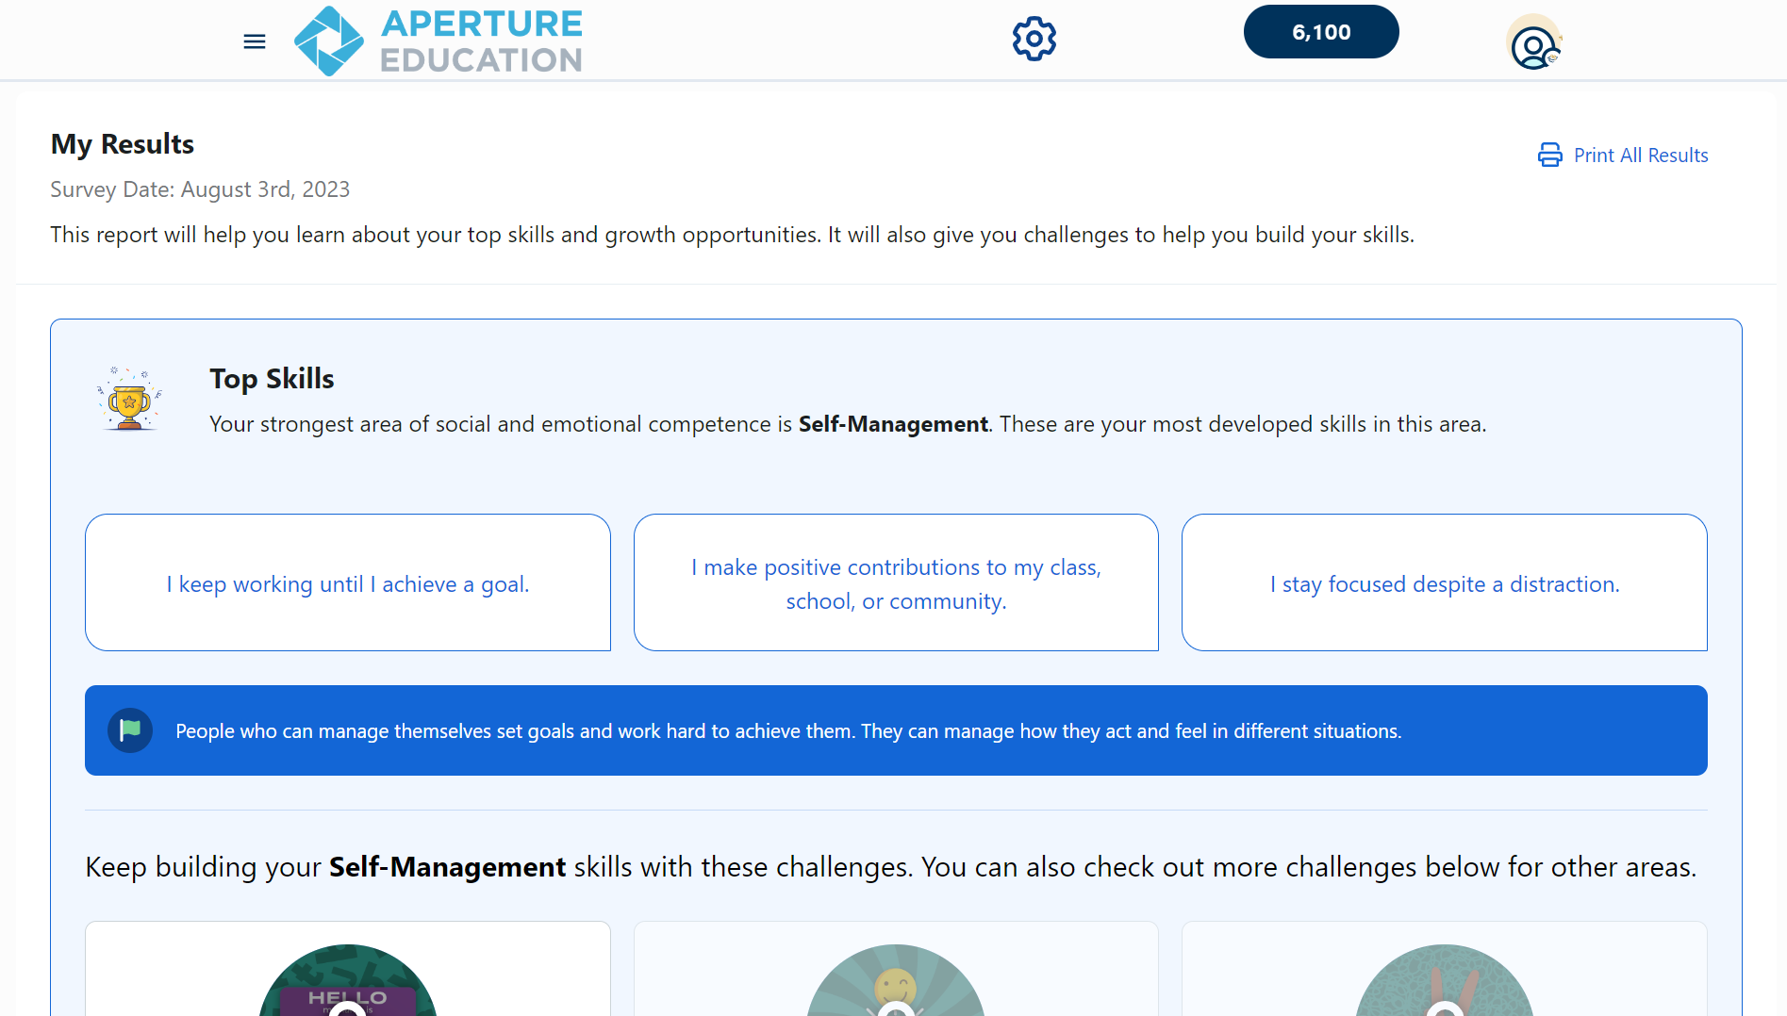

The Student Portal
My Results Page
Notes:
Talking Points:
Let’s take a look at those different features within the Student Portal that were mentioned in the video.
Once students complete the SSR, they will have access to their results.
Students will first be able to see the Top Skills that they have developed and a specific competency that aligns to their strengths.

Slide 30
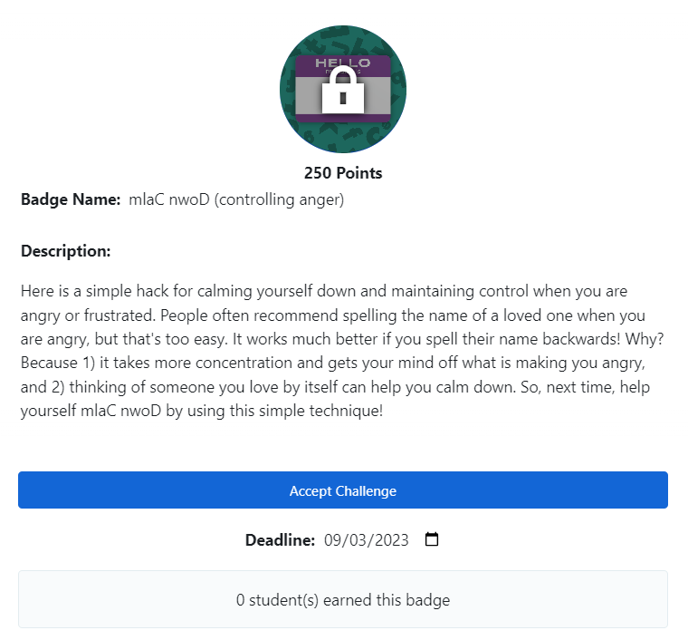
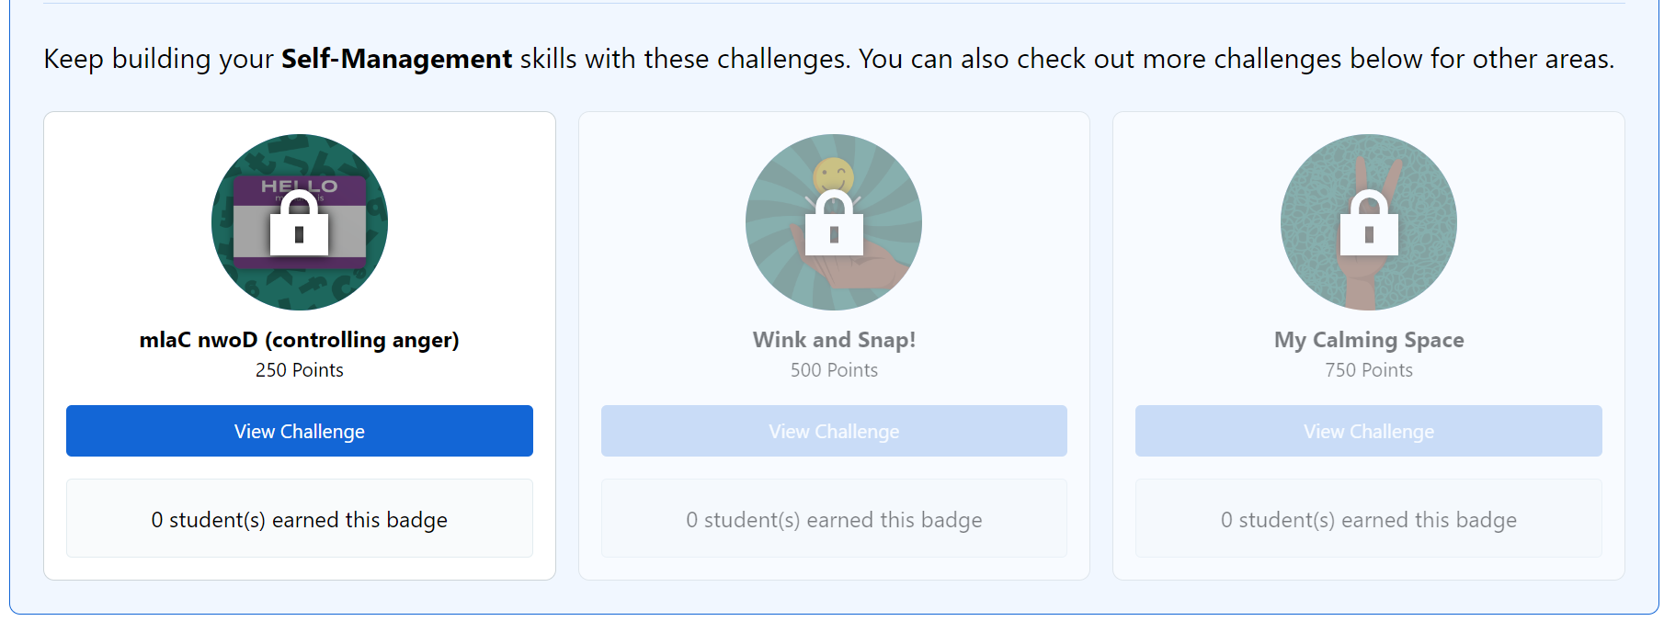
The Student Portal
Student Challenges
Challenge Details
Notes:
Talking Points:
Below their Top Skills results, students will be prompted to engage with gamified “Challenges” activities that are automatically produced in the platform. These activities are self-paced opportunities for students to reflect, learn, and practice skills that are measured by the SSR.
The activities start with challenges that are based the lowest number of points and will gradually increase once student's complete challenges and “unlock badges”.
You can see from the screen shot, that this challenge is worth 250 points, and once students click the “view challenge” button, a description will then appear. Students will then click “accept challenge” and have the option to adjust the deadline for the due date. No worries about expiration, students can always come back and adjust this if they need more time.
Students will be able to see how many of their peers have earned the same challenge badge. Once the challenge is accepted, automated tasks will appear for students to try along with the options for students to add in any of their own updates and attachments for their assigned educator or staff member to view.

Slide 31
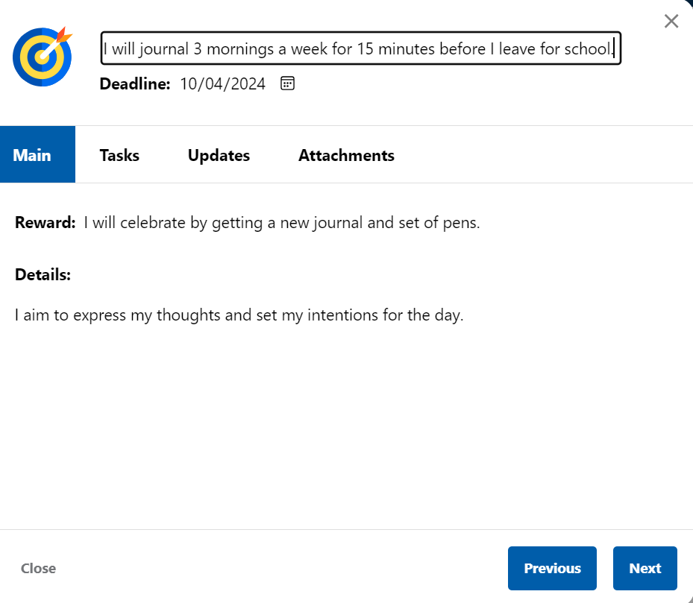
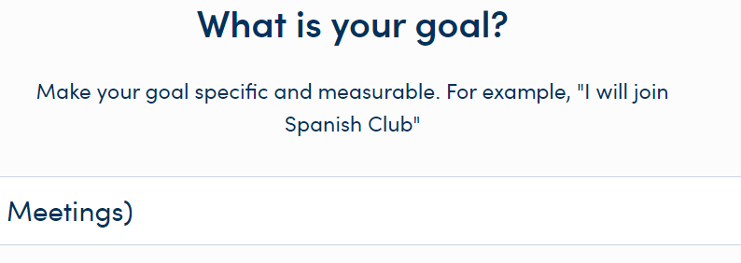
The Student Portal
Independent SMART
Goal Setting
Notes:
Talking Points:
There other student-driven activity in the Student Portal is the independent goal setting. This platform prompts students to set SMART goals in some suggested areas here or a specific area in which they want to set a goal.
The system will walk the student through how to set their SMART goal by focusing in on their “why” which reinforces student agency and buy in and input.
They then will select when they want to reach that goal and can generate bulleted tasks that act as steps to obtaining their goal, along with providing updates and attachments.
If you're an assigned educator who is working with a roster of students, you will be able to view this progress in your Educator Portal, which we are looking at next.

Slide 32

Activity: Explore the Student Portal
Login Link: https://demo.student.apertureed.com/login
Username: DAbbo170
Password: Inverness2024!
Action: Review the SSR results, the Challenges,
and Goal Setting features
Notes:
Talking Points:
As educators and administrators, you will have your own Educator Portal login but you will not have access to a Student Portal account.
We are going to provide a Student Portal login for you to explore now during this training but you can also refer back to the slides that will be sent out to use this login going forward. This will help you be able to support your students as they navigate the Student Portal.
For this activity, we will not be completing the SSR assessment in a demo environment. We will be giving you access to an account that has already completed a self-rating and you can view the assessment results, the challenges features, and the goal setting option. I will enter the log in link, username, and password in the chat and it is also on the screen now.
Let’s pause here for 4 minutes to do an independent activity using the timer on the screen. We will come back together after that and if there are any questions I can answer, please add them to the chat.
Login link: https://demo.student.apertureed.com/login
Username: DAbbo170
Password: Inverness2024!

Slide 33

The Educator Portal
Notes:
Talking Points:
Our last section focuses on the DESSA System Educator Portal. This is the platform that you as staff will be using for the DESSA SSR implementation.
You may have already had time to explore this platform, but if you have not, the access information also comes from your district leadership team.
The Educator Portal is where you can access the assessment results and data reports, instructional materials, and other resources.

Slide 34



User Roles in the DESSA System
Can generate and view all reports for the program, sites, and students.
Can generate and view reports from their site only.
Can generate and view reports for their assigned students.
Notes:
Talking Points:
There are 3 different types of user access for the Educator Portal. The user level in the Educator Portal dictates what information is displayed on the dashboard and the types or amount of data viewable in your account.
First, the Program Administrator access is typically provided to district leaders or other staff responsible for setting up rostering, assessment windows, and rating assignments. Program administrator access will allow the user to view data for all sites within their district.
Next, the Site Leader access is generally provided to school or site-based leaders, including Principals and Assistant Principals, as well as other leaders that may need access to data across the campus, such as School Counselors, School Psychologists, Social Workers, etc. Site Leader access will allow the user to access to data for their specific site.
Finally, the Rater access is provided to educators that are assigned to support students in completing the SSR. They will have access to the results for the students they are assigned to in the system.

Slide 35
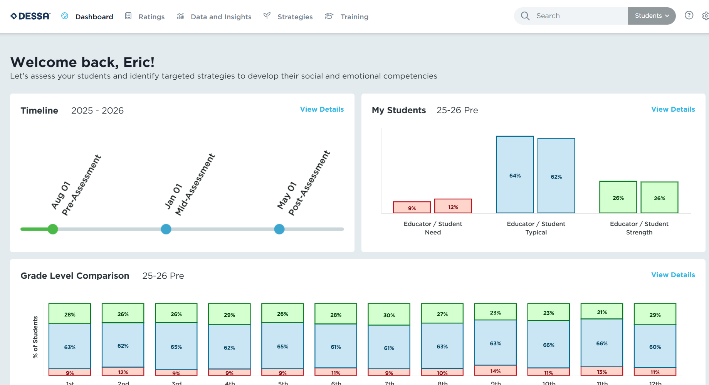
Site Leader Dashboard
Notes:
Talking Points:
On the top of the dashboard, there are several tabs. We will be going through each of these tabs to highlight what is included under them.
The first one is the Dashboard.
All users will land on their dashboard when they log into the Educator Portal. There 5 tabs across the top of the screen that we will navigate through.
When Site Leaders log in to their account, the dashboard will provide a quick snapshot of the rating window timeline, a preview of the My Students report, which displays an overview of student performance. On the bottom of the screen, they will see a grade-level comparison of all the grades in their building.

Slide 36
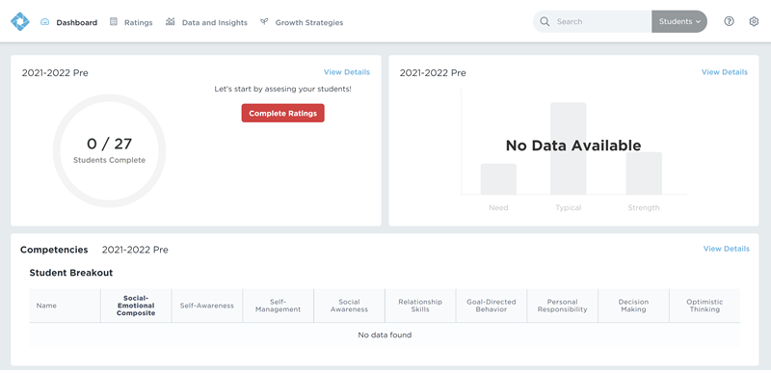
Educator Dashboard
Notes:
Talking Points:
For the first rating window, the dashboard will likely appear blank since there won’t be any ratings completed yet and therefore, there won’t be any data in the system.
Once ratings begin to occur that data will populate in the system and be able to be viewed here as well in the data and insights tab, which we will go over in more detail in a few moments.

Slide 37
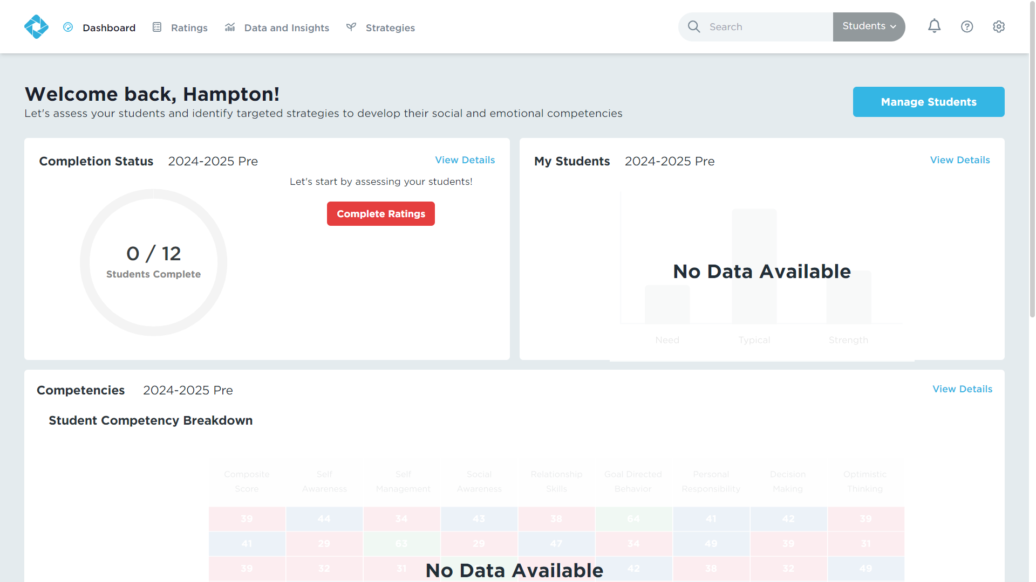
Ratings Tab
Educators supporting the Student Self-Report (SSR) will not have students loaded in the Ratings tab.
Notes:
Talking Points:
Next, is the ratings tab.
Educators supporting the Student Self-Report (SSR) will not have students loaded in the Ratings tab since students complete the ratings in the Student Portal. T
This is where staff that are assigned to complete ratings (such as elementary teachers) would go to find their educator-completed ratings.

Slide 38
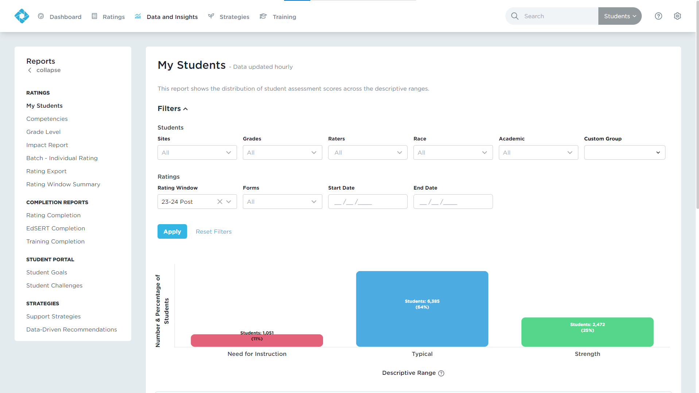
Data and Insights Tab
Real-time results
Interactive, filterable charts
Downloadable reports
Notes:
Talking Points:
The next tab is the Data and Insights tab, where all of the results and implementation reports live.
The types of reports on the list (on the left) will depend on your user level. You may also have reports that do not apply to your specific implementation.
You’ll get Real-time results, Interactive, filterable charts, and Downloadable reports. You can use the filters to generate reports for subgroups of students or use the search bar to locate an individual student by typing in their name or student ID.
We wont be going into the details of all the Data and Insights reports during this session – that is for another training after you have collected your ratings data but you can feel free to explore the different reports on your own.

Slide 39
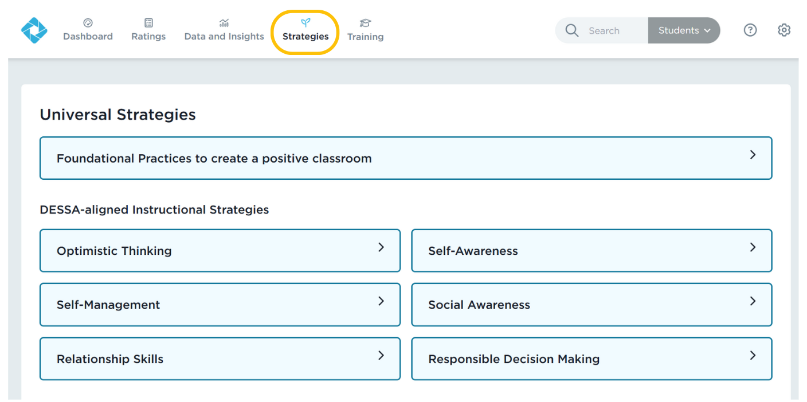
Strategies Tab
Notes:
Talking Points:
Next over on the tabs list is the Strategies tab.
The DESSA System includes lessons, activities, and resources for data-driven instruction and intervention. Under the Strategies tab, there are a variety of materials available to all users, including,
The Foundational Practices,
DESSA-aligned instructional Strategies (lessons)
And the Tier 2 Intervention Programs

Slide 40
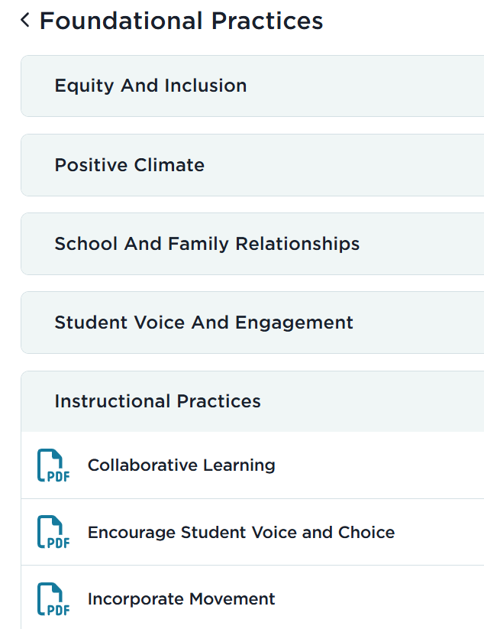
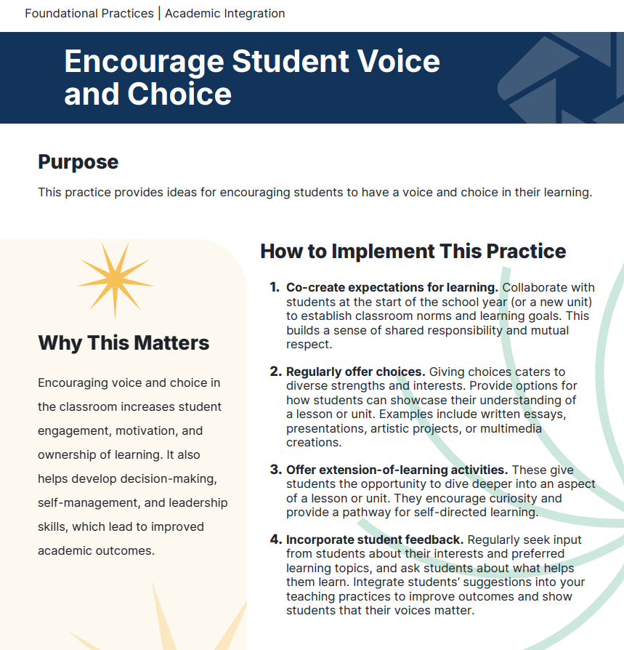
Foundational Practices
Notes:
Talking Points:
Foundational Practices: The Foundational Practices are best practices that are easy to implement consistently at the universal level. These activities create a supportive and positive learning environment throughout a school and within a classroom.
You can explore the different topic areas and the PDF resources that outline the “how” and the “why” for these recommended practices.

Slide 41
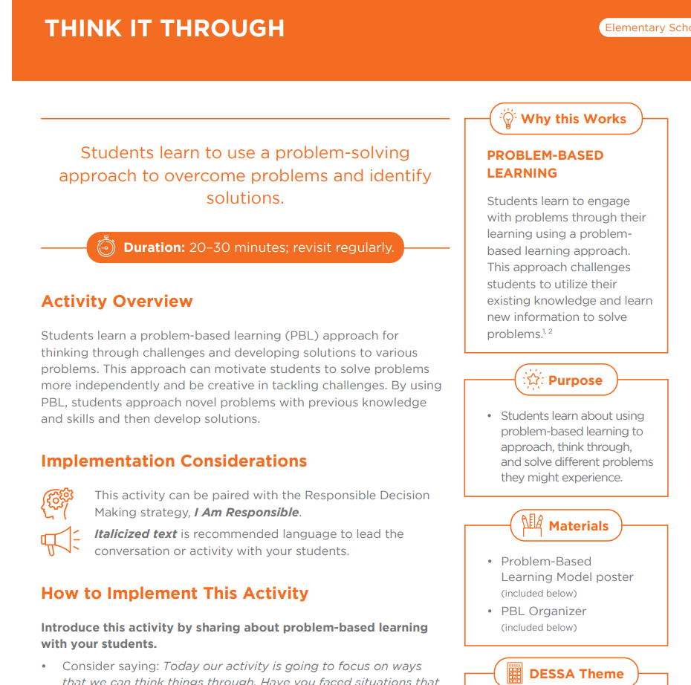
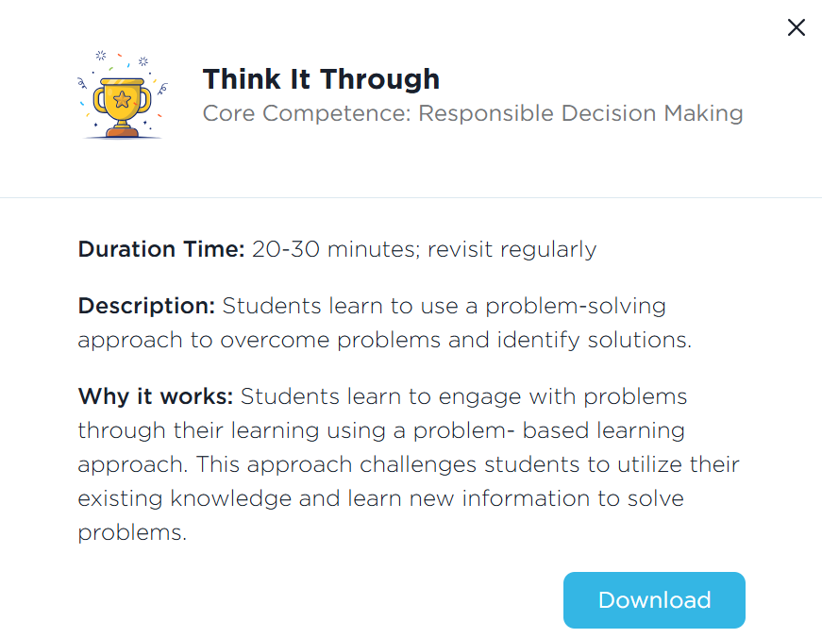
Strategies
Notes:
Talking Points:
Strategies: These lessons are research-based, DESSA-aligned materials that provide direct instruction of social and emotional skills. The Strategies are designed for universal instruction and include step-by-step directions for facilitation, along with extension activities and modifications for differentiated instruction. Student and educator reflection prompts are included in each strategy.

Slide 42
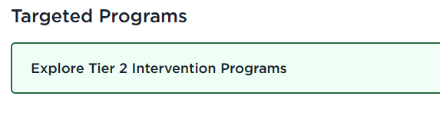
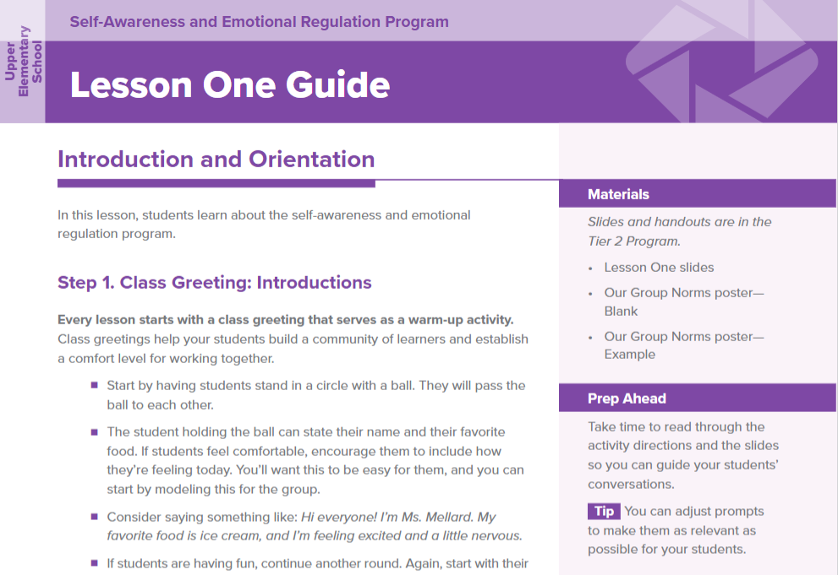
Tier 2 Intervention Programs
Sequenced, intensive lessons to develop student resilience skills with a focus on:​
Self-Awareness and Emotional Regulation
Social Awareness and Behavior Regulation
Social and Emotional Skill Development integrated with Academic Intervention
Responsible Decision Making
Relationship Skills
Notes:
Talking Points
The Tier 2 Intervention Programs consist of five multi-week programs designed for targeted, small group instruction for students who need intensive skill building.
Lessons within the Tier 2 Intervention Programs are designed to be delivered in a scope and sequence that builds skills through repeated practice and active engagement.
All of the intervention programs are available within the DESSA System, also under the Strategies tab.
The programs are grouped by grade bands: Early Elementary, Upper Elementary, Middle School, and High School.

Slide 43
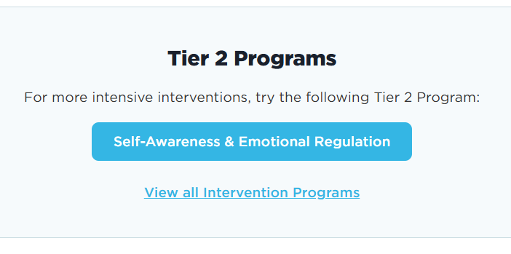
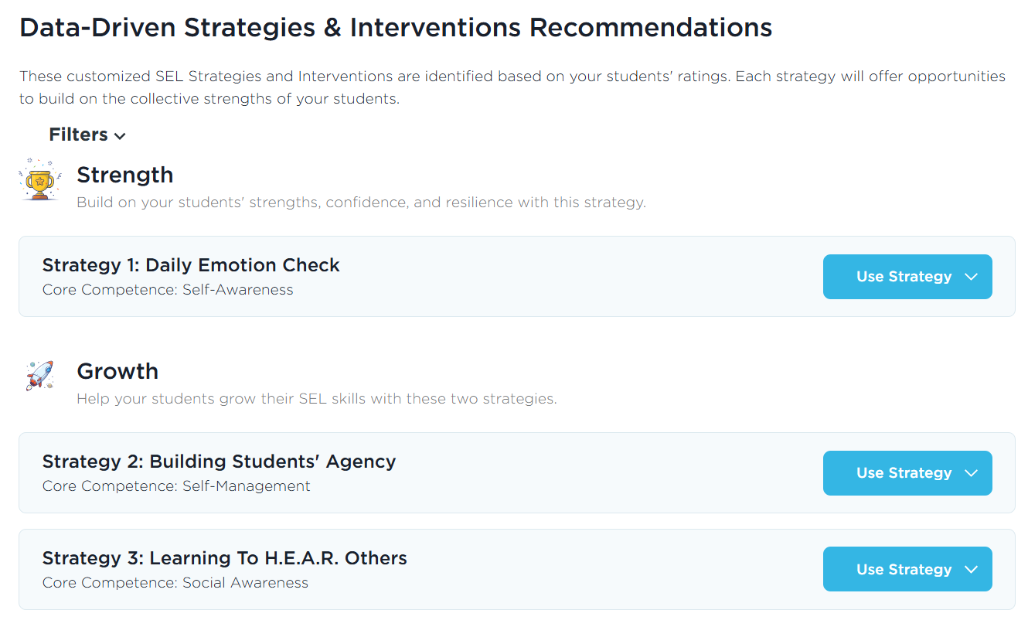
Data-Driven Recommendations
Notes:
Talking Points:
The one report we do call out in this session is the Data-Driven Recommendations. This report is located under the Data and Insights tab and it connects your DESSA results to the strategies resources under the Strategies tab. It takes the “guess work” out of it for you – based on your data, it will recommend DESSA-aligned instructional materials to use with your students. It’s helpful to know that this feature exists as you begin to plan how you will use the data collected from the SSR.
Once you generate this report for your students, three strategy recommendations will be presented: The first strategy is based on students' strengths, and the second and third strategies will help you build students' growth in lower-scoring competencies. You can view the overview of the strategy lesson and download a PDF copy. Then it will also recommend a specific Tier 2 Intervention Program to use with your students (that’s the longer, full scope/sequence program), again based on their DESSA results.

Slide 44
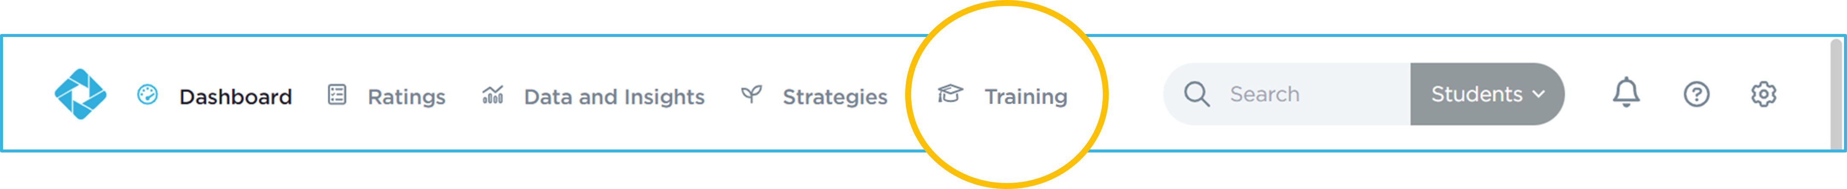
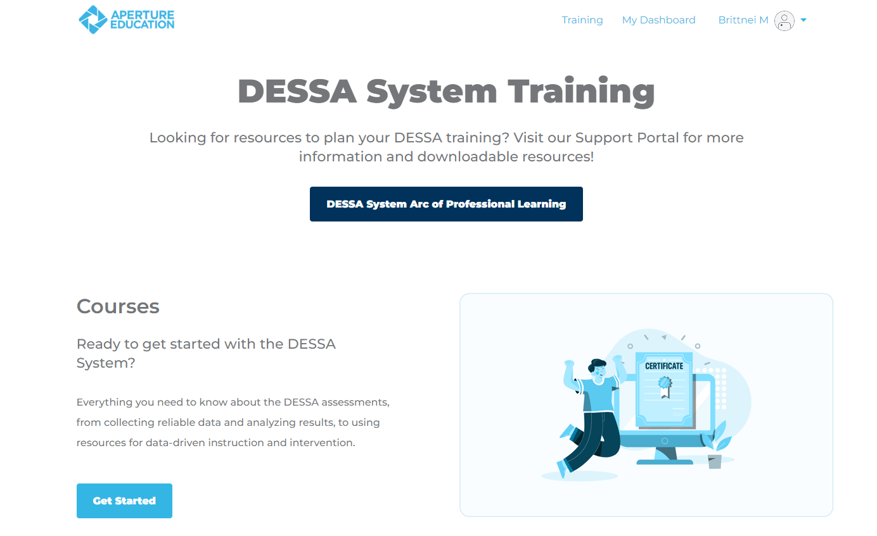
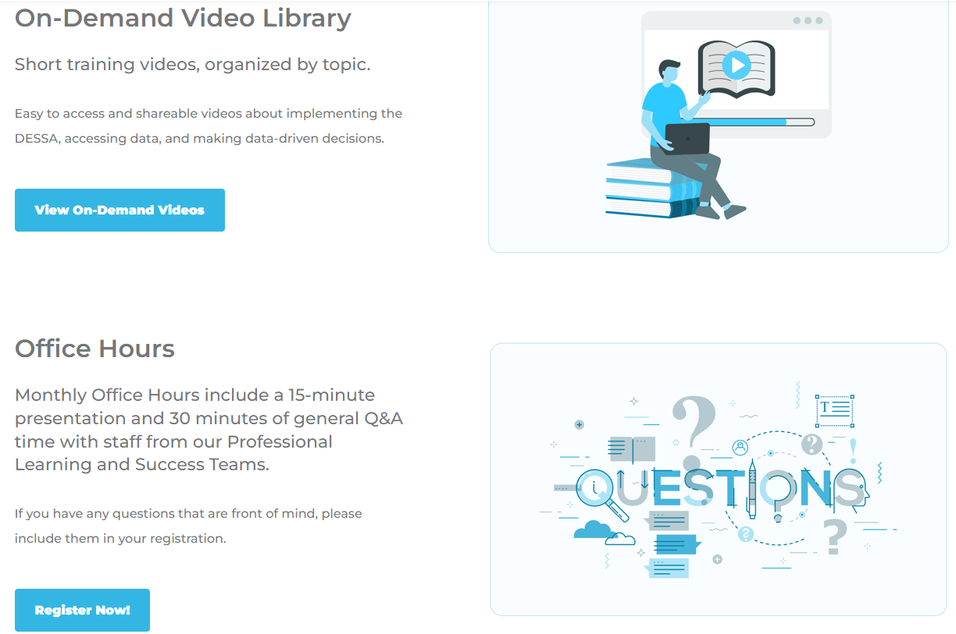
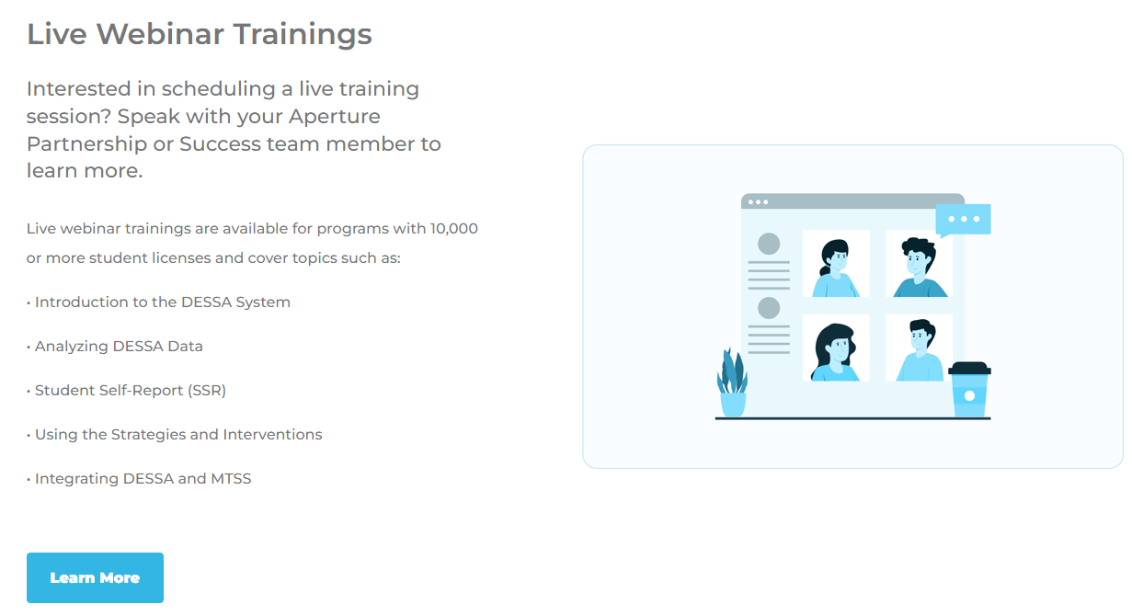
Training and Support Portal
Notes:
Talking Points:
The last tab to review within the Educator Portal is the Training Tab. The Training tab allows you to choose more learning options. There are self-paced courses for individuals who are new to the DESSA or those who just need a refresher.
The On-Demand Video Library provides short self-service videos that help users with DESSA implementation, and we offer live monthly office hours on pre-selected topics as well.
You can also register for monthly office hours with our DESSA team under the Training tab.
Additionally, the Educator Portal has an extensive Support Portal, complete with articles, resources, templates, and information for all-things DESSA implementation. To access the Support Portal, click on the circle with a question mark in it, always located in the top right side of the Educator Portal.
The Support Portal is open 24/7, offering resources to help guide users through the DESSA system.

Slide 45
Wrapping Up Any remaining questions to address?
Notes:
Talking Points
We are at the point where we wrap up for this training session – we have covered a lot and want to make sure we can address any remaining questions that you may have before we offer an optimistic closing prompt and your next steps.
(allow time for final questions)

Slide 46
Optimistic Closure: What are looking forward to with implementing the DESSA SSR?
Notes:
Talking Points
In thinking about the hopes you identified at the beginning of today’s session and using a strength-based approach, What are you looking forward to most about implementing the DESSA SSR? You can add your response in the chat or feel free to come off mute.
[Provide think time]

Slide 47
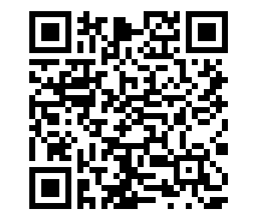
Exit Ticket: Complete Training Survey Log in to your Educator Portal to complete your DESSA ratings:
Thank you!
https://apertureed.qualtrics.com/jfe/form/SV_250ioEurFXBmBUy
Notes:
Talking Points:
Thank you so much for your time and attention today! We have reached the end of our training for today. We hope to see your program back for the “Part 2” with the “Analyzing SSR Data” training after your students have completed their ratings.
Your exit ticket is to complete the DESSA Training survey. I’ll add the link in the chat now and you can also use the QR code on screen. https://apertureed.qualtrics.com/jfe/form/SV_250ioEurFXBmBUy
Once you complete that, you can hop off the Zoom. I’ll remain on here for a few more minutes in case there are any questions.

Slide 48
DESSA SEIR
Screener for Externalizing and Internalizing Risk
Notes:
This section includes the slides for SEIR, would be included as optional slides if the customer is using this product

Slide 49
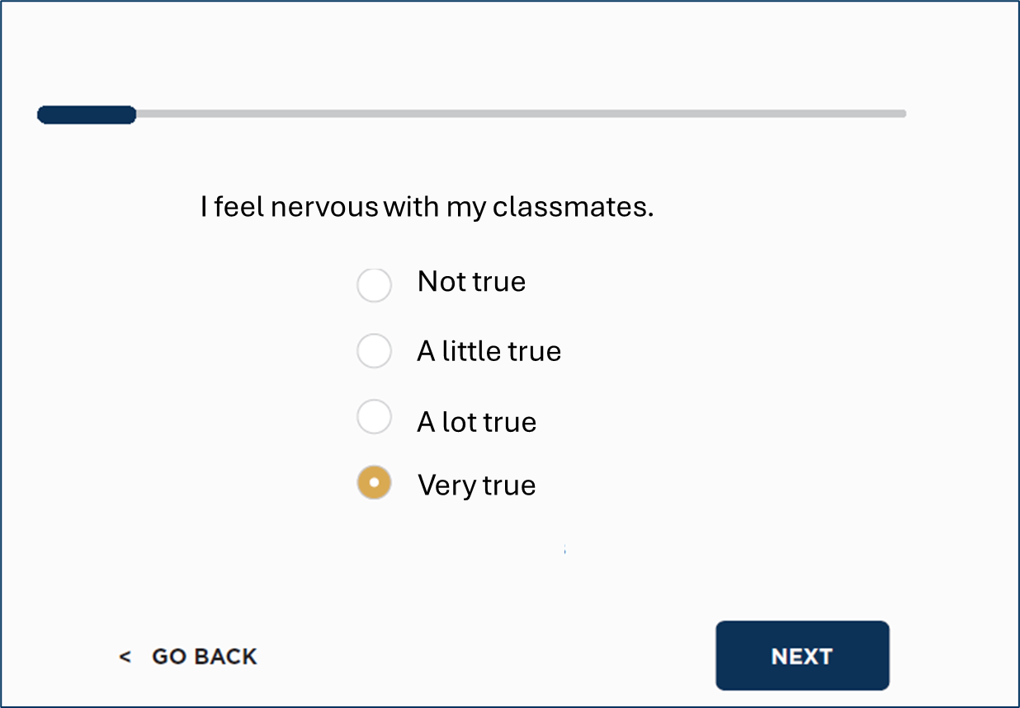
Overview: The DESSA SEIR
DESSA SEIR Student Self-Report
Reliable screener that assesses a broad range of emotional behavior risks
Student completed for grades 6-12
10 items
Two scores – internalizing risks and externalizing risks
Criterion-referenced – scores are reported in three levels: no concern, possible concern, and concern
Evidence of reliability and validity as a screener of emotional behavior risks
Notes:
Student risk factors can be screened with the DESSA Screener for Externalizing and Internalizing Risk – or the DESSA SEIR.
The DESSA SEIR is a reliable screener that assesses a broad range of emotional behavior risks. It is completed by students in 6-12 grades.
As a screener it is brief – just 10 items and takes about a minute to complete, and you can see a sample item on the screen. The student is asked to read each statement and rate from Not true to Very true of themselves.
It provides two scores – one score for internalizing risks and one score for externalizing risks. Internalizing risks are things like feeling isolated, withdrawn, and lonely, while externalizing risks are things like aggressive behavior or impulsive behavior.
The DESSA SEIR is a criterion-referenced tool – providing raw scores that are reported as three levels of concern – No concern, possible concern, and concern. It is recommended for school-based mental health professionals to follow up immediately with students who fall into the concern or possible concern ranges.
And lastly, the SEIR has documented evidence of reliability and validity as a screener of emotional behavior risks.

Slide 50

Video: DESSA SEIR
Notes:
Seir overview video – add notes to introduce

Slide 51


Screening for Risk and Resilience Factors
DESSA SEIR
Snapshot of students’ well-being
DESSA
Universal screening of social and emotional skills:
Provides baseline data about students’ resilience factors
Focuses on prevention
Builds on strengths
Universal screening of emotional behavior risk domains:
Provides baseline data about students’ internalizing and externalizing risks
Together, these data points provide information aligned with the resilience and risk approach to promote students’ well-being
Notes:
Complete mental health requires both strong protective factors and few or no mental health challenges. Helping students develop complete mental health requires information about a student’s current functioning – both their resilience factors and their risk factors. We are going to talk about two screening tools that can be used universally in schools to collect this data.
We have already talked about the DESSA Student Self-Report– which can be used to screen resilience factors, specifically social and emotional skills. Now we’ll talk about the DESSA SEIR – which can be used to screen internalizing and externalizing risks.
Together, these two data points will provide schools will a snapshot of students’ well-being, that will inform their approach to promoting student’s well-being.

Slide 52
Promoting students’ well-being is best done through a
Risk and Resilience framework that focuses on two factors:
Development of resilience (protective factors)
Early identification and prevention of risk factors
Students who have well-developed resilience factors are better positioned to navigate challenges, and to mitigate and respond to risk factors.
Notes:
When talking about promoting student well-being, it’s very helpful to think about it in terms of a risk and resilience framework. This framework is grounded in an extensive literature from both research and practice and is commonly used across many disciplines to support individuals healthy development and well-being.
As the name implies, this framework focuses on two factors. First, the development of resilience – or protective factors. When we talk about resilience, we are talking about an individual’s ability to bounce back and adapt successfully to significant challenges that they face. And protective factors are the things that help individuals do this.
The second factor in this framework focuses on risks, and specifically on the early identification and prevention of risk factors.
And as I already mentioned, there are decades research have demonstrated that students who have well-developed resilience/protective factors are better able to navigate the challenges they face, as well as to respond and cope with risk factors that arise in their lives.
So, we can use this risk and resilience framework to think about how we can promote students’ well-being and ensure that students thrive.

Slide 53
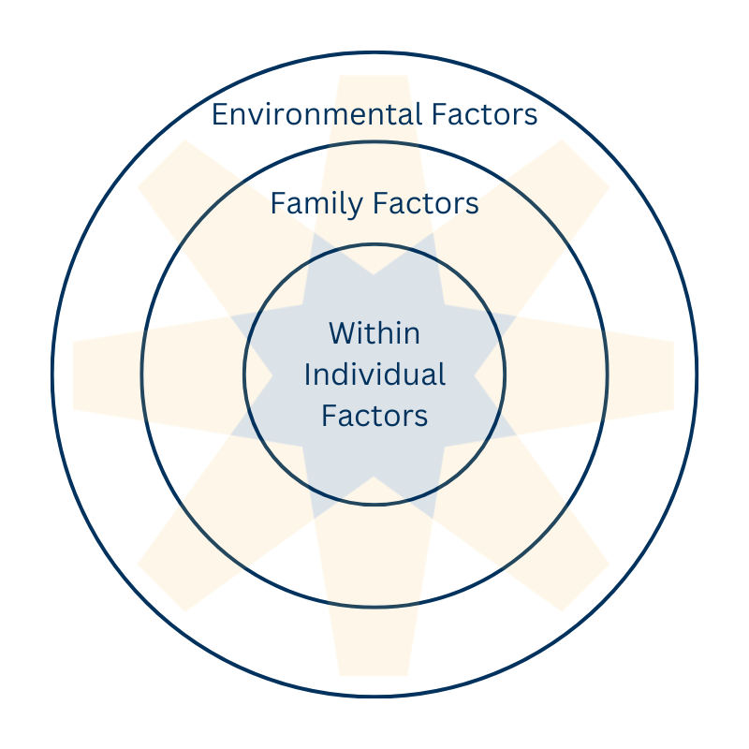
Risk and Resilience Framework
There are many risk and resilience factors that impact students. They are often classified as being 1) in the environment, 2) in the family, or 3) within the individual.
Because we work in schools with educators, we focus on screening for risk and resilience factors that educators can affect.
Notes:
There are many risk and resilience factors that impact students. And they are typically classified into three categories – in the environment, in the family, or within the individual. Environmental resilience factors are things like community systems, such as attending a high-quality school. Family resilience factors are things like having a supportive family, and then within-individual resilience factors are individual attributes such as having good health or good problem-solving skills. The same is true for risk factors – they can occur in the environment (for example, having limited community resources), in the family (such as living with a parent with substance abuse problems), and within the individual (such as having a learning disability).
To best support students’ well-being, we should be building resilience factors and removing risk factors across all these areas.
But because we work in schools with educators, we focus on the risk and resilience factors educators can most affect. And those factors are what we’ll be talking about today. We will specifically be talking about how schools can identify the risk and resilience factors students have through universal screening, followed by concrete ways to promote those critical resilience factors.

Slide 54
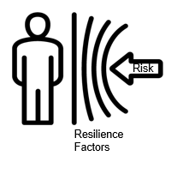
Risk and Resilience Framework
Most students will encounter challenges or risk factors – building up their protective factors helps them to be more resilient, and to navigate these challenges successfully.
All students will benefit from a focus on building their resilience. Students facing more risk require more support in developing resilience factors.
Notes:
We know that most students will encounter challenges or risk factors at some point in their lives. And building their protective factors helps them to adapt and navigate these challenges successfully when they do arise.
We also know that all students benefit from a focus on building on their resilience. Some protective factors are also known to be promotive factors, meaning they lead to positive outcomes for students even in the absence of risk factors. For example, positive school climate, social and emotional skills, and supportive relationships with prosocial adults and peers are all known to help students thrive.
So, a risk and resilience framework will help us to think about how to provide universal, preventive support to all students. The students facing more risk will require more support in developing resilience factors, but all students will benefit from this focus.

Slide 55
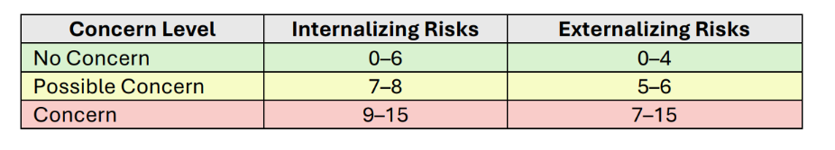
DESSA SEIR Results
DESSA SEIR results are categorized into three ranges for both Internalizing and Externalizing Risks: No Concern, Possible Concern, and Concern.
Notes:
The DESSA SEIR Internalizing Risks scale and Externalizing Risks scale both have 5 items that are each scored from 0–3; thus, the possible score range is 0–15, with a higher score indicative of a higher frequency of concerning behavior.
To facilitate the meaning of the resulting total score for both the DESSA SEIR Internalizing Risks and Externalizing Risks scales, there is a three-level
framework to characterize the level of mental health concern. The three levels are No Concern, Possible Concern, and Concern.
If you’re interested in more information about the development of the DESSA SEIR, be sure to check out the manual.

