Slide 1
DESSA Training Part D:
Progress Monitoring Reports and Features
Analyze and Interpret Results
Processes for Data-Driven Decision-Making
Audience: Educators
Notes:
Τραινινγ Ρεχορδινγ: ηττπσ://γο.σχρεενπαλ.χομ/ωατχη/χΟεηλβνΖΔΕπ
Ταλκινγ Ποιντσ:
Welcome to this DESSA Training Part D for DoWEA Educators.
If you have not already, please complete the previous DESSA trainings provided, which focus on the DESSA overview and implementation, as well as the reporting features for accessing data from the different tiered levels for student support. Connect with your leadership team to confirm your required trainings.

Slide 2
Session Objectives
By the end of the session, you will be able to:
Access various reports within the Educator Portal, focusing on the Progress Monitoring features
Learn how to track student growth in the DESSA System and monitor effectiveness of interventions over time
Interpret assessment data through a strength-based lens to inform instructional decisions
Notes:
Talking Points:
By the end of today’s session, you will be able to:
Access various reports within the Educator Portal, focusing on the Progress Monitoring features
Learn how to track student growth in the DESSA System and monitor effectiveness of interventions over time
Interpret assessment data through a strength-based lens to inform instructional decisions

Slide 3
Agenda
Overview: DESSA implementation and progress monitoring
Explore: DESSA System reports and features used for progress monitoring
Interpret and Align: Results and data-driven decision-making
Notes:
Talking Points:
This session will consist of three sections:
An overview of DESSA implementation and progress monitoring
Then designated time to learn about and explore the available reports and features that can be used for progress monitoring within the DESSA System
And ending with an emphasis on how to interpret the results and align data-driven decision-making

Slide 4
Overview: DESSA implementation and progress monitoring
Notes:
Talking Points:
Let’s get started with the overview of DESSA implementation and progress monitoring.

Slide 5
DESSA Implementation Model
Pre-Assessment
Post-Assessment
Access, Analyze, and Use Data
Start of
School Year
End of School Year
Ongoing, universal, and data-driven Instruction
Targeted intervention and individualized instruction
Note: Refer to your DoWEA leadership for specific implementation details
Notes:
Talking Points:
Generally speaking, DESSA ratings are completed multiple times per school year. During designated rating windows, the selected assessment forms are automatically assigned to each rater, based on the implementation details identified by the leadership team.
A pre-assessment is completed after the start of the school year.
After data is collected, there is an emphasis on accessing, analyzing, and using DESSA data to make informed decisions about supporting students from a tiered perspective.
Throughout the school year, ongoing, universal, and data-driven instruction is provided to all students, and targeted intervention and/or individualized instruction is provided to students who demonstrate a need for further support in specific skills areas.
A post-assessment is completed towards the end of the year.
Collecting data from multiple ratings allows for progress monitoring.
Note: Refer to your DoWEA leadership for specific implementation details.

Slide 6
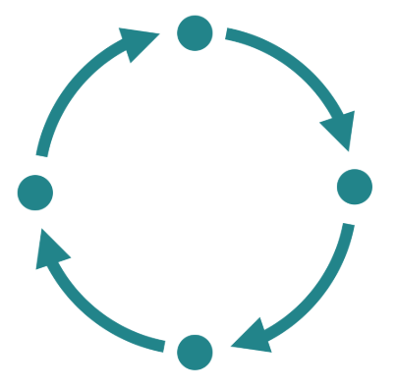
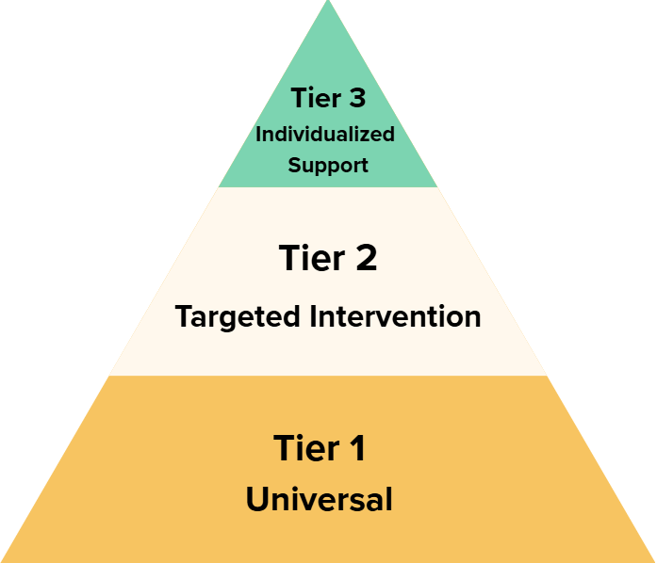
Progress Monitoring: Overview
Systematic, ongoing collection and analysis of student performance data
The goal is to determine if interventions are effective by comparing scores on successive assessments
Data is collected to track growth, gauge effectiveness of instruction and interventions, and make data-driven decisions
Provides more frequent opportunities to evaluate growth and make changes
Multi-Tiered System
of Support (MTSS)
Notes:
Talking Points:
Progress monitoring is the systematic, ongoing collection and analysis of student performance data.
The goal of progress monitoring is to determine if the interventions are effective by comparing scores on successive assessments.
Within progress monitoring, data is collected to track growth, gauge the effectiveness of instruction and interventions, and make data-driven decisions to adjust implementation and provide timely support.
Rather than waiting until the end of the year to determine if growth has occurred, progress monitoring provides opportunities throughout the school year to evaluate growth and make any indicated changes to improve end-of-year outcomes.
Progress monitoring is a key component of the multi-tiered system of support (MTSS) framework.

Slide 7
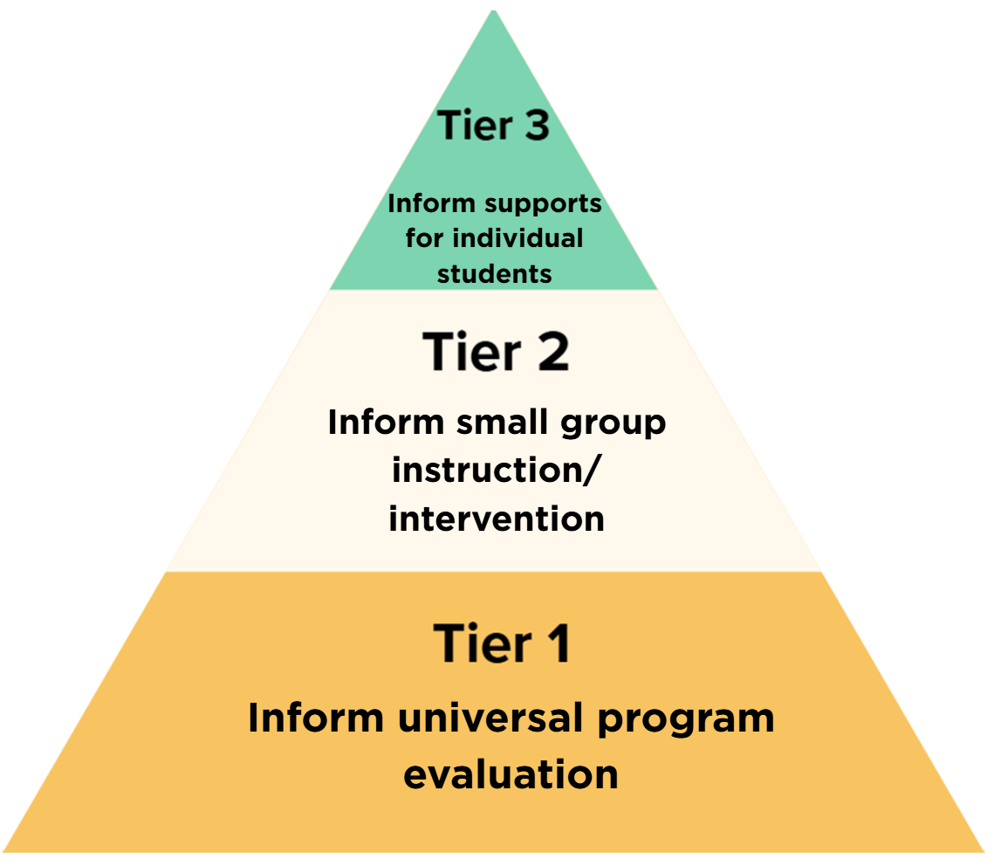
Progress Monitoring: DESSA & MTSS
Reminder:
DESSA results should be included in addition to other data points, information, and context
Progress Monitoring
Notes:
Talking Points:
Progress monitoring at the universal Tier 1 level allows for program evaluation – understanding whether implementation is effective. In other words, evaluating whether the instruction and interventions are working, resulting in overall student growth.
At the Tier 2 level, where students are identified for additional, targeted support, progress monitoring can inform small group instruction and intervention within specific competency areas.
Individual student growth is measured with progress monitoring at the Tier 3 level, using assessment results to guide support for a specific student.
It’s important to remember that the results of the DESSA should be included in addition to other data points, information, and context.

Slide 8
Progress Monitoring: Completing a Rating
Pre-Assessment
Post-Assessment
Progress Monitoring
Start of
School Year
End of School Year
Complete additional rating, as needed
Progress Monitoring
Note: Refer to your DoWEA leadership for specific implementation details
Notes:
Talking Points:
Progress monitoring with the DESSA happens when data from multiple ratings is available.
This may be collecting data from the designated rating windows during the school year (automatically assigned pre- and post-assessments).
A pre-assessment establishes a baseline of skills, in addition to helping inform what students may need at different tiered levels. A post-assessment measures skills growth.
Progress monitoring can also be done when data is collected outside of a designated rating window, on an as needed basis for individual students throughout the year (manual selection of a rating form).
Collecting data at multiple points in time provides opportunities throughout the school year to evaluate growth and make any indicated changes to improve end-of-year outcomes.
Note: Refer to your DoWEA leadership for specific implementation details.

Slide 9
Progress Monitoring: DESSA Forms
DESSA mini
DESSA 2
Full assessment
Evaluate progress in individual competency areas:
Overall score and competency area T-scores
Screening tool
Four unique forms
  DESSA 2 mini Form A
  DESSA 2 mini Form B
  DESSA 2 mini Form C
  DESSA 2 mini Form D
Score provides a measure of overall competence
Optimistic Thinking
Self-Awareness
Self-Management
Social Awareness
Relationship Skills
Responsible Decision Making
Ratings separated by a minimum of four weeks
Notes:
Talking Points:
As a screening and progress monitoring tool with four unique forms, the DESSA mini can be administered multiple times per school year. The score from the DESSA mini provides a measure of overall competence.
The DESSA 2 can be used to evaluate progress within the individual competency areas, using the overall composite (SEC) score and the individual competency T-scores.
To evaluate progress, collecting data (completing ratings) should be separated by a minimum of four weeks.
During designated rating windows, the selected assessment forms are automatically assigned to each rater. Any assessment completed outside of a designated rating window requires the manual selection of a rating form.

Slide 10
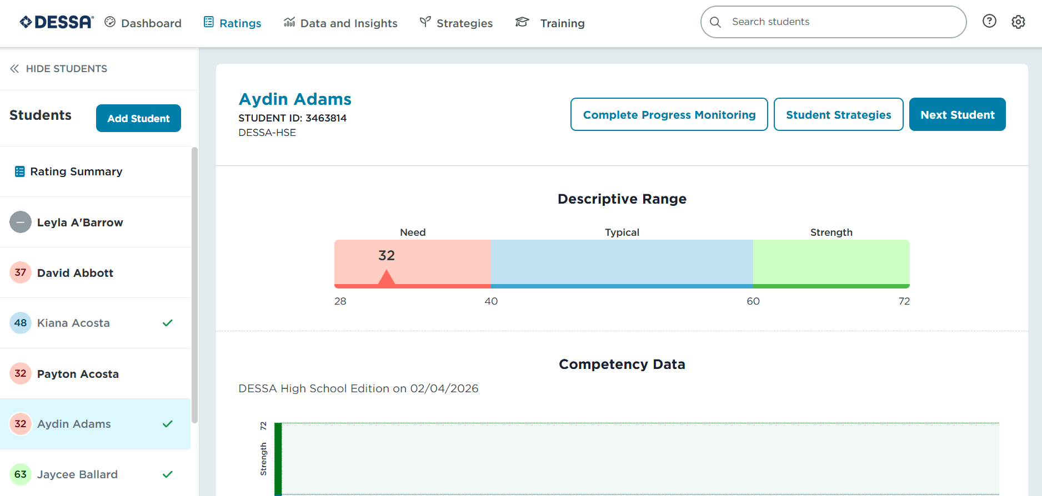

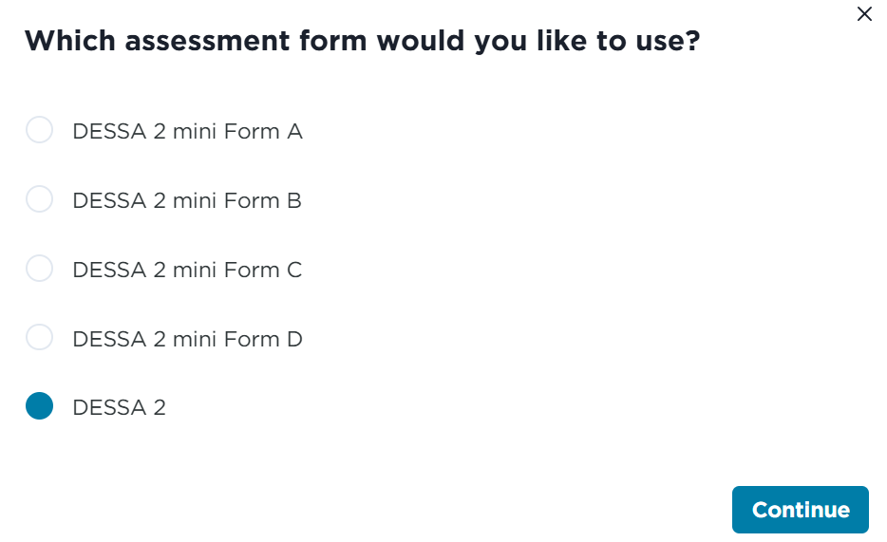
Completing a Rating Outside of a Scheduled Rating Window
Note: Refer to your DoWEA leadership for specific implementation details
Notes:
Talking Points:
If a DESSA rating needs to be completed for a student outside of a scheduled rating window, an assessment form can be opened by the educator(s) assigned to that student.
To complete a rating outside of a designated rating window, navigate to the Ratings tab.
Locate the student on your assigned roster or select “Add Student” to update the list.
Select the “Complete Progress Monitoring” button on the top right side of the student’s rating profile. The available rating forms will populate, including the DESSA mini screening forms and the DESSA 2. Before selecting a specific form, ensure you have confirmed with the leadership team which rating form should be used for the individual student for progress monitoring purposes.
The rating will populate, simply complete the rating and click submit.
Results for ratings are available in real time, viewable as soon as the rater submits the form (while still on the Ratings tab) and also included with the reports under the Data and Insights tab and the student’s individual profile.
Note: Refer to your DoWEA leadership for specific implementation details.

Slide 11
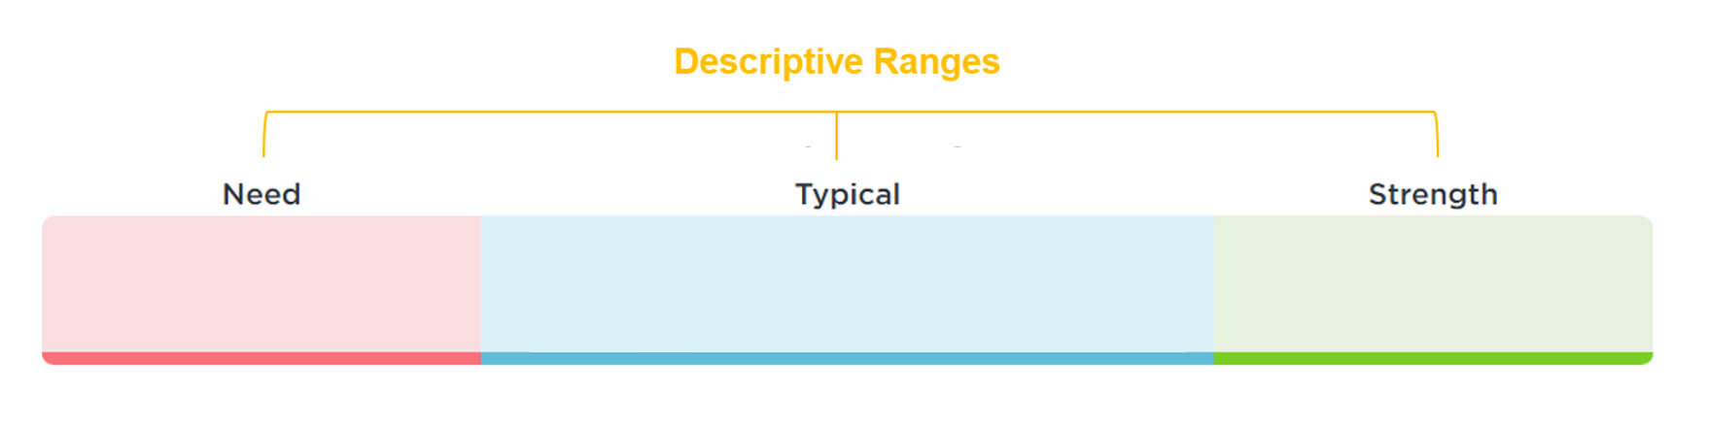
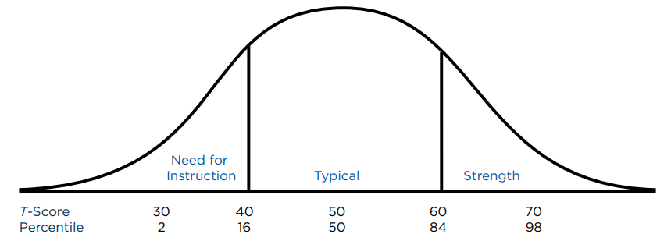
Progress Monitoring: DESSA Results
T-Scores:
28-40
T-Scores:
41-59
T-Scores:
60-72
Notes:
Talking Points:
As a reminder, the DESSA reports results using T-scores which are categorized into three descriptive ranges. The T-scores range from 28-72, with a mean of 50 and standard deviation of 10. The mean tells you the average or center of your data, while the standard deviation tells you the typical spread or variability of data points around the mean.
The three descriptive categories include:
Need for Instruction: T-scores 28-40
Typical: T-scores 41-59
Strength: T-scores 60-72
The T-score and Descriptive range should be considered when analyzing DESSA results. Based on a normal distribution of scores, we can anticipate that the majority of students should be in the Typical range (68%), with about equal amounts of students in both the Strength and Need Instruction ranges (16% for each).

Slide 12
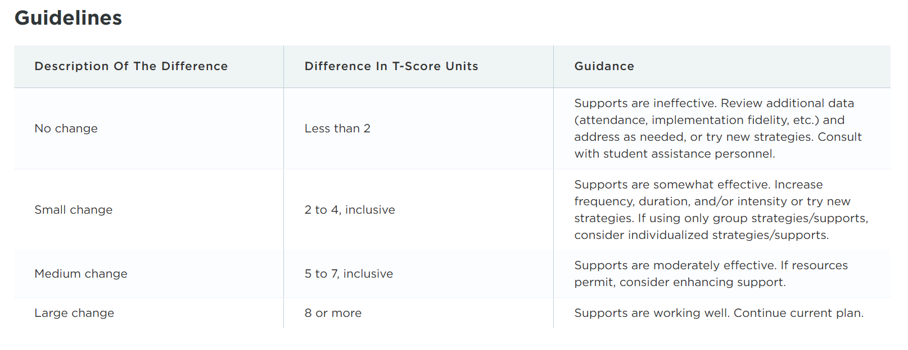
Progress Monitoring: Positive Change
Note: The guidance in this table reflects negligible (no change) or positive change in T-scores.
Notes:
Talking Points:
This visual provides interpretation guidance for comparing assessment scores.
The guidance in this table reflects negligible (no change) or positive change in T-scores.
In the first column you'll see a qualitative description of the difference in T-score growth followed by what that will look like numerically. Finally, the last column will outline possible next steps given the outcome.
A difference of Less than 2 T-score units indicates No change. The guidance explains that supports are ineffective, with the direction to review additional data (such as attendance and implementation fidelity) and address as needed, or to try new strategies while also consulting with other relevant personnel.
A difference of 2 to 4 T-score units indicates a Small change. The guidance explains that supports are somewhat effective, with the direction to increase frequency, duration, and/or intensity or try new strategies. If using only group strategies/supports, consider individualized strategies/supports.
A difference of 5 to 7 T-score units indicates a Medium change. The guidance explains that supports are moderately effective, with the direction to consider enhancing support, if resources permit.
A difference of 8 or more T-score units indicates a Large change. The guidance explains that supports are working well, with the direction to continue the current plan.
This progress monitoring data and interpretation guidance is provided directly within the DESSA System, allowing for easy access while comparing results. We will take a look at where to locate this information in the Educator Portal in the next section of this training.

Slide 13
Progress Monitoring: Considerations
Ensure DESSA is added to the existing practices for progress monitoring and student support systems
Include other data points, information, and context
Approach this process from a strength-based lens, understanding that progress takes time
Be mindful of potential score decline
  Significant life changes, hardship, traumatic events
  Middle-school aged students (Soland et al., 2022)
  Seasonal changes, such as returning to school after the summer (e.g., Lee, 2022)
Notes:
Talking Points:
There are a few considerations to keep in mind when reviewing progress monitoring data.
First, the DESSA should be added to existing practices for progress monitoring and student support systems, such as MTSS. The results of the DESSA should always be included in addition to other data points, information, and context; following best practices, we should never rely on only one data point when assessing growth and progress.
Next, approach this process from a strength-based lens, understanding that progress takes time. In between assessment administrations, there must be adequate time for instruction and practice, skill development and generalization, and opportunities to observe new and emerging behaviors.
It’s important to be mindful that students’ scores may decline throughout the school year for a variety of reasons. Students who may experience significant life changes, hardship, or traumatic events may demonstrate lower competence in skills measured by the DESSA. Additionally, there is evidence that middle-school aged students experience a decline in these skills (Soland et al., 2022). Progress monitoring with the DESSA can help educators determine whether there is a need for additional support throughout the year.
Additionally, seasonal changes may also affect students’ progress. For instance, prior research has shown that students grow in these skill areas over the school year but decline over the summer (e.g., Lee, 2022). This may mean that students will require additional instruction and time to practice skills at the start of each school year, and potentially after other long breaks off from the typical school schedule.

Slide 14

Explore: DESSA System reports and features used for progress monitoring
Login to the DESSA System
Educator Portal to follow along
Notes:
Talking Points:
This next section of the training will focus on learning about and exploring the available reports and features that can be used for progress monitoring within the DESSA System.
Similar to previous trainings, this section will guide you through how to access various reports and features within the DESSA System, and then provide directions for independent review of data within your own Educator Portal.
At this time, please login to your DESSA System Educator Portal to follow along.

Slide 15
Accessing Progress Monitoring Data in the DESSA System:
Individual Student
Group Results
Notes:
Talking Points:
We will begin by accessing the progress monitoring data for an individual student and then by group level results.

Slide 16
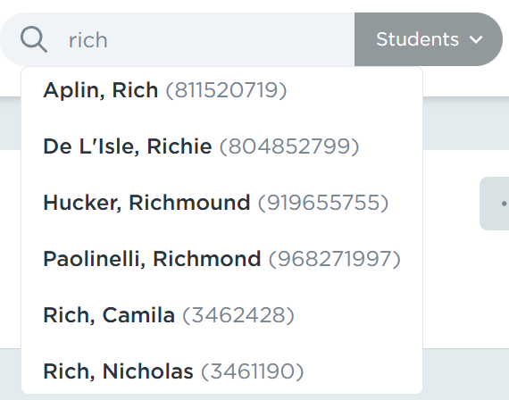
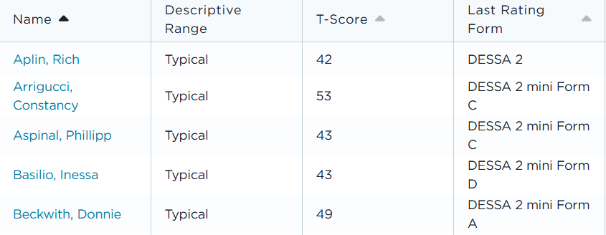

Accessing Progress Monitoring Data: Individual Student
Notes:
Talking Points:
First, navigate to a specific student’s individual student profile that has data for multiple ratings. You can select a student’s hyperlinked name from reports under the Data and Insights tab or by using the search bar.

Slide 17
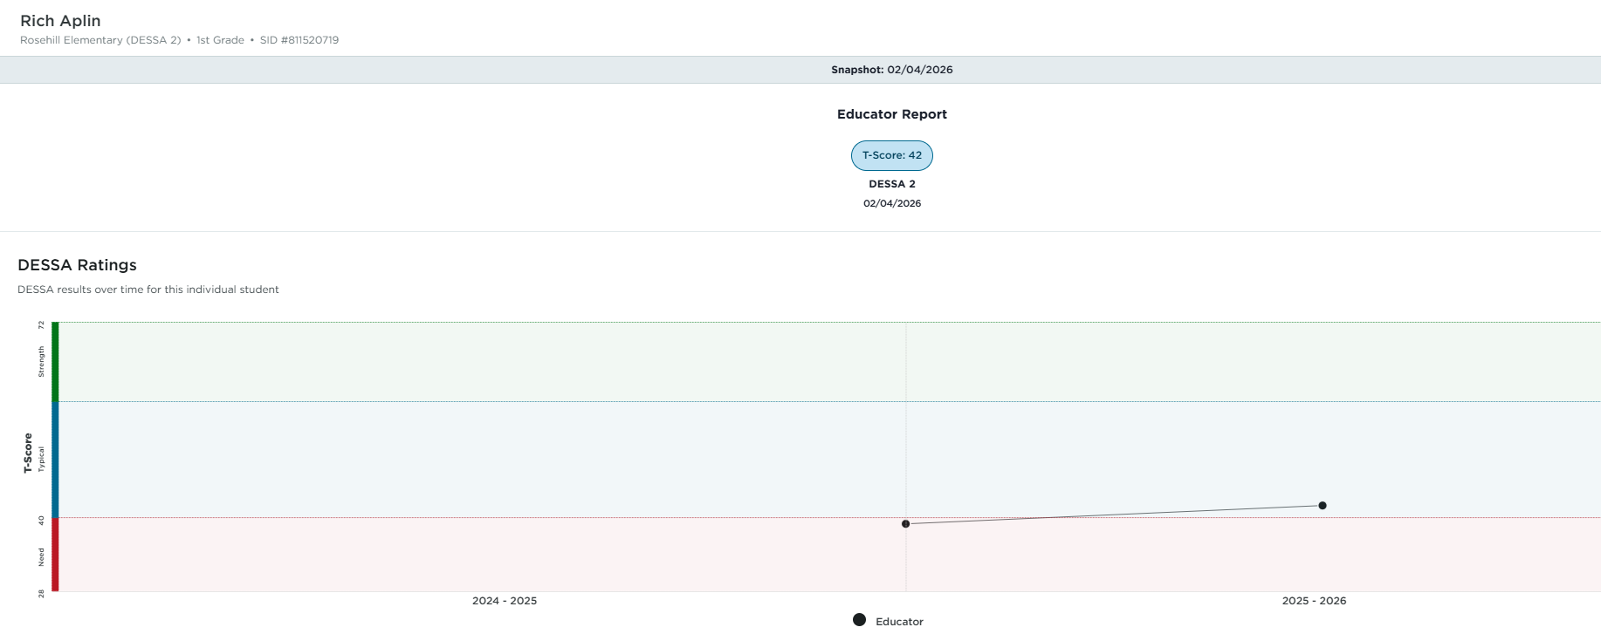


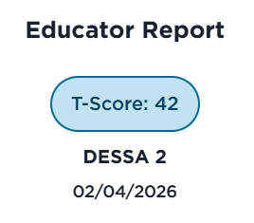
Accessing Progress Monitoring Data: Individual Student
Individual
Student
Profile
Notes:
Talking Points:
The Individual Student Profile page includes the details about all assessments completed for the student.
You will see the student’s information at the top of the page, which will always reflect the student’s current grade level.
It will provide a snapshot of the name and results of the most recent assessments completed.
Below that, the DESSA Ratings chart will display the student’s DESSA results over time, providing a visual to monitor student growth.
In this example, we can see there are two data points on the visual, meaning two ratings were completed, and the results trend upward from the Need for Instruction range (on the earlier rating) into the Typical range (on the later rating).
This historical data is available for all assessments completed for the student, even if you were not the educator completing the assessments in previous years or earlier in the same year.

Slide 18
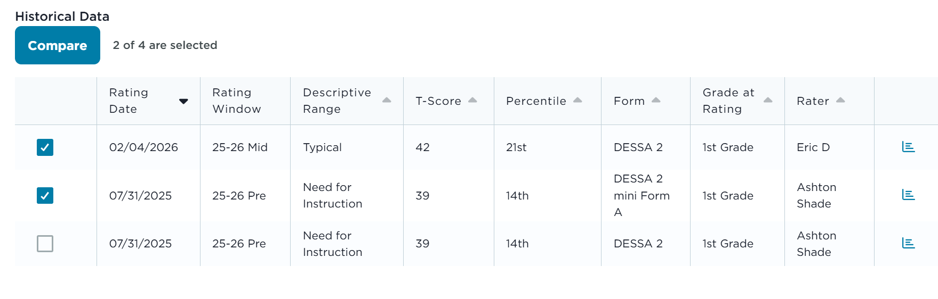
Accessing Progress Monitoring Data: Individual Student
Individual
Student
Profile
Notes:
Talking Points:
Scrolling down on the Individual Student Profile, the Historical Data table underneath these charts provides the details for each assessment that has been completed for the student.
Again this historical data is available for all assessments completed for the student, even if you were not the educator completing the assessments in previous years or earlier in the same year.
This table includes a “Compare” feature to review student progress.
To generate comparisons for completed assessments, locate the blank checkboxes on the left side of each assessment line in the table.
Click the box next to the assessments to compare; note that the “Compare” button will populate above the column of checkboxes for the available ratings to compare. Select up to 4 ratings to compare and then click the “Compare” button.

Slide 19
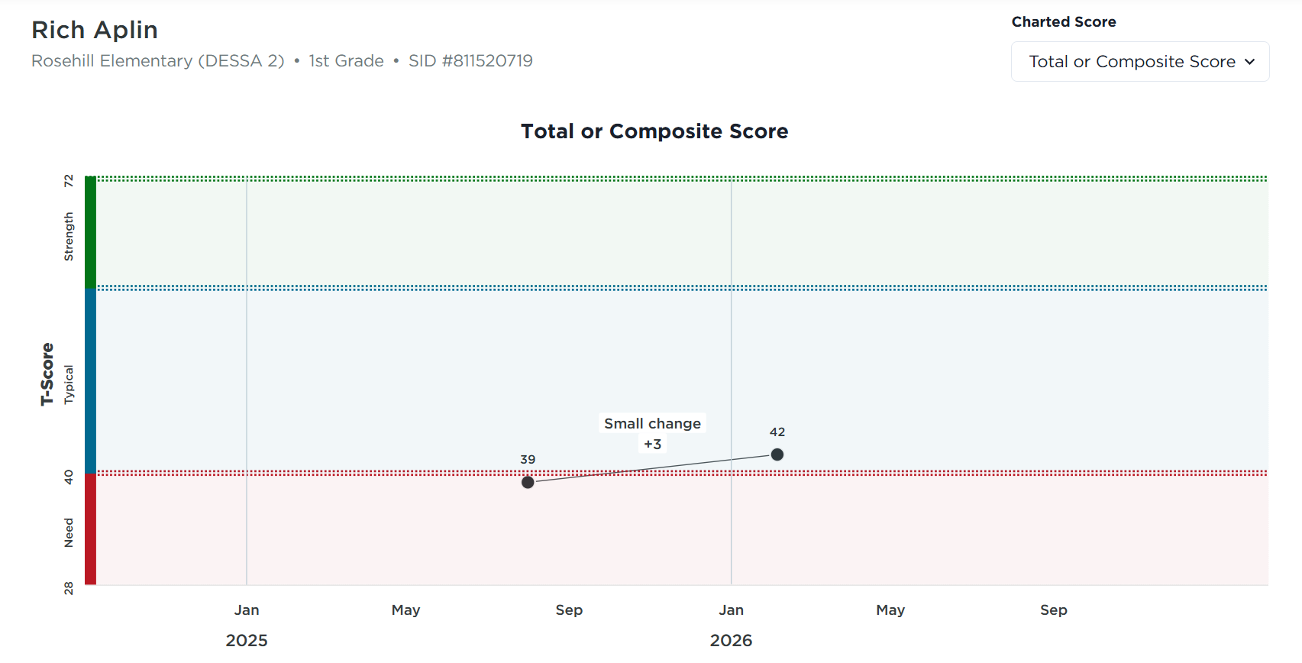
Accessing Progress Monitoring Data: Individual Student
Individual
Student
Profile
Notes:
Talking Points:
The difference in scores will be displayed on the DESSA Ratings chart, with the size of the T-score change, indicating either positive or negative trends.
In this example, the student scored within the Need for Instruction range on the earlier assessment and demonstrated +3 T-score points on the later assessment, resulting in a small change.

Slide 20
Accessing Progress Monitoring Data: Individual Student
Individual
Student
Profile
Note: The guidance in this table reflects negligible or positive change in T-scores.
Notes:
Talking Points:
Underneath the chart, the “Guidelines” for reviewing progress monitoring data is available.
The guidance in this table reflects negligible (no change) or positive change in T-scores.
For this example student, a “Small Change” was noted as a positive change in T-scores, with the guidance indicating that supports are somewhat effective. The suggested actions are to increase frequency, duration, and/or intensity or try new strategies. If only using group strategies/supports, consider individual strategies/supports.

Slide 21
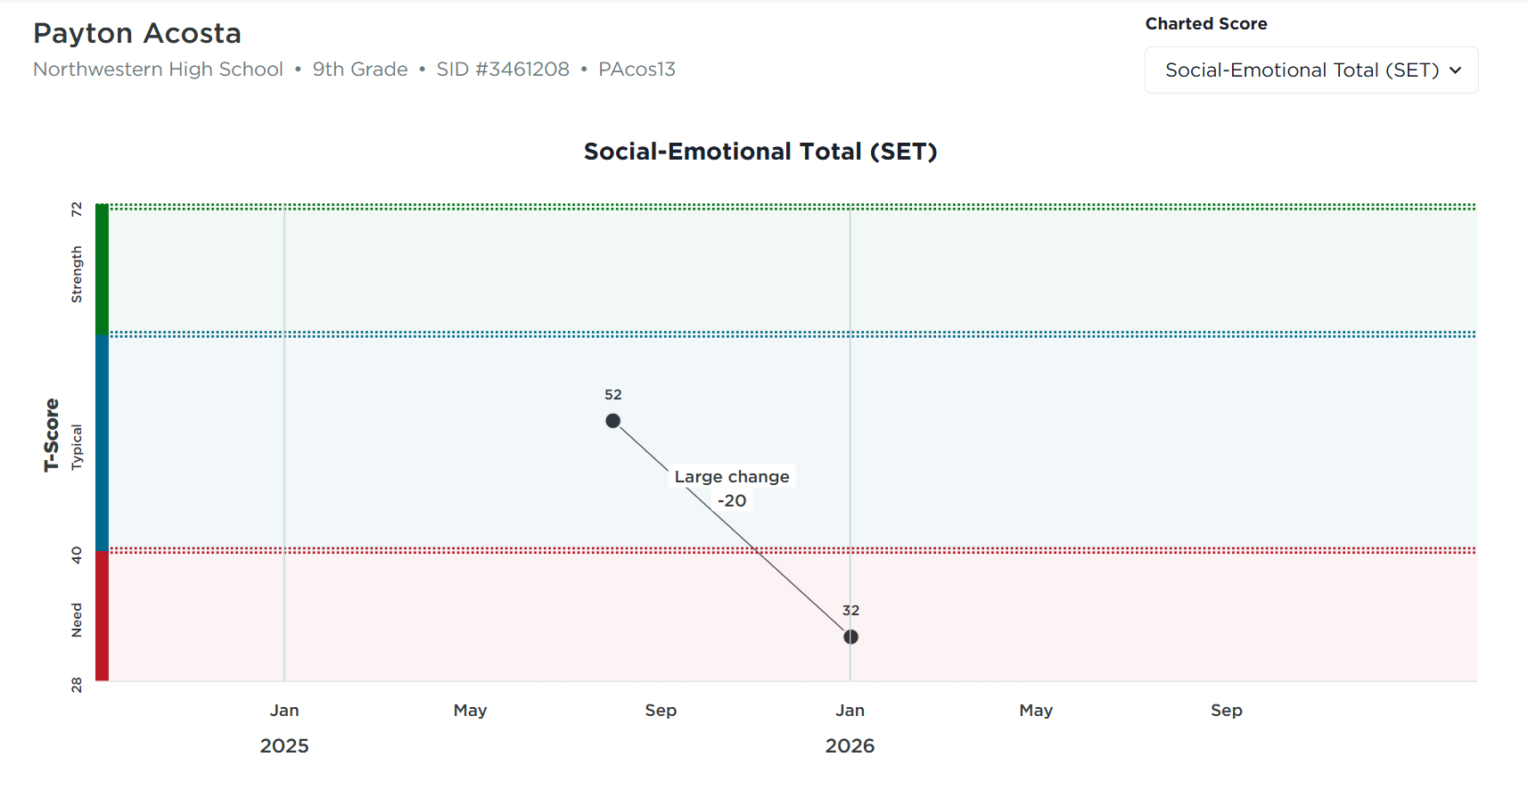
Accessing Progress Monitoring Data: Individual Student
Individual
Student
Profile
Students may demonstrate a decrease in scores for a variety of reasons
If negative trends are observed, further analysis should include additional data and information
  Attendance, implementation fidelity, out-of-school context
Consider further assessment and consult with the Student Support Team
Notes:
Talking Points:
It’s important to note that some students may demonstrate a decrease in scores, as mentioned previously, for a variety of reasons.
This example shows the results for a student who demonstrates a decline in scores from the earlier rating compared to the later rating.
If negative trends are observed, further analysis should include additional data and information, such as attendance, implementation fidelity, and out-of-school context.
Teams should consider further assessment and consult with the Student Support Team to determine whether a change in the strategies or supports being provided are needed.

Slide 22
Data-Driven Dialogue
Before reviewing “Compare” feature and results for an individual student (if available), take a moment to respond to the reflection prompts below. What do you predict you will see in your data? What wonders or questions does this spark?
I predict…
I wonder…
My questions/expectations are influenced by…
I am hoping to learn…
Notes:
Talking Points:
In just a moment, you’ll be prompted to pause this training recording to review the individual student progress monitoring features and results (if available) within your Educator Portal. Before directions are provided for an independent activity, take a moment to consider these reflection prompts below. What do you predict you will see in your data? What wonders or questions does this spark?
I predict…
I wonder…
My questions/expectations are influenced by…
I am hoping to learn…
These prompts allow for educators to both calibrate their expectations and center on engaging in data-driven dialogue as they work with interdisciplinary team members to support students.

Slide 23
Independent Activity
Review Progress Monitoring Results: Individual Student
Directions:
Pause the training recording for 3-5 minutes and select an individual student with multiple data points (2 or more assessments completed), if available
Review the available results under the Individual Student Profile, using the “Compare” feature to view the difference in scores
If only one data point is available:
  Review the progress monitoring options under the Rating tab (selecting a form)
  Review the results available on an individual student’s profile that would could be considered for progress monitoring
Consider: What is the potential course of action for supporting this student?
Should progress monitoring be completed for a specific student?
If there are multiple data points available:
  Negligible or Positive Change in scores: refer to the “Guidance” table on the Individual Student Profile
  Negative Trends Observed: further analysis should include additional data and information, such as attendance, implementation fidelity, and out-of-school context
Notes:
Talking Points:
It’s time now to pause the recording for an independent activity to review DESSA results in your Educator Portal. The directions are to:
Pause the recording for 3-5 minutes and select an individual student with multiple data points (2 or more assessments completed), if available.
Review the available results under the Individual Student Profile, using the “Compare” feature to view the difference in scores for like assessments.
If only one data point is available, review the progress monitoring options under the Rating tab (selecting a form). Then take a few minutes to review the results available on an individual student profile that could be considered for progress monitoring.
Then consider what the potential course of action could be for supporting this student:
If there is only one data point, should progress monitoring be completed for a specific students?
If there are multiple data points available, what are the results:
If the compared results reflect negligible (no change) or positive change in T-scores: refer to the “Guidance” table available on the Individual Student Profile.
If negative trends are observed, further analysis should include additional data and information, such as attendance, implementation fidelity, and out-of-school context.
Pause the recording now for this independent activity. Resume when ready to continue.

Slide 24
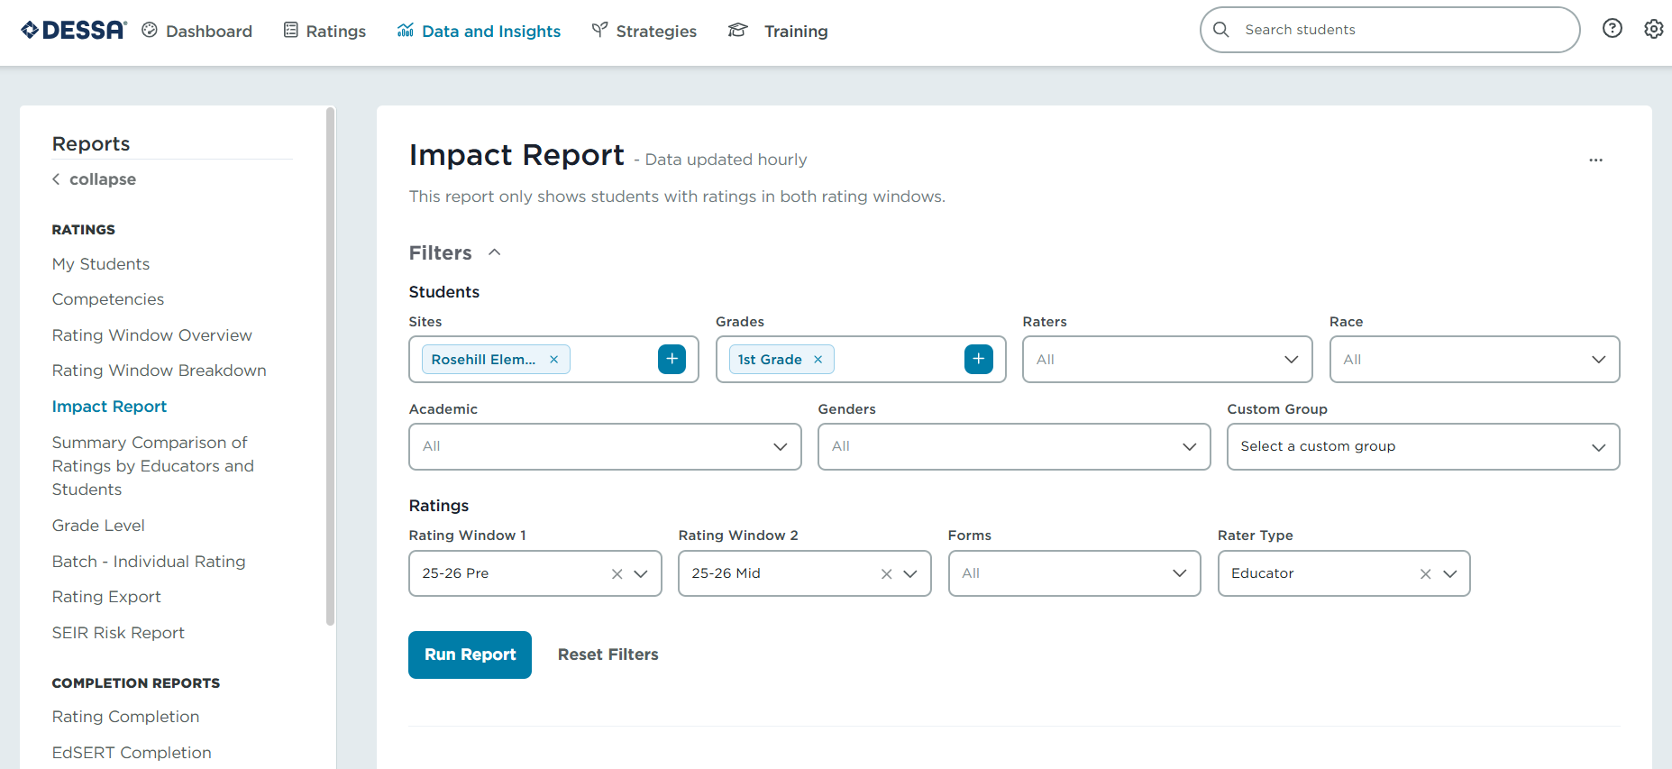
Accessing Progress Monitoring Data: Group Results
*
*
Notes:
Talking Points:
We are going to review another report within the DESSA System that allows for accessing progress monitoring data for group results.
Return to your Educator Portal to follow along. Start by navigating to the Data and Insights tab and locating the Impact Report on the left side, under the Reports list.
The Impact Report compares the progress for groups of students from two different rating windows. When generating this report, the results will only show students with ratings from both of the rating windows selected.
Use the filters to select the categories (optional) and the two rating windows (required) to be compared, and then click “Run the Report.”
The Impact Report will display several visuals comparing the results based on the filters set for the two rating windows selected to compare.
Note: This report requires data from two rating windows to compare. For training purposes, please continue to follow along with the screenshots within the recording and slide deck to understand how to utilize this report to measure impact once multiple data points are available.

Slide 25
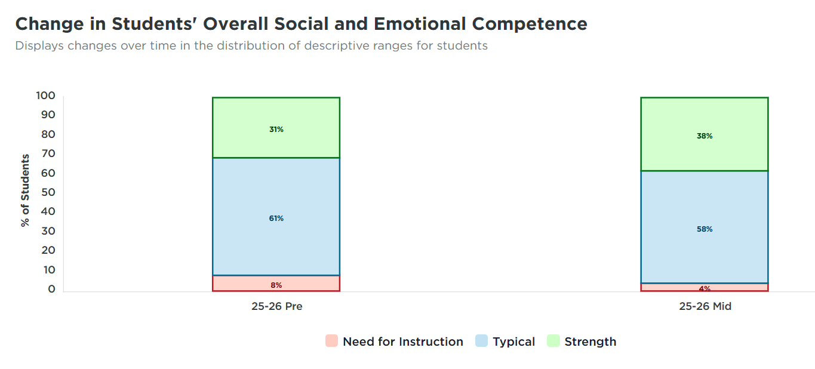

Accessing Progress Monitoring Data: Group Results
Impact Report
Notes:
Talking Points:
The first visual displays the changes in distribution of descriptive ranges from the first rating window to the second rating window.
When hovering or clicking on each descriptive range section, the amount of students within that range will be visible.
This information can be used to evaluate the effectiveness of overall programming.
In this example, it’s immediately clear that the students in 1st grade at this school demonstrate growth overall:
There is an increase of students within the Strength range for the second rating window (31% to 38%),
a majority of students within the Typical range (which is expected based on the assessment norms),
and a decrease of students in the Need for Instruction range (8% to 4%).
At a high level, this might indicate that the Tier 1 universal supports that are in place for this specific grade level are working and that the instruction should continue.
​

Slide 26
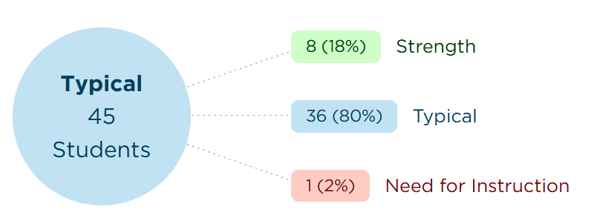
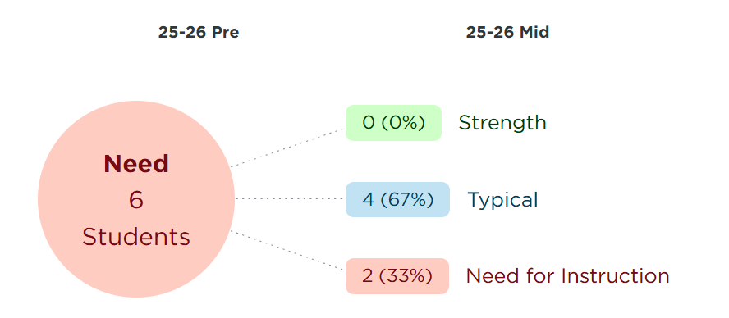
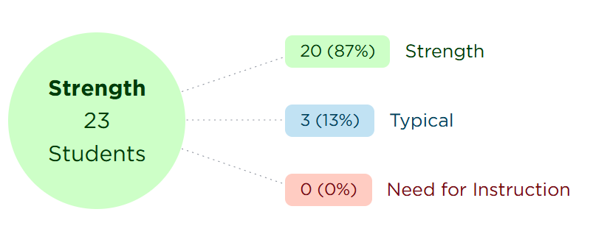
Accessing Progress Monitoring Data: Group Results
Impact Report
Notes:
Talking Points:
The next visual displays the Student Movement within the descriptive ranges from the first rating window to the second rating window.
The large circles show the students in each range during the earlier assessment and the boxes coming off the circles represent the number of students in each range at the later assessment that is being compared.
In this example, positive changes can be observed in the Need for Instruction range, where 4 students moved from the Need for Instruction range during the first rating window into the Typical range during the second rating window. Looking at the Typical range, 8 students moved from the Typical range during the first rating window into the Strength range during the second rating window.
In order to view more details about which students are included in each category and movement pattern, click on the different sections of these visuals. ​

Slide 27
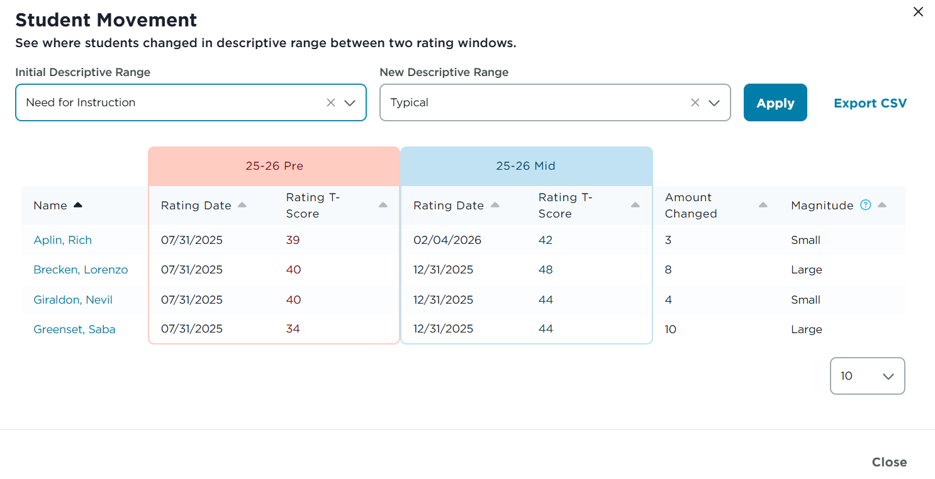
Accessing Progress Monitoring Data: Group Results
Impact Report
At a high level, this might indicate that the Tier 1 universal supports that are in place are working and that the instruction should continue.
​
Notes:
Talking Points:
Clicking on the different sections will populate the list of students within the corresponding range.
For example, an educator would select the callout section that says “4 (67%) Typical” (circled here on the slide visual) to the view the list of the 4 students that moved from the Need for Instruction range in the first rating window into the Typical range on the second rating window.
In the popout that is generated, the students’ names, results for both rating windows, amount of T-score change, and magnitude of change is listed.

Slide 28
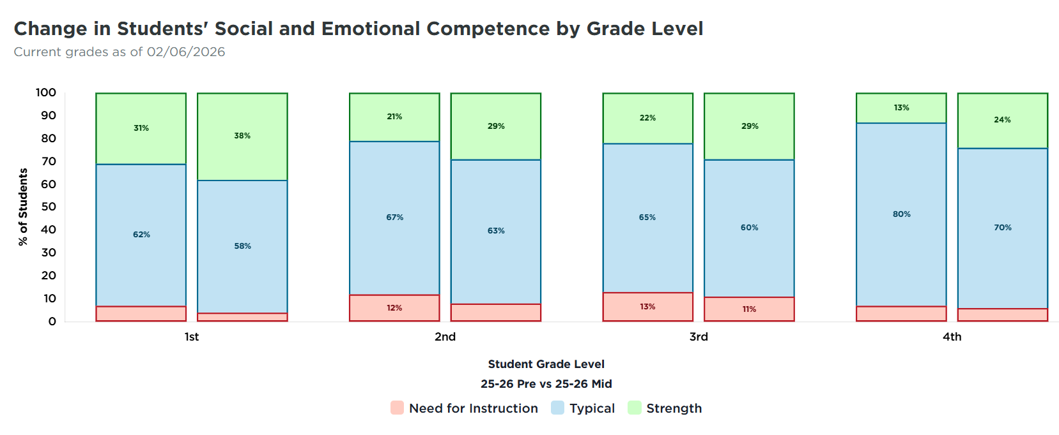

Accessing Progress Monitoring Data: Group Results
Impact Report
2nd Grade
3rd Grade
4th Grade
Notes:
Talking Points:
The next visual displays the change in descriptive range results by Grade Level.
When hovering or clicking on each descriptive range section, the amount of students within that range will be visible.
In this example, the filters were set to include four different grade levels to compare, 1st grade through 4th grade. Each comparison shows:
an increase of students in the Strength range,
a majority of students within the Typical range (which is expected based on the assessment norms),
and a decrease of students within the Need for Instruction range.
At a high level, the results may indicate that the Tier 1 universal supports that are in place for these grade levels are working and that the instruction should continue.

Slide 29
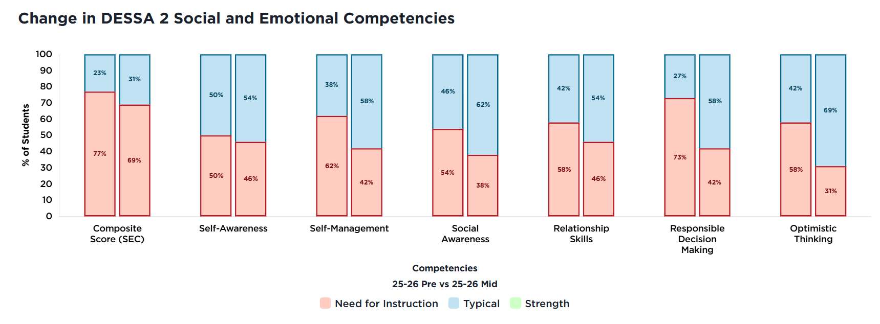


Accessing Progress Monitoring Data: Group Results
Impact Report
2nd Grade
3rd Grade
4th Grade
Notes:
Talking Points:
The final visual that may be available on the Impact Report displays the change in descriptive range results by specific competency areas, if the filters included results from completed full DESSA ratings.
When hovering or clicking on each descriptive range section, the amount of students within that range will be visible, allowing for quick comparisons.
In this example, looking at the comparison of student growth in Self-Management in 1st through 4th grades, there was a decrease in students that scored within the Need for Instruction range in this specific competency, based on results of the full DESSA.
At a high level, this may indicate that targeted Tier 2 and/or individualized Tier 3 supports that focused on teaching and practicing Self-Management skills have been effective.

Slide 30
Independent Activity
Review Progress Monitoring Results: Group Results
Directions:
Pause the training recording for 3-5 minutes and generate group results using the Impact Report.
Use the filters to select the categories (optional) and the two rating windows (required) to be compared.
Analyze the results of the available visuals.
Consider:
What additional data and information should be included in this analysis?
What is the potential course of action for supporting student growth?
Note: For this activity, data from multiple ratings will need to be available. If only one rating window has been completed, continue to the next slide and return to the Impact Report once multiple data points have been collected.
Notes:
Talking Points:
It’s time now to pause the recording for an independent activity to review DESSA results in your Educator Portal.
For this activity, data from multiple ratings will need to be available. If only one rating window has been completed, you can continue to the next slide and return to the Impact Report once multiple data points have been collected.
The directions are to:
Pause the recording for 3-5 minutes and generate group results using the Impact Report.
Use the filters to select the categories (optional) and the two rating windows (required) to be compared, and then click “Run the Report.”
Analyze the results of the available visuals comparing the results based on the filters set for the two rating windows selected to compare.
The first step of this activity is to simply become familiar with the results generated within the Impact Report.
Then consider:
What additional data and information should be included in this analysis?
What is the potential course of action for supporting student growth?
Pause the recording now for this independent activity. Resume when ready to continue.

Slide 31
Data-Driven Dialogue
Pause for a moment and consider what you noticed in the data you have analyzed. What patterns or trends did you see? Were you surprised by anything? What alignment do you see with other school data?
Sentence starters:
I observe that…
Some patterns/ trends that I notice…
I can count…
I’m surprised that I see...
This aligns with other school data like…
Notes:
Talking Points:
As you resume the recording, take a moment here to pause and check-in with yourself.
Similar to the prompt from the beginning of this training, it’s important to continue reflecting on the collected data and engage in data-driven dialogue.
Pause for a moment and consider what you noticed in the data you have analyzed, both during this training and in during your own analysis outside of this training. What patterns or trends did you see? Were you surprised by anything? What alignment do you see with other school data?
Some sentence starters for this reflection could include:
I observe that…
Some patterns or trends that I notice are…
I can count…
I’m surprised that I see…
This aligns to other school data like… (examples include: referrals, benchmark assessments, attendance, evaluation referrals)

Slide 32
Interpret and Align: Results and data-driven decision-making
Notes:
Talking Points:
This final section of the training will highlight continued best practices for interpreting results and data-driven decision-making.

Slide 33
Using the DESSA to Make Data-Driven Decisions
Is there a need?
What is the need?
What will we do?
Is it working?
Notes:
Talking Points:
As shared in previous training modules, the DESSA results should be considered in conjunction with other data points in the decision-making processes for student support; it is not used as the sole data point in these processes.
Using the DESSA to make data-driven decisions, educators can identify:
Is there is a need?
What is the need?
What will we do?
And, Is it working?
As always, additional information and data should be considered as part of this analysis, and results should be interpreted at each tiered level to inform instruction, intervention, and supports.

Slide 34
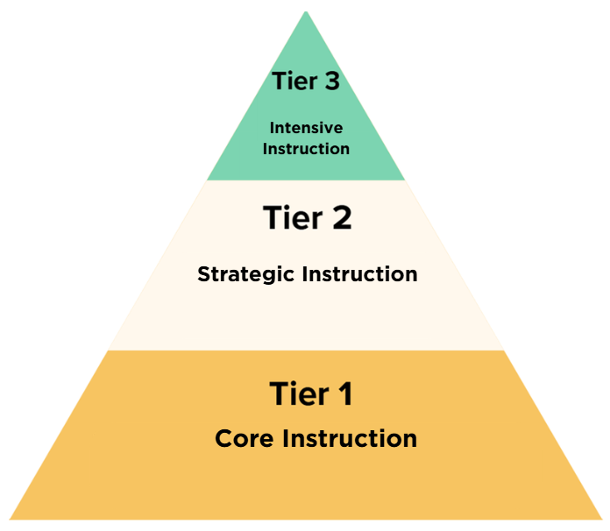
Data-Driven Decisions: Tier 1
Tier 1:
Supports all students
District & School DESSA data:
  Inform strategic goals, initiatives, and professional development
  Inform decisions campus-wide
  Measures effectiveness and impact of implementation
Classroom DESSA data:
  Inform instruction and practices
  Evaluate progress over time
Notes:
Talking Points:
At the Tier 1, or universal setting, data is used to make decisions about universal instruction and supports for all students.
The goal at this universal level is to foster learning environments with a strong foundation to meet the needs of all students.
District and school level DESSA data should inform strategic goals and initiatives, support planning of educator professional development and guide decisions about campus-wide efforts.
Additionally progress monitoring at the district and school level measures effectiveness and impact of implementation.
Classroom level data is used to inform resilience skill building instruction and practices and evaluate student progress over time.

Slide 35
Data-Driven Decisions: Tier 2
Tier 2:
Identify which students may benefit from additional intervention
  Supports are in addition to what they are receiving at Tier 1
Specific competency areas and skills are identified for targeted instruction and additional practice
Progress monitoring may occur outside of designated rating windows
Notes:
Talking Points:
At the Tier 2 level, students are identified for targeted intervention in a small group setting. These supports are in addition to what they are receiving at Tier 1.
Specific competency areas and skills are identified for targeted instruction and additional practice.
Students receiving support within Tier 2 may require more frequent progress monitoring by completing ratings for individual students outside designated rating windows.

Slide 36
Data-Driven Decisions: Tier 3
Tier 3:
Supports determined based on individual need
  Aligned and layered to the supports the student receives in Tier 1 and Tier 2
Intervention is targeted for specific skills
Additional data is included in analysis and decision-making processes
  Attendance patterns, student abilities, if they qualify for special education and if so, what services they are receiving, and their out-of-school situation, etc.
Notes:
Talking Points:
At the Tier 3 level, decisions for individual student support are determined based on individual need.
These supports are aligned and layered to the support the student receives in Tier 1 and Tier 2.
Intervention is targeted for specific skills and additional data is included in this analysis and decision-making process, such as attendance patterns, student abilities, if they qualify for special education and if so, what services they are receiving, and their out-of-school situation, etc.

Slide 37
Data-Driven Decisions: Progress Monitoring
Progress Monitoring
Notes:
Talking Points:
Finally, as outlined in the beginning of this training, progress monitoring is used to make decisions based on results over timeAt the Tier 1 level, program evaluation indicates whether students are demonstrating growth overall.
At the Tier 2 level, progress monitoring results inform ongoing small group instruction and intervention within specific competency areas.
And at the Tier 3 level, individual student progress is measured, and supports are adjusted as needed.

Slide 38
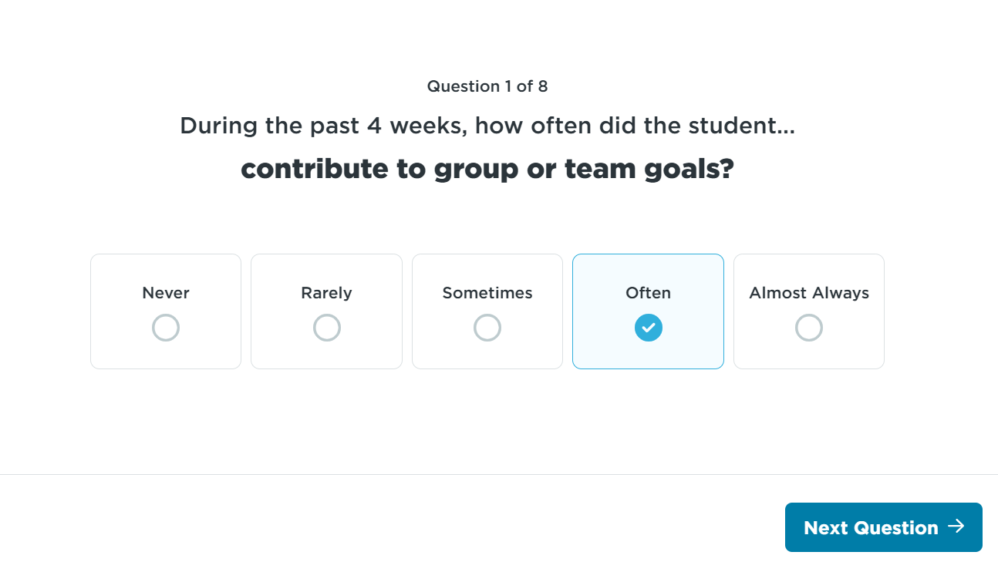
Strengths-Based Approach
DESSA is rooted in resiliency
Strengths-based assessment
Includes items (questions) that are positively phrased, desirable behaviors
Identifying what students can do
Using data to identify how to help students continue growing
Notes:
Talking Points:
At its core, the DESSA is rooted in resiliency. As a strength-based assessment, the DESSA includes items (questions) that are positively phrased, desirable behaviors.
In other words, educators are looking for the things that students can do and celebrating those skills and then using the data to identify how they will help students continue growing.

Slide 39
Fostering Student Resilience & Future Readiness
Looks like:
Fosters:
Resilience & Future Ready Skills
Explicit instruction of
future ready skills
Academic Integration of
future ready skills
Direct teaching of resilience skills
Practice of resilience skills
Safe & Predictable Environments
Consistent expectations
Predictable routines & procedures
Consistent language & practices
Psychological & physical safety
Practice of resilience skills
Relationships & Connectedness
Practice of resilience skills
Generalization of resilience skills
Support networks
Explicit relationship-building practices
Quality instruction using
high-leverage practices
Components of Trauma-Informed Care, Substance Abuse for Mental Health Services Administration, 2014
Notes:
Talking Points:
This graphic explains three foundational components that foster student resilience and future readiness skills.
Take a moment to review the information on the slide for the three different components listed:
Safe and Predictable Environments
Relationships and Connectedness
And Resilience and Future Ready Skills.
(Pause during the recording to allow time for independent review)
A foundation for resilience and future readiness through tiered practices fosters psychological and physical safety, helping students feel more likely to learn, to engage, and to continue to develop their resilience skills in new contexts.
Additionally, providing an intentional focus on building relationships, resilience, and future ready skills fosters protective factors, mitigating against potential risk.
Through data-driven instruction and opportunities to practice, students can generalize skills between school and home or outside in the community.
Focusing on these components ensures a preventative and proactive response to meet all students’ needs.

Slide 40
Wrapping Up
Notes:
Talking Points:
We have covered a lot of information within this training! It’s time to start wrapping up.

Slide 41
Review of Objectives
By the end of the session, you will be able to:
Access various reports within the Educator Portal, focusing on the Progress Monitoring features
Learn how to track student growth in the DESSA System and monitor effectiveness of interventions over time
Interpret assessment data through a strength-based lens to inform instruction decisions
Notes:
Talking Points:
As a review, we set out to achieve these objectives for this training:
Access various reports within the Educator Portal, focusing on the Progress Monitoring features
Learn how to track student growth in the DESSA System and monitor effectiveness of interventions over time
Interpret assessment data through a strength-based lens to inform instructional decisions

Slide 42
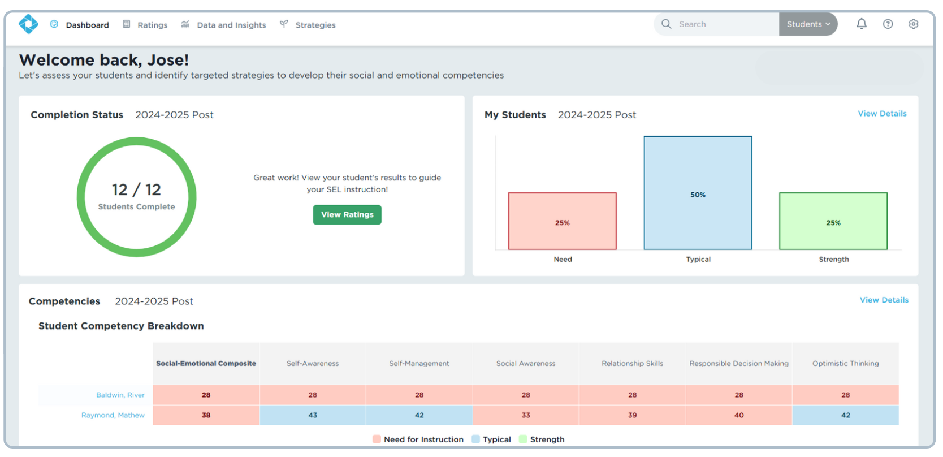
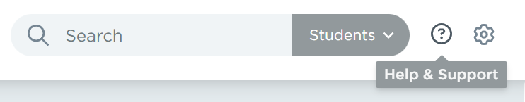


Resource: Support Portal
Notes:
Talking Points:
As you continue your DESSA implementation, there are additional resources available in the DESSA System Support Portal.
To access the Support Portal, click on the circled question mark icon in the top right corner of your Educator Portal.
Use the search engine to explore specific topics and locate templates, guides, action plans, videos, and technical manuals.

Slide 43

Thank You!
Notes:
Talking Points:
Thank you for completing this training, we've now reached the end of this session.
Please complete this module evaluation survey using the link provided within the course module, linked below the video recording.
(For DESSA modules, the training survey link is listed directly below the recording within the module. This is the approved location for the link, instead of within the PowerPoint).

